Slide 1
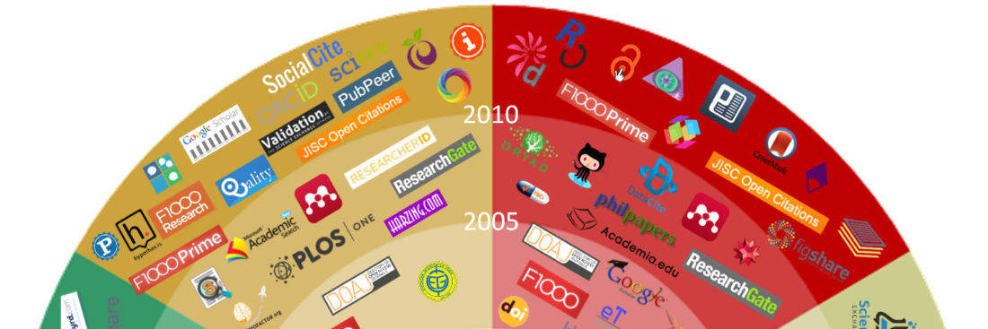



Changing research workflows
Opportunities for researchers, librarians and publishers
Bianca Kramer & Jeroen Bosman
SpringerNature webinar, February 2, 2017
@MsPhelps
@jeroenbosman
(except logo’s)
Notes:
Motiverend en voor ons belangrijk, afgelopen 20 jaar en vooral laatste 5-10 jaar meer in onderzoek/publiceren veranderd dan 350 jaar daarvoor

Slide 2
A model of the research workflow
funding & project management
preparation
including being
assessed/evaluated
assessment
discovery
search information &
getting access
incl. communication
with the general public
analysis
data collection,
experimenting & analyzing
outreach
also including sharing
papers and data sets
publication
writing
including reference management & citing
Notes:
Simpel, kan nog simpeler, blijft model; werkelijk onderzoek nooit sequentieel

Slide 3
Poll
Notes:
Simpel, kan nog simpeler, blijft model; werkelijk onderzoek nooit sequentieel

Slide 4






A model of the research workflow
Rounds of grant writing
and application
preparation
Iterations of
search and reading
assessment
discovery
analysis
Rounds of experiments and measurements
outreach
Submit, peer review, rejection, resubmitting
publication
writing
Drafting, receiving comments,rewriting
Notes:
Simpel, kan nog simpeler, blijft model; werkelijk onderzoek nooit sequentieel

Slide 5
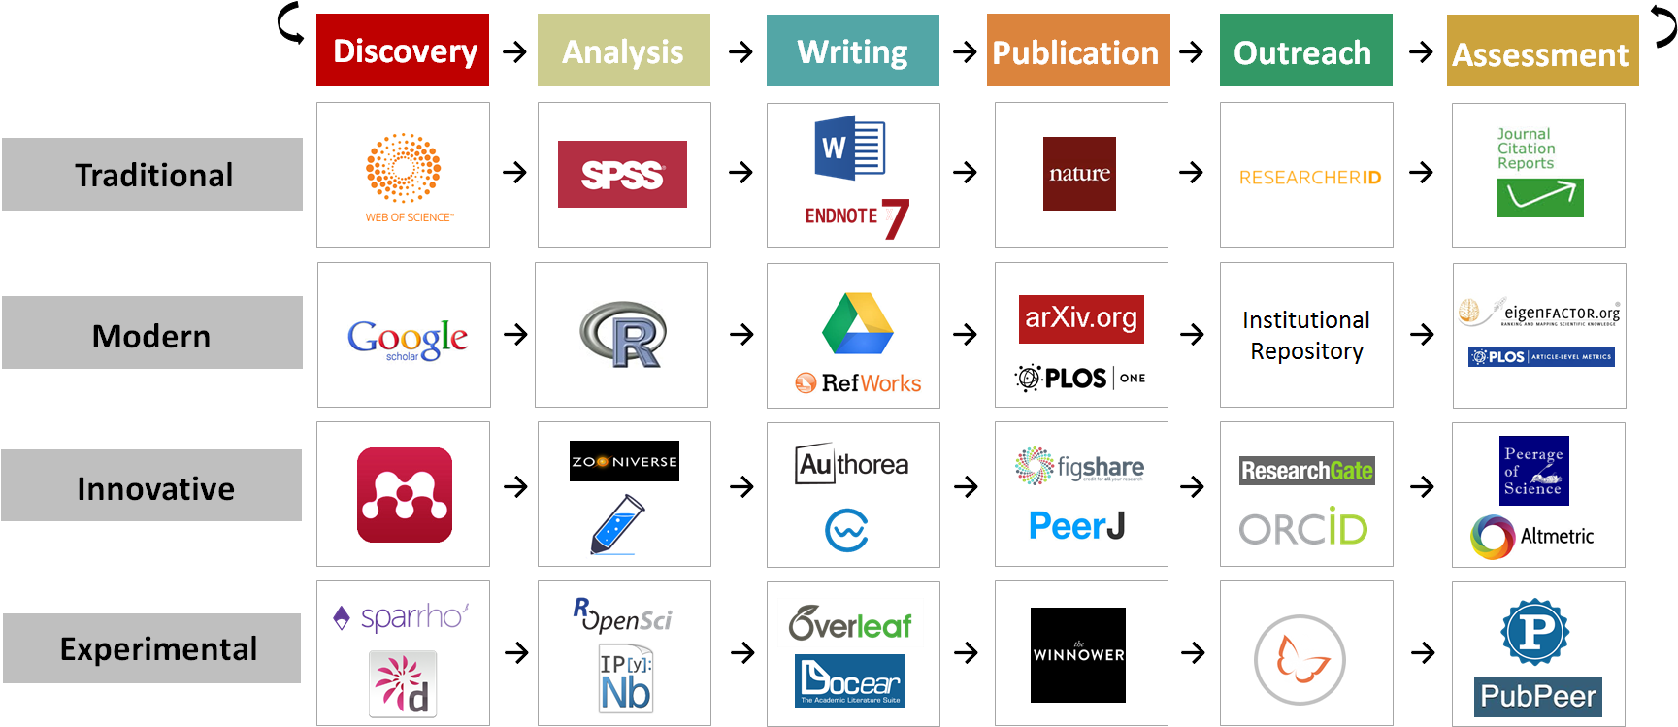
Changing research workflows
2015

Slide 6

























Changing research workflows: company ‘suites’
y
y
y
y
y
SpringerNature
Digital Science

Slide 7















Changing research workflows: open science
Open Science

Slide 8
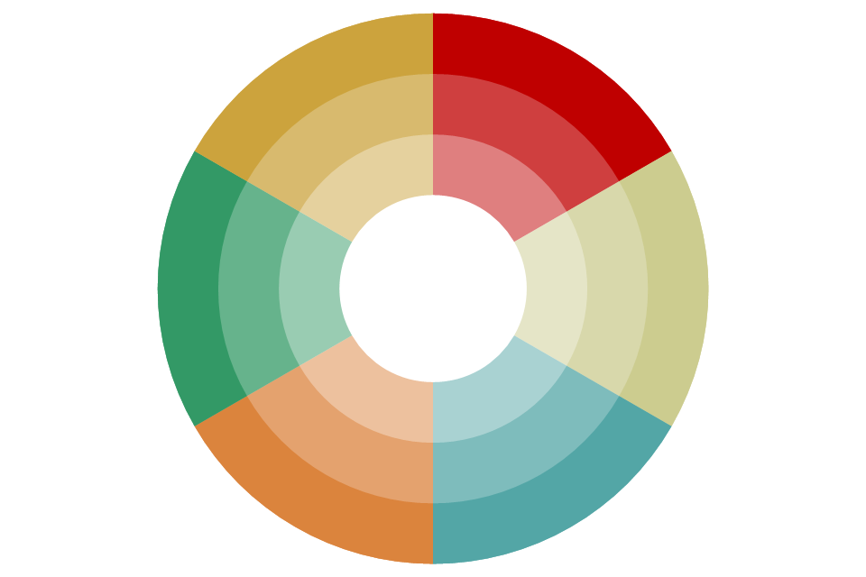











































































































































Assessment
Discovery
2010
2005
Outreach
Analysis
Publication
Writing
Initial view of tools that were innovative
at time of launch, taken from our comprehensive tools database

Slide 9

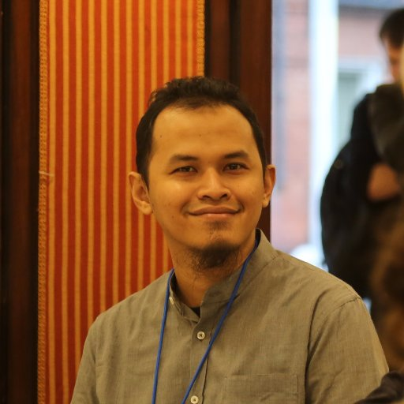
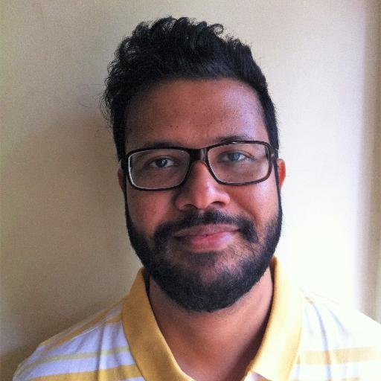

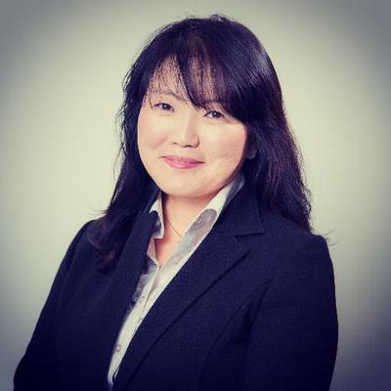
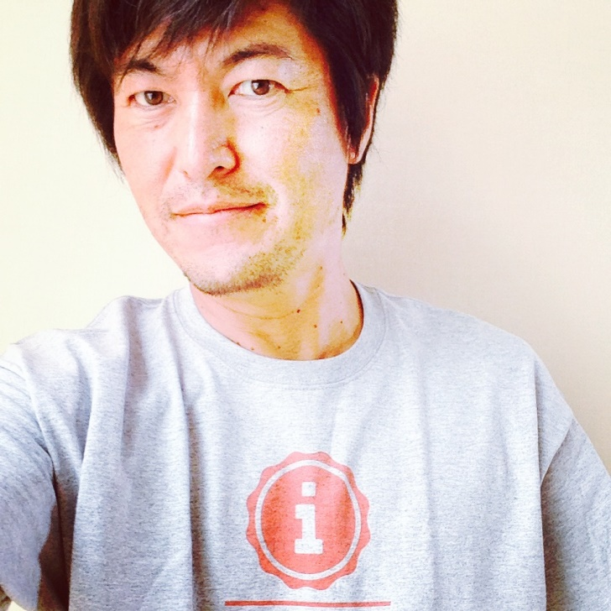

Slide 10
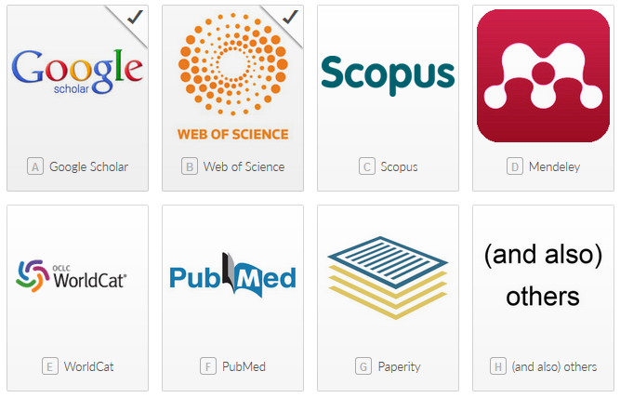
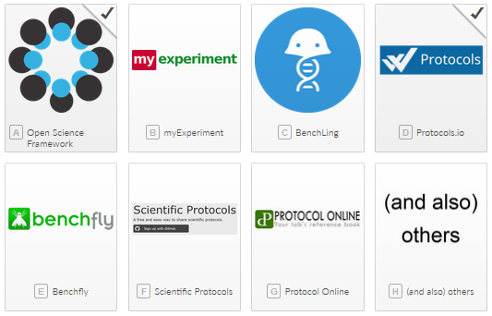
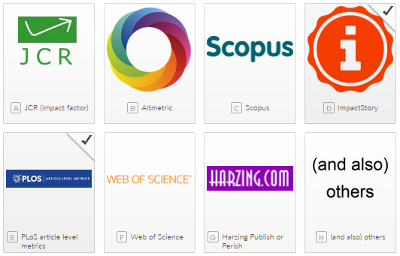
Global survey 2015-2016

Slide 11
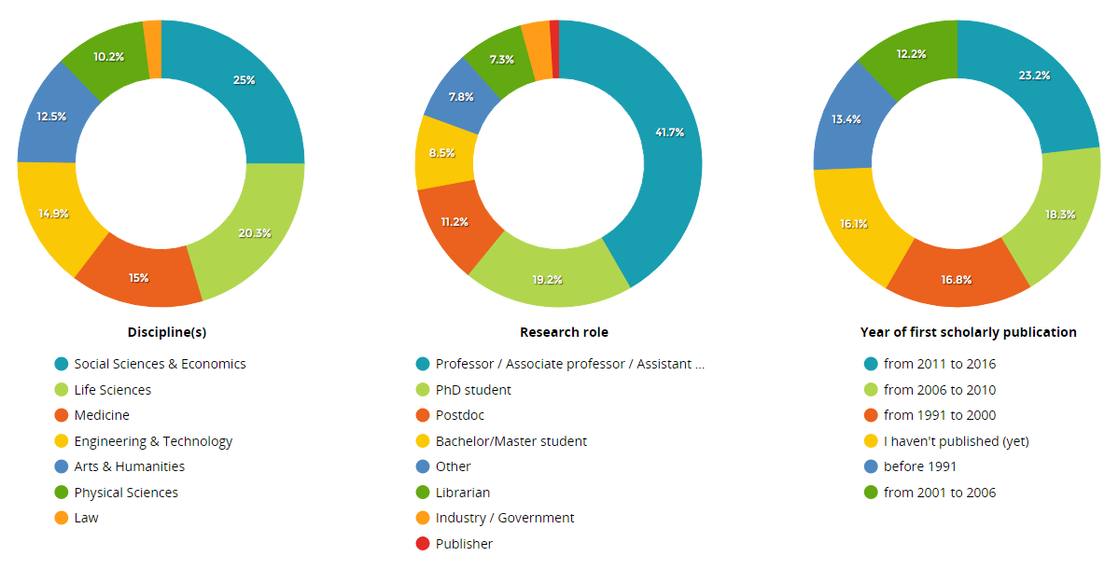
20,663 respondents

Slide 12
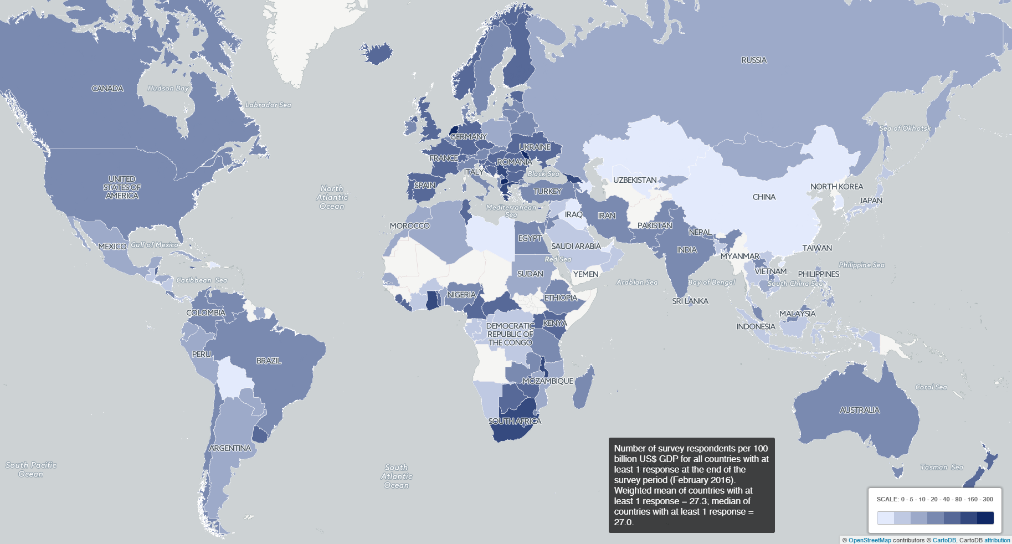
20,663 respondents

Slide 13


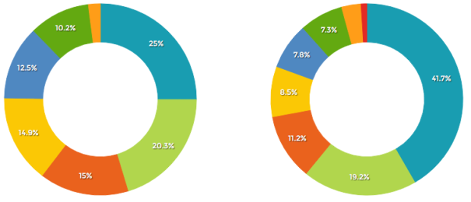
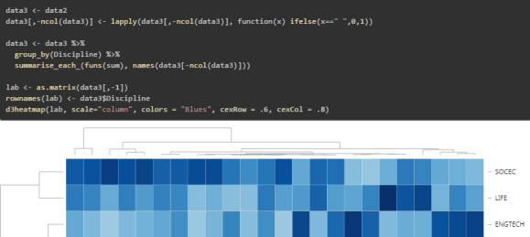
Data sharing
Dataset
Data Note
Dashboard
Scripts
http://101innovations.wordpress.com

Slide 14
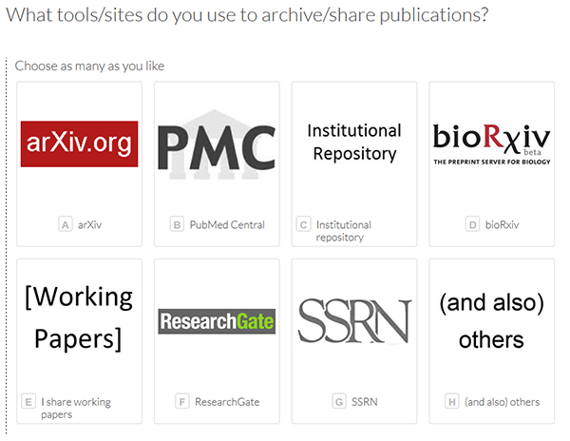
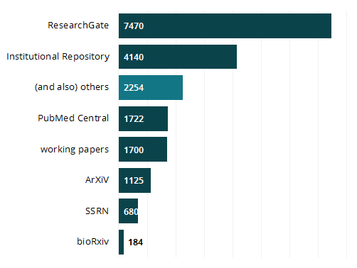
Archive / share publications
11652 of 14896 researchers answered this question

Slide 15
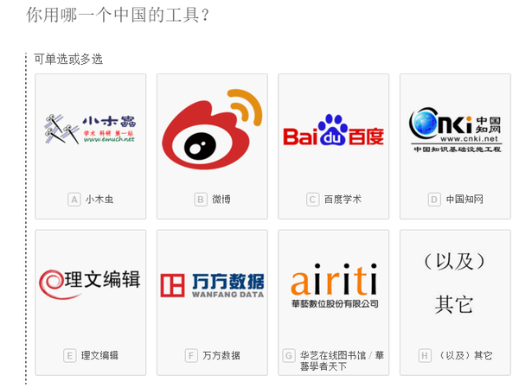
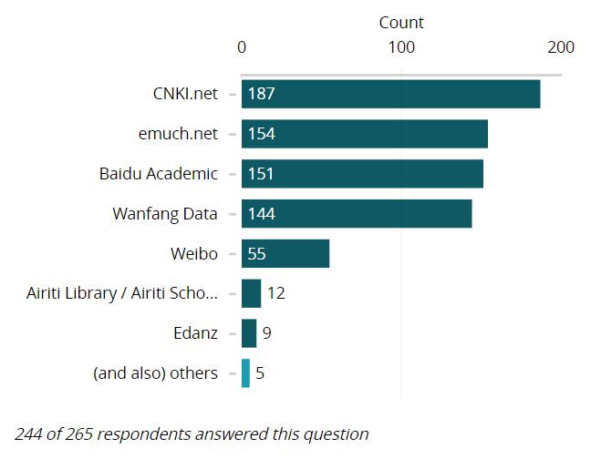
Language-specific tools - 中文

Slide 16
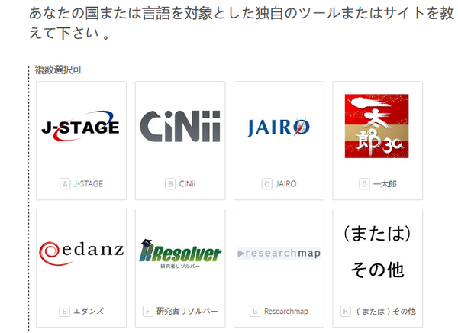
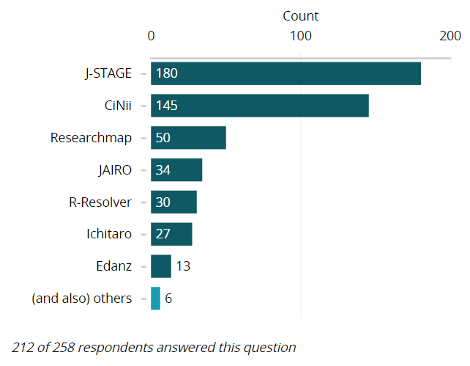
Language-specific tools - 日本語

Slide 17








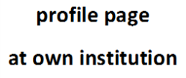













Research workflows: tools used together

Slide 18
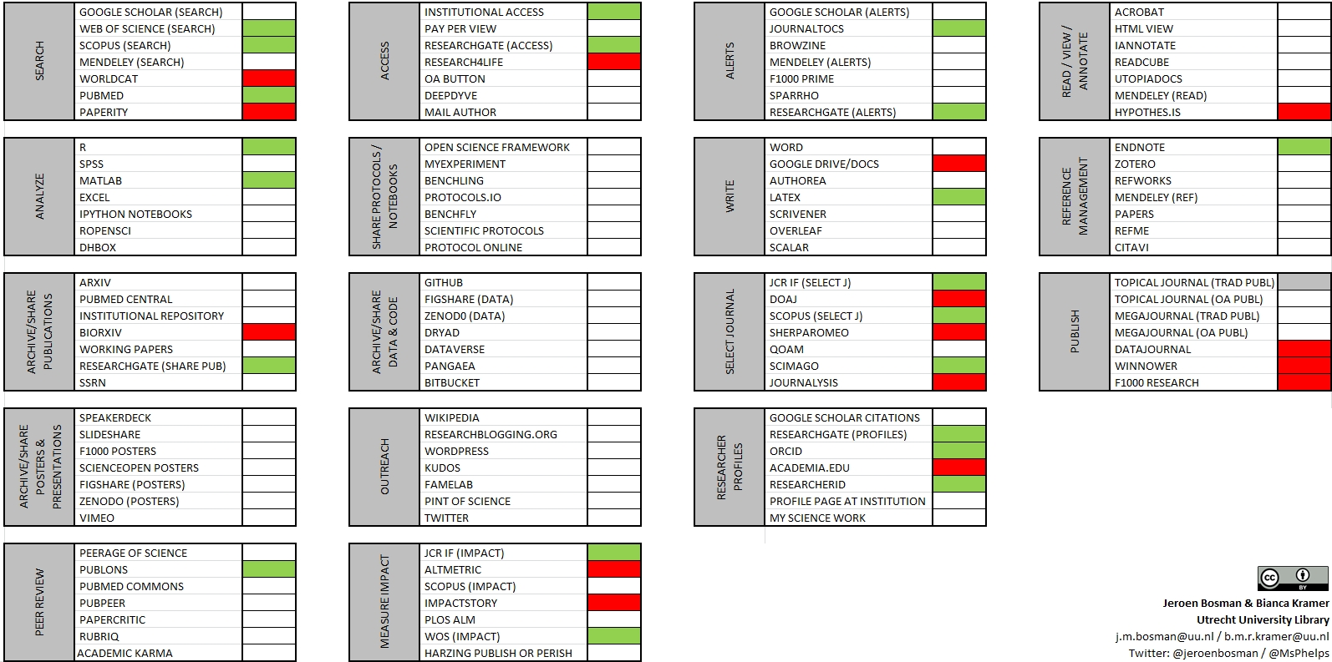

Tools used together – topical journals (traditional publishers)
Online version allowing display of tool of your choice: http://tinyurl.com/toolcombinations

Slide 19
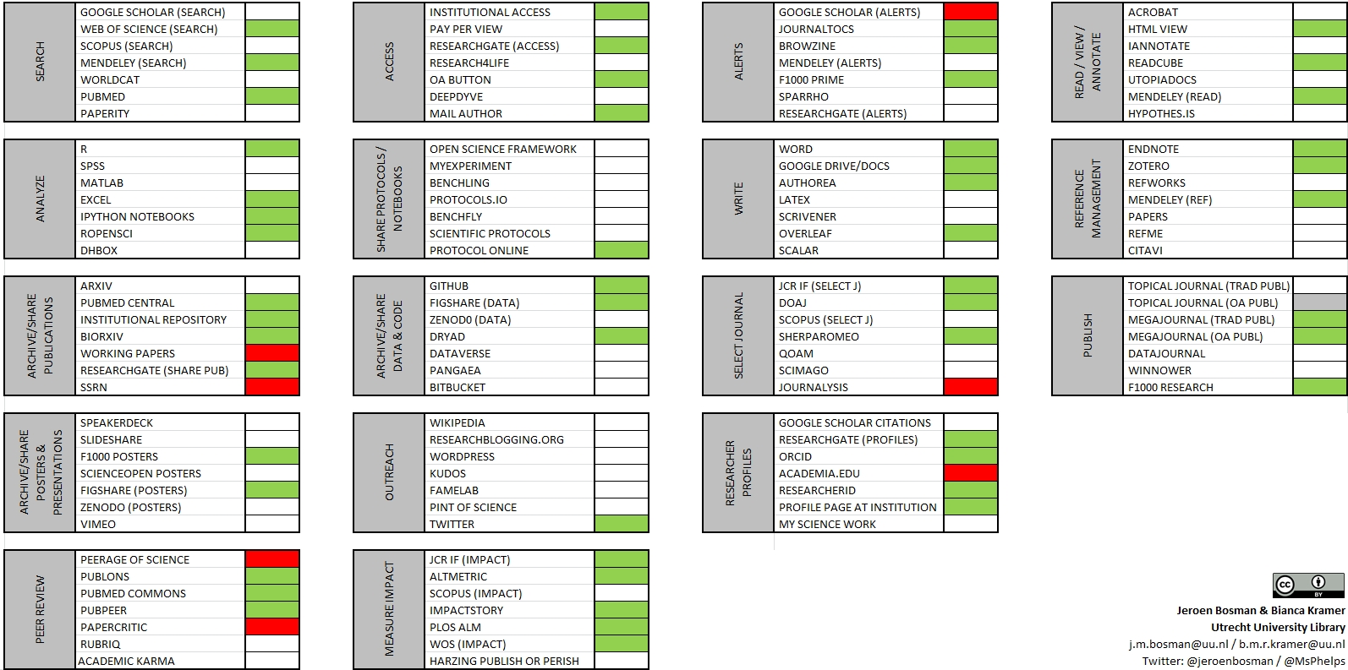

Tools used together – topical journals (Open Access publishers)
Online version allowing display of tool of your choice: http://tinyurl.com/toolcombinations

Slide 20
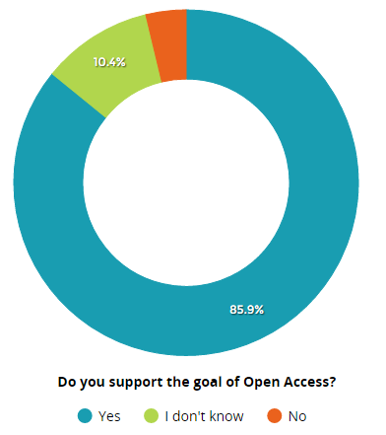
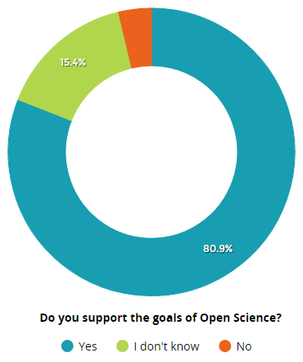
Support for Open Access / Open Science
3.8%
3.7%
i.e. openly creating, sharing and assessing research, wherever viable

Slide 21
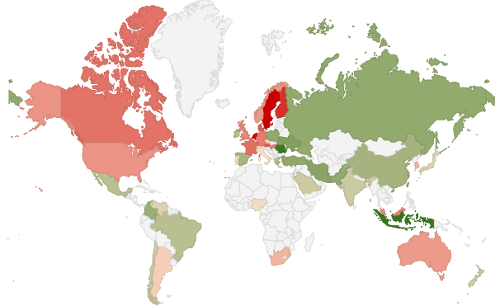

Support for Open Science vs. Open Access (ratio OS/OA)
0.85
0.97
1.10
showing countries with
49+ respondents

Slide 22
Developments towards good, open and efficient research
Fast, smooth, easy
Preprint adoption by publishers & researchers
Data management policies at funders
ORCID adoption
Slow, difficult
Not letting impact factors drive decisions
Overcoming fear of data scooping
Accepting value of all types of research output

Slide 23



Constraining and enabling contexts for open and ‘good’ workflows
assessment criteria
institutional policies/culture
PI demands
learning curves
agreements with collaborators
uncertainty over effects & legitimacy
political support at (inter)national level •
pressure from funders •
public stance on Open Science by institution •
user-friendly and powerful tools •
interoperability •
role models •
attention for positive effects •

Slide 24
Types / levels of research support
 | Inform | Support | Advise, advocate | (Co-)shape policies
e.g. | info on website, in LibGuides, etc. | offer training, Q&A | what’s a good choice, why, what’s important | think with institution, graduate schools, etc.
asks for: | knowledge, organizing info | communication skills, expertise | advocating priorities, field-specific knowledge; a vision | authority, role being accepted

Slide 25
Poll
Notes:
Simpel, kan nog simpeler, blijft model; werkelijk onderzoek nooit sequentieel

Slide 26
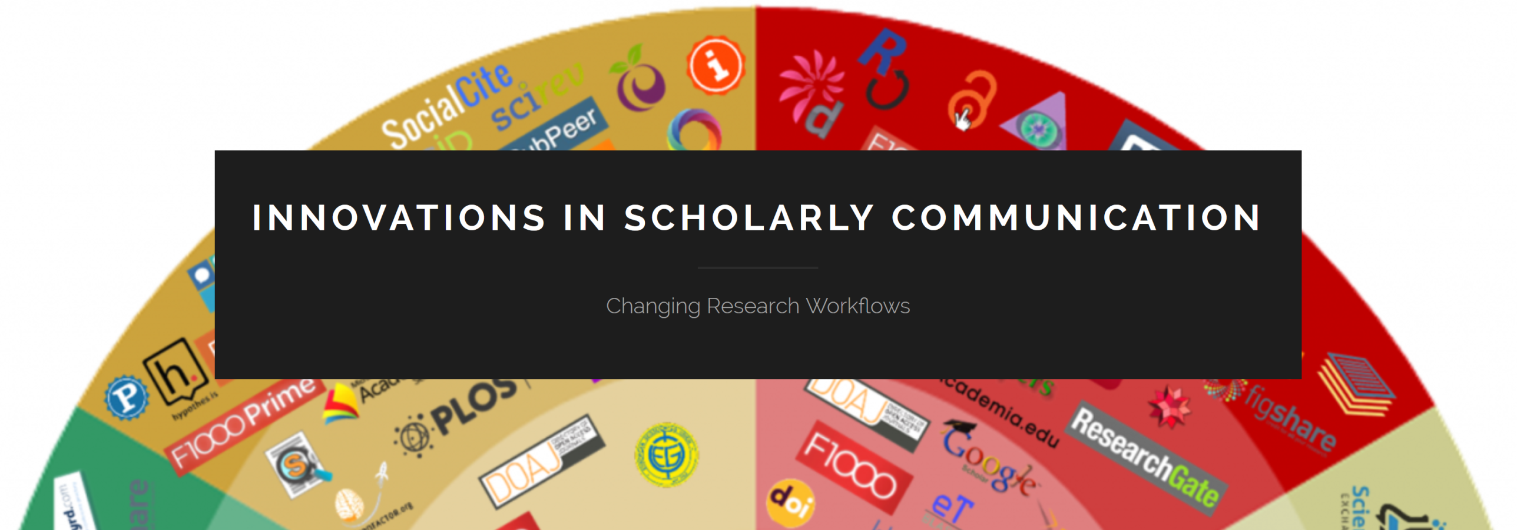
http://101innovations.wordpress.com

