Slide 1

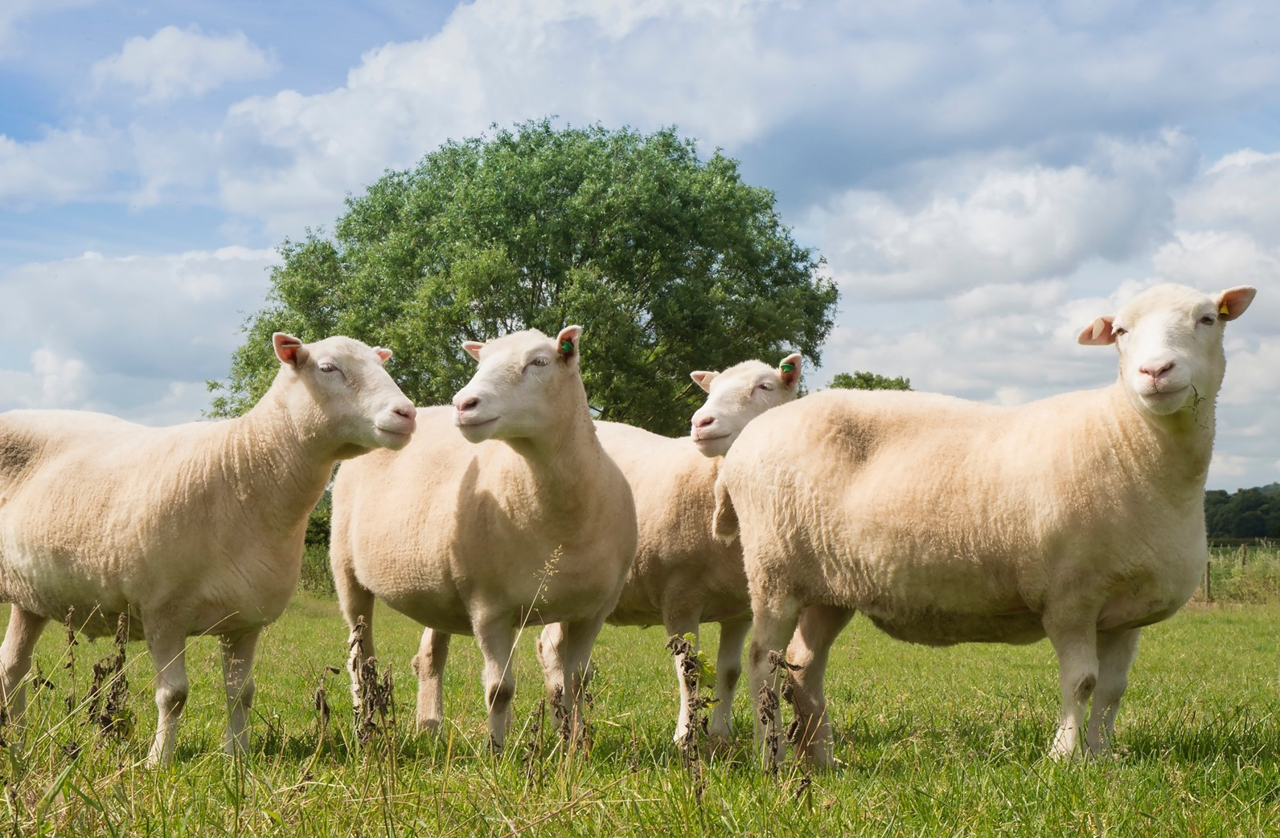

Cover image
Please select the cover image you require from the following selection:
5 x Discovery stories (SN)
5 X Transformer images (SN)
Once you have chosen the cover image move the associated Thank you page to the end of the presentation and delete all the other cover and thank you pages.
Printing
When printing the deck you can reduce ink use by selecting:
Ctrl p (print)
Change the option to greyscale
Remote Access
at Springer Nature
Laird Barrett
Product Manager, Identity
09th April, 2020
Following the progress of Dolly's clones
Notes:
Welcome, everybody. Nice to meet you. As Denis mentioned, I'm one of the product managers at Springer Nature, and I am specifically the product manager for the London-based identity team. I'm talking to you from London today.
So we provide authentication services to our websites, like nature.com or SpringerLink for example. And today I'm going to talk to you a little bit about the options to set up remote access for your researchers or students to Springer Nature websites, again, like SpringerLink or nature.com.

Slide 2
Agenda
What is ‘remote access’ to Springer Nature websites and why it’s an urgent topic right now?
What remote access options to our websites does Springer Nature offer?
How does each option work?
What are the pros and cons of each option?
How do you enable each option?
What have Springer Nature developed recently to ease remote access in the current circumstances?
Persisted authentication
Google Scholar Universal CASA
What are we planning to do next to further ease remote access?
Notes:
I have an agenda here.
To begin with, I'll talk to you a little bit about what I mean by remote access and I'll talk about why it's an urgent topic right now, which may be very obvious to many of you. I'll talk about what remote access options we offer, so I’ll, at a very high level, talk about how each option works from a user experience and a technical perspective. I'll tell you what I think are the pros and cons of each option and provide a recommendation about it, so the circumstances in which I think it's a good idea to enable each option. And then I'll talk to you about how you actually go about enabling each of the options.
After that, I'll get on to talking about a couple of recent developments that we've put in place over the last few weeks to ease remote access for researchers and students in the current circumstances, one that we're calling persisted authentication and another that's called Google Scholar Universal CASA, and again, I'll talk you through what those are and how they work.
And then I'll finally end by talking about what we're planning to do next to further ease remote access.
As Denis said, if you have any questions or even if you have differing opinions, please type them in and express them, and I'm happy to respond to those as we progress through the webinar.

Slide 3
Remote access
Section breaks
Section breaks are available in each palette colour and in a neutral blue grey.
In most cases one section break colour should be used consistently throughout the deck – ideally following the colour of the Advancing Discovery bookmark on the cover page.
1.0
Notes:
Okay, let's dig into it. So remote access. So what do I mean by remote access?

Slide 4
Remote access
How a research or student working off-campus or out-of-office, from home for example, authenticates to a Springer Nature website as an active member of an institution to access institutional subscriptions
Not a new problem
An urgent topic now because many researchers and students working from home now due to Covid-19 campus and office closures
Notes:
The primary way in which we institutionally authenticate researchers and students to access institutional subscriptions on our websites, again, like SpringerLink and nature.com, is via an IP address. So a researcher is on a device that's connected to the institutional network, we see the IP address of where they're coming from, and we know they're a member of the institution on that basis and entitle them on the basis of that IP address.
When I talk about remote access I'm talking about the situation where a researcher isn't on campus or in their office, but they're instead working offsite from home, and obviously this is something that is happening much more frequently now and in a massive scale in response to Covid-19 and campuses and offices closing, and that's presenting a problem for some institutions and organizations and researchers and students.
I should say that remote access isn't a new problem, so it's a problem that has been around for a while. You know researchers and students have obviously worked from home or remotely in the past, and many institutions or organizations will have some kind of remote mechanism set up, and so some of them that I'll talk about today you might already have enabled, but you might be considering other options as well in the current circumstances for your patrons.

Slide 5
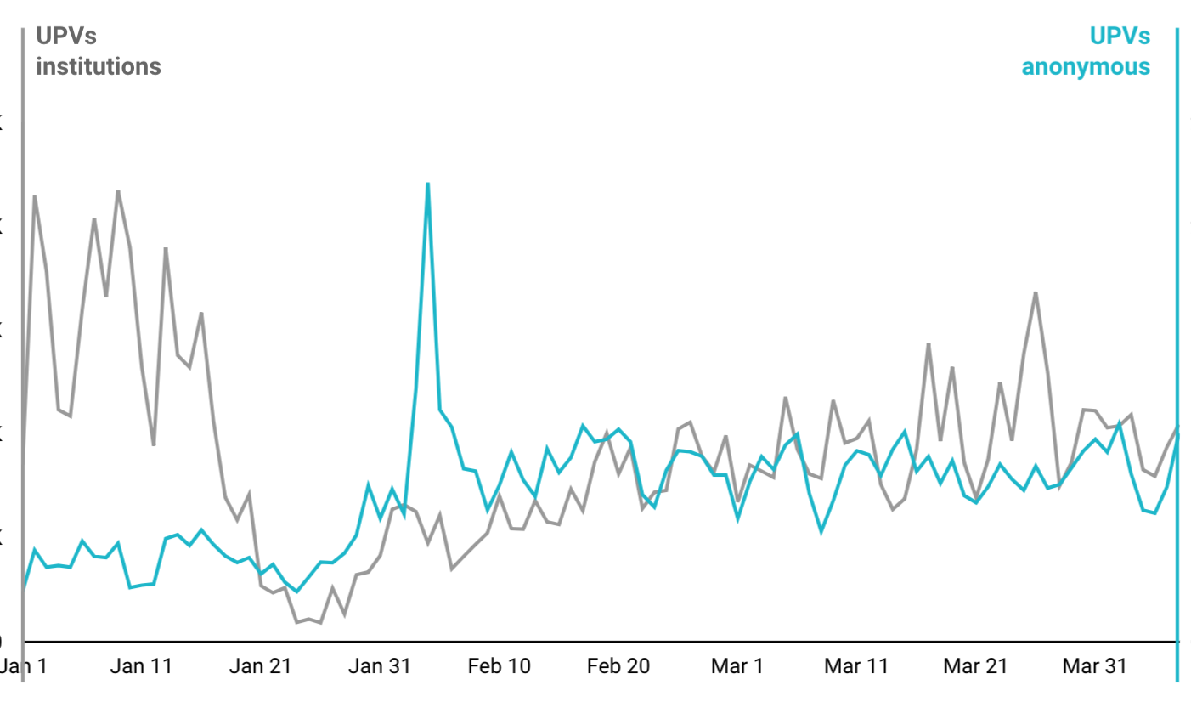
What we’re seeing on our websites
Traffic is up, but that’s due to freely available Covid-19 content
Fewer users are institutionally authenticating
Anonymous denials are steady
For countries ahead on the social isolation curve institutional authentication and anonymous denials steadily climb back up together
Notes:
Before I get into the options, I just wanted to talk a little bit about what we're seeing in terms of the situation for researchers and students out in the world from the data we can collect on our website.
So the graph you're taking a look at, it's unique page views, so it's an individual user coming to view a page, and it's specifically for nature.com. It's for the last three months, from January until the end of March, and it's showing a couple of things here. So one is, it's showing unique page views, not just for nature.com but specifically for users in China, which is an interesting case because they're obviously ahead of the curve when it comes to Covid-19. And the gray line that you can see here is unique page views from users who are institutionally authenticated in some way and the trend and pattern over the last three months, and unique page views from users who are not institutionally authenticated who are coming to our sites anonymously over the last three months.
The interesting thing to pull out here is we always get a seasonal dip here in sort of late January, during the Chinese New Year when people are working less, but you'll see this giant blue spike here, and what this is is Springer Nature has made all of the Covid-19 content freely available on nature.com, and as the situation with Covid-19 was really starting to heat up during and after the Chinese New Year, you see a lot of people coming anonymously because they don't have to authenticate, the content is free to access that Covid-19 content, but that spike is all accessing Covid-19 content.
And we see that over time, after this sort of initial interest in Covid-19 content, you can see that the situation sort of starts to normalize a little bit and people start to get back to work, and we see that gray institutional authentication line start to climb back up, but it's still not at the levels that it was prior to the New Year in China. And we still have also higher anonymous page views, and some of this higher anonymous page views is users who are researchers and students and members of institution but they're working from home now and they're struggling to access content.
This pattern isn't the same in every country; it's different in many countries in Europe. Interestingly, in Germany, we have seen institutional usage significantly rise. The implementation of remote access methods is quite widespread in Germany, and so we've seen lots of researchers staying at home and wanting to do literary reviews at the moment or writing and so accessing content on our websites much more frequently and able to do so because their institutions have pretty widely implemented remote access methods.
But that gives you a sense of what we're seeing and some of the patterns that we're seeing in terms of researcher and student behavior on our websites at the moment.

Slide 6
Remote access options
Section breaks
Section breaks are available in each palette colour and in a neutral blue grey.
In most cases one section break colour should be used consistently throughout the deck – ideally following the colour of the Advancing Discovery bookmark on the cover page.
2.0
Notes:
Okay. So let's dig into remote access options and what we have in place that can help ease remote access for researchers and students. There is a little bit of context that I should give before I dig deeply into these.

Slide 7
Brief context
Remote access options to some of our most popular Research websites
Nature
SpringerLink
SpringerMaterials
AdisInsight
Nano
Scientific American
None of these options are mutually exclusive
Authentication via any of these methods will produce COUNTER usage
Springer Nature does not charge anything for setting up any of these authentication methods, although you may incur costs setting up and maintaining them
Some publishers will have similar options available
Some of you will have one or many of these options already enabled
Notes:
So one is that I'm talking about remote access options to some of our most popular research websites, so that's Nature, that's SpringerLink, and some of our database products, SpringerMaterials, ADISInsight, Nano, Scientific American. I'm not talking about remote access methods to our wider range of products out into our professional and education divisions, but I'm very much focused on these researcher products. I should say that none of these options are mutually exclusive, so you can have all of them IP and all of the remote access methods set up at the same time. You may not want to do so because, while we don't charge anything to set them up, there might be some costs incurred on your end to get them set up and to maintain them, and it's probably confusing for your patrons, researchers and students, to have too-wide an array of options possibly.
I should say that all of these authentication methods produce COUNTER usage in that usage reporting that we provide, so it doesn't matter in which way the user authenticates. That usage, once they're authenticated, flows into your COUNTER reports.
Again, we don't charge anything for setting up any of these authentication methods, although you might incur costs setting them up and maintaining them on your side.
Some publishers will have similar options available, and I think that's an important thing to consider when you're setting up remote access options. You probably don't want to have different methods across different publisher sites for your patrons, researchers, so they have to go through different steps and processes as they move between different publisher sites if you're a subscriber to content from multiple publisher sites. And again, some of you will have one or many of these options already set up.

Slide 8
The options
IP authentication via Virtual Private Network or Secure Proxy Server
Federated access (also-known-as Shibboleth and OpenAthens)
Referrer access
Associated user - SpringerLink and the Database products ONLY
Token URL access - Nature and Scientific American ONLY
Google Scholar CASA (Campus Activated Subscriber Access) - SpringerLink and Nature ONLY
Notes:
Okay, let's go on to what I will take a look at next. So I'll talk through really the six options for remote authentication, and I'll try to keep it at a fairly high level and go through these fairly briefly because I suspect many people on the line are familiar with them.
So one of them is IP authentication via Virtual Private Network or secure proxy server. Those are two different things but just for the purposes of this presentation I've grouped them together as remote IP authentication methods.
Federated access, which you might also know is Shibboleth and OpenAthens, and I'll talk a little bit about the terminology in this area to try and clarify it.
Referrer access.
Associated user, which is available for SpringerLink and our database products only.
What we call Token URL access, which is available for Nature and Scientific American only.
And finally something called Google Scholar CASA, Campus Activated Subscriber Access, which is available on SpringerLink and Nature only.
Okay, let's dig into VPNs and secure proxy servers to begin with.

Slide 9
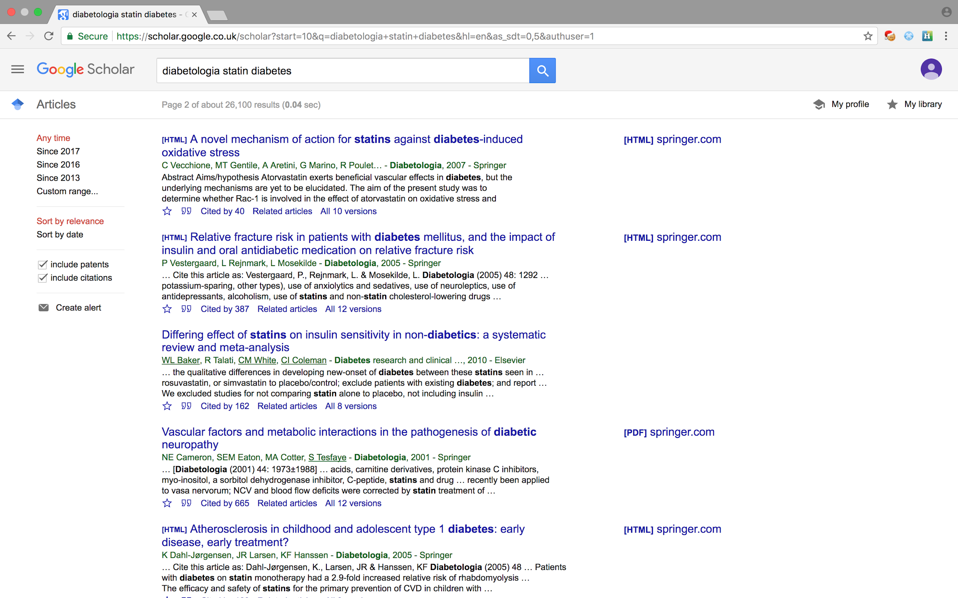
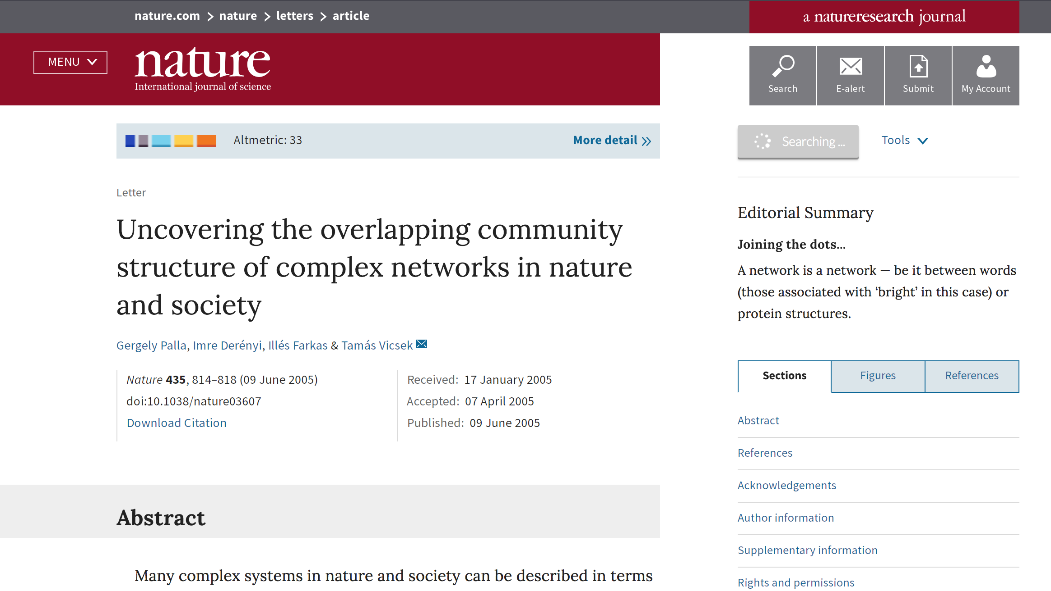

IP authentication ‘on-campus or in-office’
Connect to institutional network IPs
Notes:
So I talked a little bit earlier about the IP authentication experience when a user is on campus, which is a great and wonderful user experience really. You know, your device is connected to your network. You might discover a piece of content somewhere that might be in the discovery service, your library discovery service, and in a different discovery service, like Google Scholar. It might be in an eTOC alert or on social media, and then you click on that piece of content and you come through, and in the background, based on your IP, we authenticate and entitle you to your institutional subscriptions.
You don't have to do anything as a user. It just works and it's very nice.

Slide 10
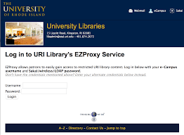
IP authentication via VPN or Proxy from home
Connect to institutional network VPN or Proxy server IPs
Notes:
You can extend that IP authentication remotely by introducing a VPN or a proxy, and at some point during the user's discovery and access experience, they'll have to log in to that VPN or proxy to join the network so that when we see the IP that we're coming from, we authenticate them on the basis of the VPN or proxy server IPs.
And this is also quite a nice user experience for users, although we have certainly seen examples where users do get confused and this becomes a longer and more complicated experience, so we sometimes see users for example find a piece of content in their discovery service, like Google Scholar, they click through to it, they hit the paywall. They realize that they need to authenticate to their VPN or proxy. They might go back to their library discovery service and authenticate there and search for the article there again, and then using a proxy URL there come back through to the article on our site, and it can be a long and complicated journey. It partly depends on how familiar the patron, the researcher or student, is with this method.

Slide 11
IP authentication via VPN or Proxy from home -
Pros and Cons
PROS
CONS
Can be easy and low cost to set up
Can provide information about how users within an institution are authenticating and accessing resources
Many discovery services support proxy URLs
Widely supported by publishers
User experience can sometimes be painful
Some concerns about VPNs or proxies being able to handle the traffic load
Some concern about the viability of using VPNs or proxies in certain areas
Can be a vector for abuse
Notes:
So some of the pros are that it can be easy and low cost to set up. There are some great proxy products out there, for example OCLC's EZproxy is very popular in North America, although there are other options out there.
It can provide you as the librarian or patron with information about how users within an institution are authenticating and accessing resources, which might be useful in terms of providing support to your patrons.
Many discovery services support what are sometimes called proxy URLs, so these are URLs that you can fit into the regular or the common discovery and access flow so that users can just click on the link that they're interested in and they might be prompted to authenticate, but they'll quickly get through to the piece of content.
And IP is obviously very widely supported by publishers, including IPV at VPNs or proxy.
Some of the cons are, again, I said sometimes the user experience can be a bit painful but depending on the user and how they understand the flows.
There have been some concerns about VPNs or proxies being able to handle the traffic load, so the international library consortium, organization, issued a statement a few weeks ago expressing some concern that as students and researchers leave campus en masse that VPNs or proxies would be overloaded. We haven't heard or seen evidence of this yet, but that concern has been expressed.
There's some concern depending on what area of the world you're in and how the internet is regulated there about the viability of using a VPN or a proxy. We've heard about some challenges in certain areas of the world based on how the internet is regulated.
And it can be a vector for abuse, and what I mean by that is, if somebody gets ahold of a researcher or student's credentials to log in to the VPN or proxy, either maliciously or because that researcher or student has shared it with that group, that user, that person can then get in and access the content, and it's worth noting that this is the principle by which organizations like Sci-Hub have accessed and scraped content from publisher site and accumulated a database of content.

Slide 12
IP authentication via VPN or Proxy from home -
How to set it up
Set up VPN or Proxy
Provide VPN or Proxy IPs to Springer Nature Online Services or your Licencing Manager
Inform you patrons about the user experience
Notes:
If you want to get this set up, really you just need to first research and look into setting up a VPN or proxy. You just need to provide those VPN or proxy IPs to Springer Nature Online Services or your Licensing Manager and we'll get those configured on our side and then inform your patrons about the user experience works.
Okay, so that's VPNs and proxies. Very popular. They are certainly actually the most popular remote authentication method.

Slide 13
Federated access - a few definitions
Single Sign On - A broad term for using a single credential to log in to multiple systems and websites.
Federated access - A form of single sign-on that allows users to use a single credential to authenticate across multiple enterprises’ systems and websites (e.g. using your university credential to log in to SpringerLink, ScienceDirect, Wiley Online, etc.).
Shibboleth and OpenAthens - Software solutions that facilitate the federated access method. Institutions normally use one software or another and some publishers will prompt users down one path or another. OpenAthens also acts as a non-country federation.
SAML-based authentication - A technical term for federated access. The message we send from the Springer Nature Service Provider to the institution’s Identity Provider are in Security Assertion Markup Language (SAML).
Federations - Country-level organisations that institutions and publishers can join to facilitate the exchange of metadata between the two that underlies the federated access method. There is a global federation called EduGAIN that country-level federations are members of and which facilitates the exchange at a global level for those who opt-in.
Notes:
Next, what I call a federated access, and I just wanted to try and clarify some of the terminology here.
So federated accesses is sometimes more broadly called single sign-on, and single sign-on is a broader term for using a single credential to log in to multiple systems and websites. Federated access is the more precise term for what we're talking about here.
So federated access is a form of single sign-on that allows users to use a single credential to authenticate across multiple enterprises' systems and websites, so that for example is using your university credential to log in to SpringerLink and Elsevier ScienceDirect or Wiley Online or Taylor & Francis Online, etcetera, so you have one credential to again authentic across multiple enterprises' systems and websites. And then I think that that's the best term for this authentication method.
Some people call it Shibboleth and OpenAthens, so Shibboleth and Athens are softwares that sort of enable the federated access method, and OpenAthens is an organization that also operates as a non-country federation. I'll talk about federations in a moment. This term is quite commonly used for federated access. I don't fully actually know the historical reasons for why that's the case, but you often see on publishers' websites or in conversations about this method that it is referred to the Shibboleth and OpenAthens.
Sometimes, and rarely less, so-called SAML-based authentication, so this is more of a technical term, federated access, so the message that we send from our systems to your systems when we're authenticating the user, to the institutions' systems owner authenticating the user, are in a language called Secure Assertion Markup Language, and that's where the SAML part comes from.
And then we have federations, so these are often country-level organizations and they've been formed. For this method to work, there needs to be an exchange of data, metadata specifically, between the publisher and an institution so that our systems can talk to each other for the authentication method to work. And so these country-level organizations, federations, have formed to facilitate that exchange so that every publisher and university or corporation doesn't have to do it on a one-to-one level. When I say corporation, it tends to be academic institutions that have joined and form these federations
There is a broader group called EduGAIN, which is sort of the global federation. Springer Nature is a member of a number of country-level federations but we also send our metadata on to EduGAIN and we ingest the metadata from EduGAIN, so if your institution is a member of a federation and you send your metadata on to EduGAIN, we will already have it in our system, and hopefully through your federation you'll have our metadata in your system so all of that exchange has already occurred to enable this method.

Slide 14
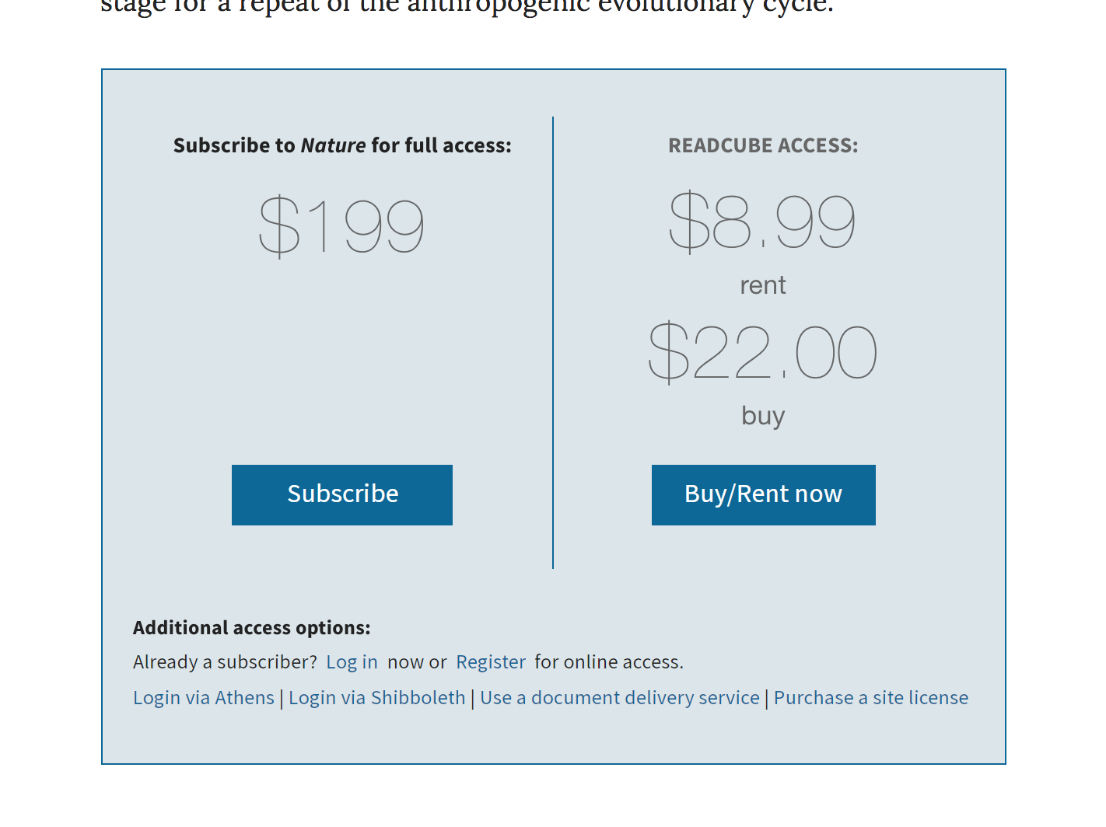
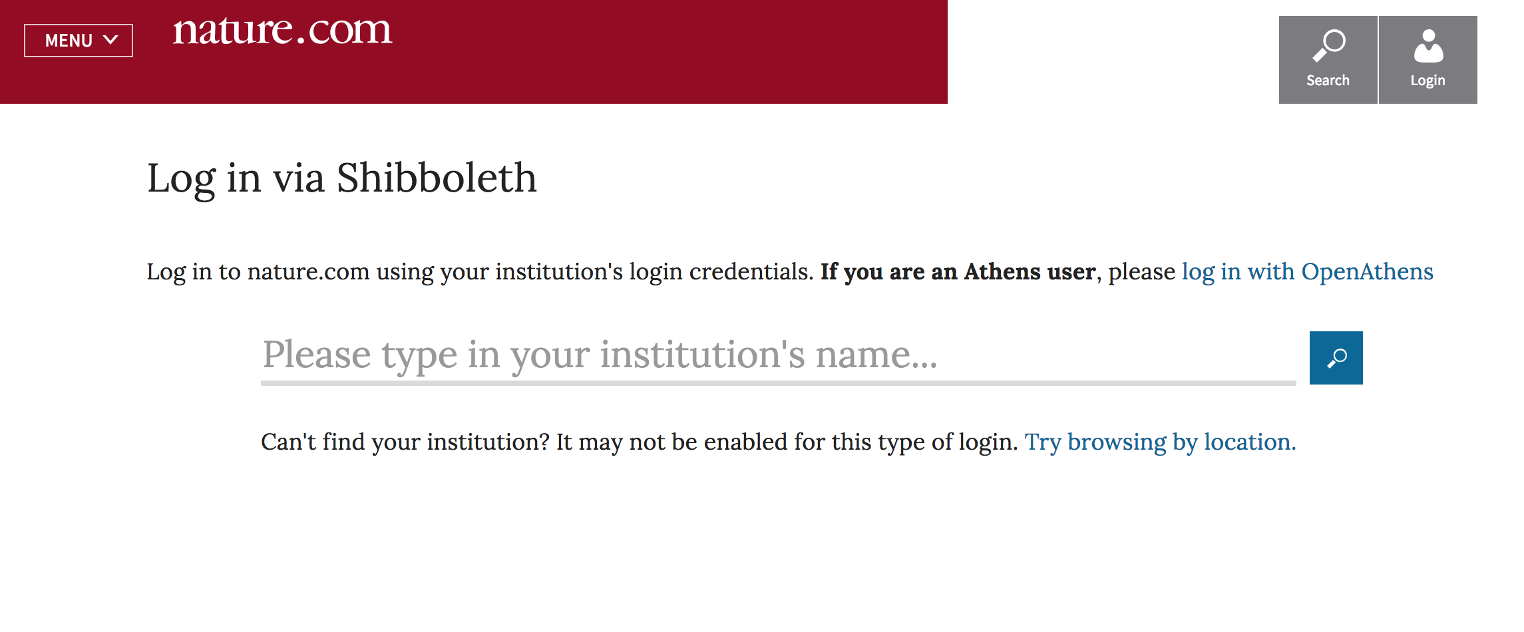
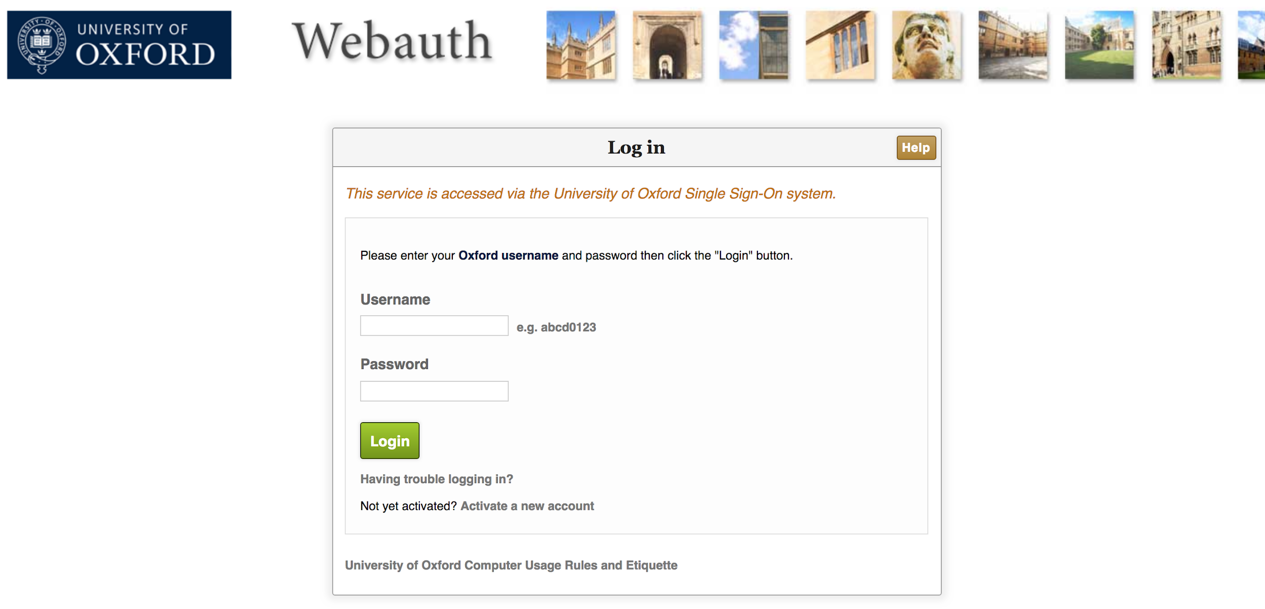
Federated access
Notes:
The experience for federated access can be a longer one is the truth. So often a researcher will find a piece of content. They'll go through the article and hit a paywall. They'll initiate the federated access experience. They'll find their institution. This is the point at which we bounce the user out to the institution's login screen, and we send that SAML-based message to say, hi, I've got this user who wants to log in – can you confirm that they're a member of the institution? And then the user puts in their credentials, and we get a SAML-based message back from your identity provider saying, yes, this person is a member of our institution. Go ahead and authenticate them to access our subscriptions. And they come back through to this content.
There are efforts to make this experience better, and I'll talk about those very briefly, but this is the sort of standard experience that is out there across publisher sites.

Slide 15
Federated access -
Pros and Cons
PROS
CONS
Widely supported by publishers
User experience is improving
User experience can sometimes be painful, although can be better than VPN or proxy
Set-up can be technical and painful, may involve your IT department
Can also be a vector for abuse
User privacy concerns
Notes:
So the pros and cons.
So the pros are that it's widely supported by publishers. And user experience is improving. And again, I'll talk about that in a moment.
Some of the cons are that the existing user experience across many publisher sites can be painful, although in some cases it can be better than a VPN or a proxy in that it fits into those discovery and access flows where the user clicks on an article and they come through and they just want to continue through that route to authenticate. They don't want to go out to authenticate to a proxy or authenticate to a VPN at that point.
The set-up can be technical and painful and may involve your IT department. It doesn't always have to be. If it's the case that through a federation we've already exchanged metadata, it might just be a case of you getting in touch with us to say, hi, I would like this enabled and here's what we call the entity ID, so the identifier that represents your identity provider, and then it's just a very simple configuration on our side to make it work.
It can also be a vector for abuse if somebody gets ahold of credentials to log in via this method.
There have also been user privacy concerns around this method because in that message that you send back from your identity provider to us, you can include individual details in that message. I should say that whether you send those details back or not is within the control of the institution. We don't request those details, and if you do send them through to us, we throw them away. We only use federated access for institutional authentication currently.

Slide 16
RA21 and SeamlessAccess
RA21 (Resource Access in the 21st Century) - An industry group that issued a recommendation to implement an improved experience of federated access across publishers’ sites. This new user experience of federated access introduced a consistent call-to-action to initiate the access method across sites and once a user has done so once, their institutional selection would be persisted in their browser. This provides the user with a shorter and easier experience as they bounced between publisher’s sites.
SeamlessAccess - The group implementing the services that enable the RA21 recommendations. Only Springer Nature on nature.com and the American Chemical Society have rolled out the SeamlessAccess experience of federated access so far. SeamlessAccess does NOT replace federated access, it’s a new user experience of federated access.
Notes:
Just very briefly, it's worth mentioning – and you may be familiar with these terms and these organizations – there was a group called Resource Access in the 21st Century, an industry group, RA21, that was set up a couple of years ago to really find a way to ease remote access to researchers, and they issued a set of recommendations that called for a more consistent experience of federated access across publisher sites and a persistence of the users' institutional selection across publishers' sites to improve the experience of federated access for users. They issued some recommendations last year. That group is now closed and done.
And there's a new group called SeamlessAccess, who have been charged with building the services that support this new recommended experience.

Slide 17
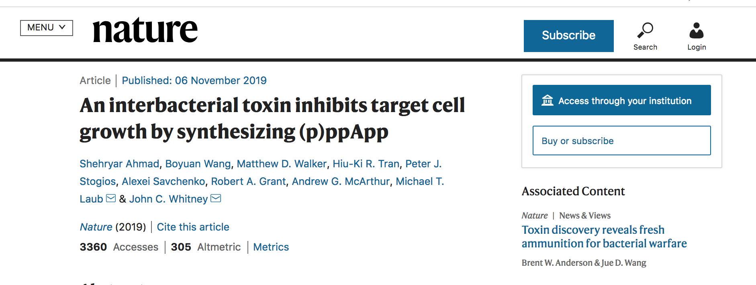
SeamlessAccess - Clear and Consistent Call-to-action
Notes:
And it's worth noting that Springer Nature is the first publisher to roll out the SeamlessAccess experience across one of their websites. We did this on nature.com in November of last year. If you go to nature.com right now, you'll see the recommended call to action, and if you're not authenticated already, you'll see the recommended call to action on the top right of an article page to access through your institution. And when a user goes through that process once, so it's the same federated access journey where they select their institution, we bounce them out and they put in their credentials.

Slide 18
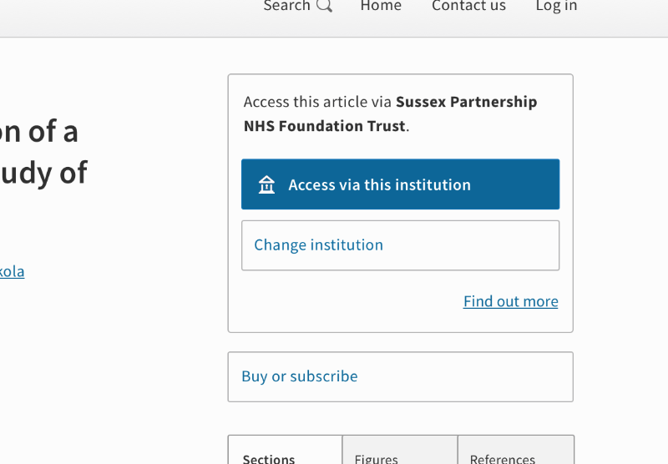
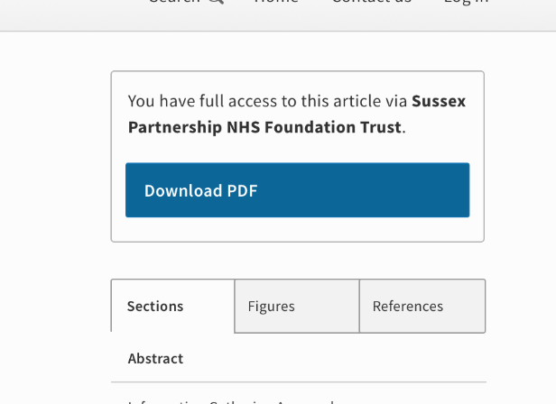
SeamlessAccess - Persisted institutional selection
Notes:
We store their institutional selection in their local browser storage, in their browser, so if they go away and come back to our website, we're able to remember what institution they selected, and if they still have an active authentication session with their institutional identity provider, they just have one-click access then. So they just click on this button, we do the conversation with the identity provider in the background, and the page reloads and the user can access the PDF. If the user session is expired – and how long the user session lasts for is dependent upon your institution's identity provider, it can be hours, it can be weeks – if the user session is expired, then the user has to put in their institutional credentials with their institution again to authenticate. It's another small step but it's still a shorter and easier journey. And the idea is that this persists across other publishers' sites as they roll out this new experience of federated access.
So the ACS is the second publisher. The American Chemical Society is the second publisher to have implemented this. They just did this last month, and so now if you go through the experience either on the ACS's website or on nature.com, then your institutional selection is stored in your browser and you have the use of authentication via federated access across our sites. Other publishers are working on implementing this as well.

Slide 19
Federated access -
How to set it up
Check that you have an Identity Provider that supports SAML-based authentication - most do
Contact Springer Nature Online Services or your Licensing Manager to request enablement; if you can provide the entity ID or OpenAthens ID please
If you’re a member of a federation, your Identity Provider may already have our metadata and our Service Provider may already have yours and it’s simply a data configuration on our side; If not then we may need to exchange metadata
Notes:
So how do you get it set up?
So the best thing to do is check that you have an identity provider that supports SAML-based authentication; most do.
You can contact Springer Nature Online Services or your Licensing Manager to request enablement. If you can provide the entity ID, which is often a URL and it often has the word Shibboleth in it or a URI with Shibboleth in it, if you’re able to provide that to us as well, that's useful and that will help us to set up the configuration on our side. Or you might be a member of OpenAthens and you might have an OpenAthens ID, a string of numbers, and if you could provide that as well, please.
If you're a member of a federation, then it's possible that we just need to do a configuration on our side and it will be set up very quickly. If you are not or not a member of a mutual federation, it's possible that we might have to exchange metadata with you and we can walk you through that process, but in many cases, that's not going to be necessary.
Okay, so that's federated access, so that's number two. Those are the two big ones I should say, so those are the two most popular remote access methods.

Slide 20
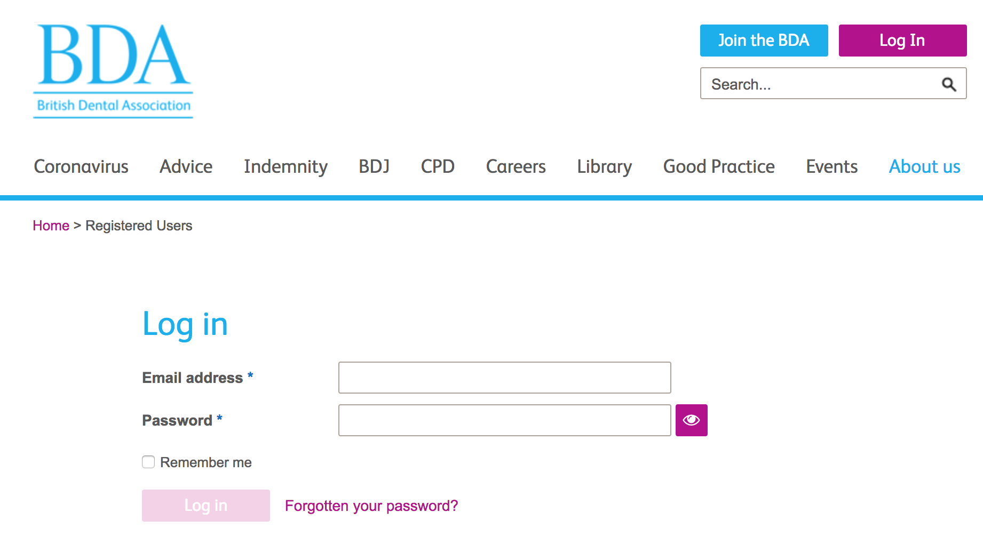
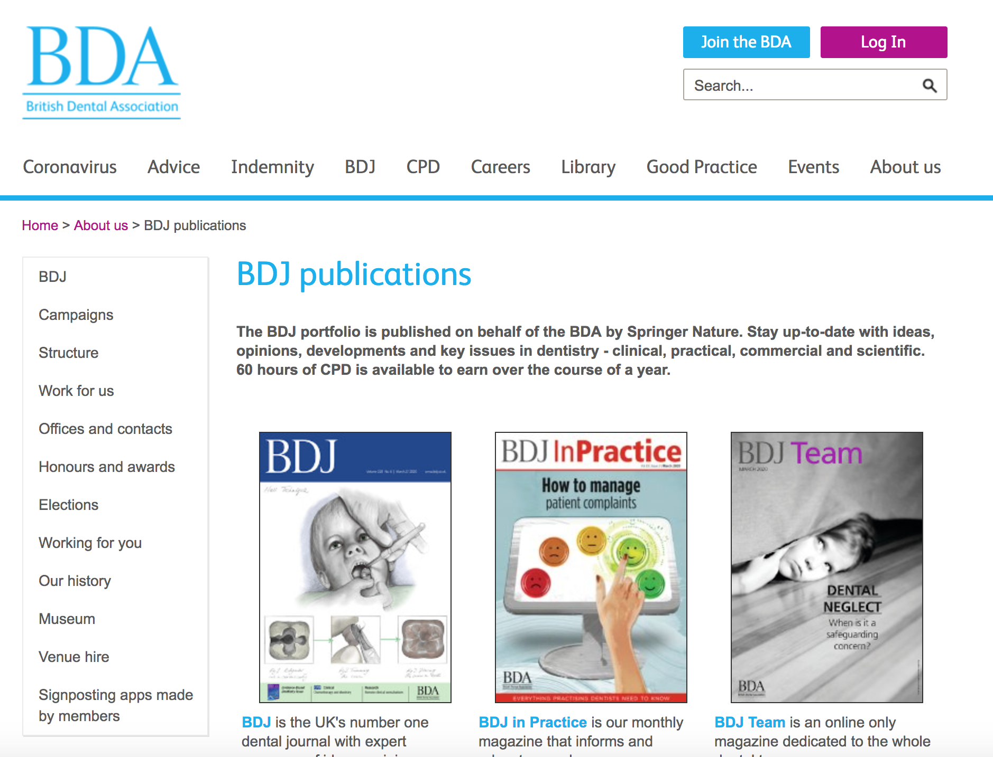
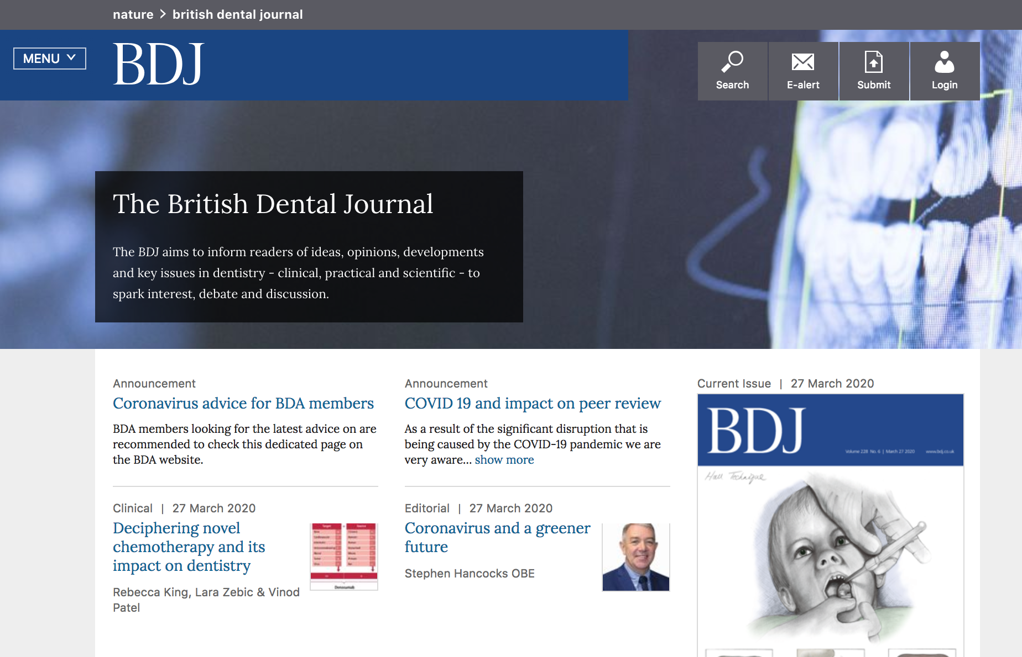
Referrer access
Organisation website
Members Only webpage
Referrer URL
Notes:
These next ones, at least the next few I'm going to talk about, are really options that are there for different types of organizations, but I think they're better as secondary fallback options if VPN or proxy or federated access doesn't work for your institution or organization for some reason.
So this is what we call referrer access.
So this is an authentication method that's often used by learned societies who we co-publish journals with, and the idea is that a member of that society or whatever institution or organization that might be has to go to an organizational website, as in this case I've got the British Dental Association here. They've got to go to that organization's website. They have to log in to that website to start with, and within that website there has to be a members only webpage, so a page that's only available to members who have logged in to the organization's website. And then surfaced on that page have to be links through to our website or journals on our website, and when a user clicks on one of those, the user comes through with their referrer URL so we know what webpage the user has come from, and on the basis of the user coming from this members only webpage, we authenticate them as a member of that institution and we grant them access to that institution's subscriptions.
So this isn't very widely used by academic institutions or corporations as a method of access. Again, it's primarily used by societies.

Slide 21
Referrer access -
Pros and Cons
PROS
CONS
Doesn’t fit well into normal discovery and access journey
Set-up can be painful
Doesn’t scale very well to multiple publishers
Can also be a vector for abuse
Notes:
I'll just go into the pros and cons, and to be honest, I don't have many pros to talk about with referrer access. I think it's best just to have it as a fallback option if VPNs or proxies or federated access don't work for you. The reason it's not great as a broader remote access method is that it doesn't fit very well into the normal discovery and access journey, so you can imagine that it will be painful for this researcher to find their piece of content, go through to our website, and then have to go back to their organization's website, log in, hit to the members only page, click on the link, search again for the piece of content. It's a painful experience.
Set-up can be painful. You've got to set up a website that has individual authentication on it and that members only page.
It doesn't necessarily scale very well to multiple publishers either, so if you subscribe to multiple publishers, you have a massive list of website or journal links on that members only page that users have to search through, to click through. Two, it can be very painful for them.
And again, it can be a vector for abuse. It's possible to fake over for a URL.
So again, really just a fallback option but good to know it's there if one of the primary options doesn't work for you.

Slide 22
Referrer access -
How to set it up
Build a website with individual authentication for patrons and a ‘members only’ area with a link to our website
Provide URL of the members only page to Springer Nature Online Services or your Licencing Manager with a request to enable
Notes:
If you want to set it up, it requires building a website with individual authentication for patrons and a members only area with a link to our website, and then you can provide the URL for the members only page to Springer Nature Online Services or your Licensing Manager with a request to enable it.

Slide 23
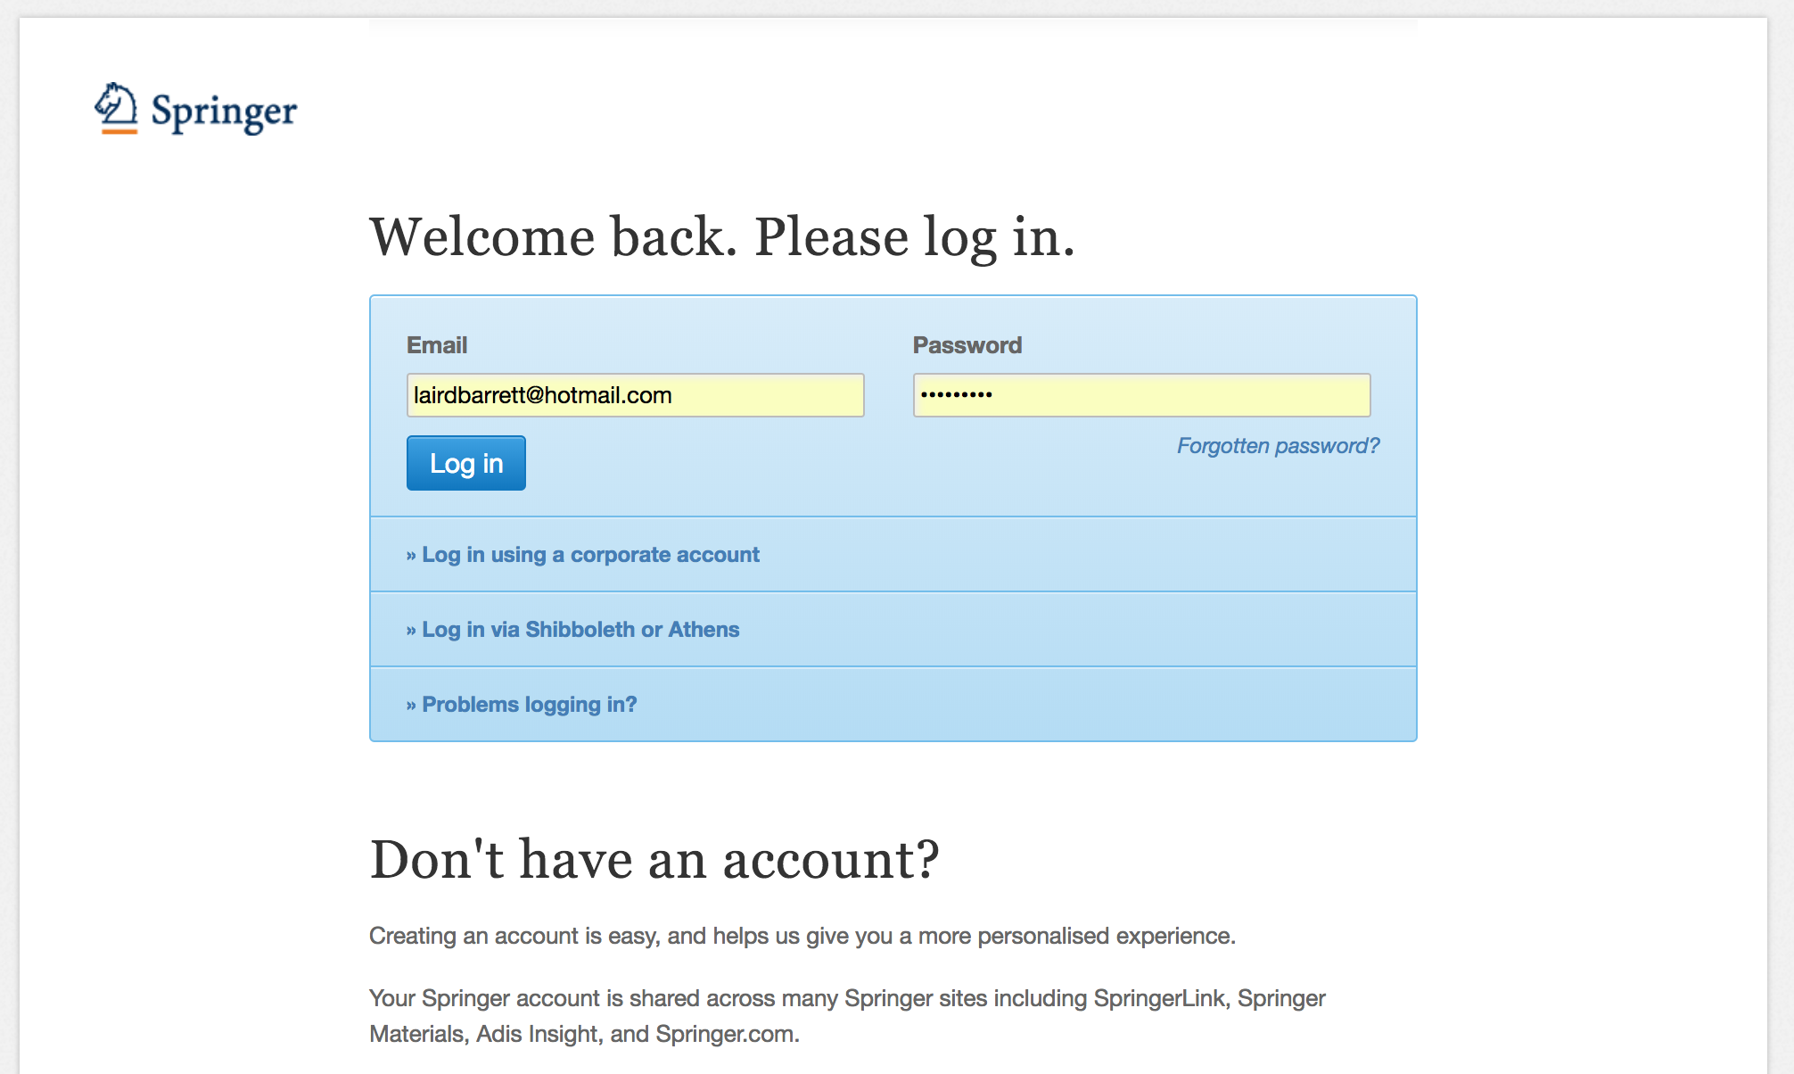
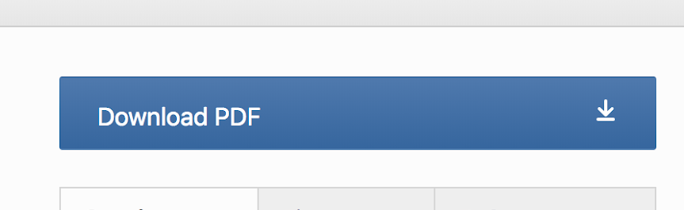
Associated user - SpringerLink and the Database Products
By auto-association when on IP or by invitation
Notes:
Okay, associated user.
So this one is only available for SpringerLink and our database products, SpringerMaterials, AdisInsight, Nano. The idea here is that an individual researcher can come and register on SpringerLink for example, and when they register, we will create a connection between their individual profile on SpringerLink and their institution so that when they're individually logged in, they can then access their institutional subscriptions. And we facilitate this in a couple of ways.
So there's a method called auto-association so that if the researcher registers while they're within their institutions, connected to their institution's network and within their institution's IP ranges, then we will create the association if the institution has enabled auto-association.
Or you can do it by invitation as well, so within the Springer Nature librarian portal, you can turn on and off auto-association, but you can also put in researchers' or students' emails. If the researcher or student is already registered on SpringerLink or as a Springer user, then the association will just be set up. If not, then it will trigger out an email asking that person to come and register and then we'll create an association when they register.

Slide 24
Associated user -
Pros and Cons
PROS
CONS
Works well if you have a small, infrequently changing user base and don’t subscribe to too many publishers
Can create significant administration to manage associations; 10-year duration
Doesn’t scale very well to multiple publishers
Not widely offered by publishers
Notes:
I think the pros, I think this is really an authentication that works best if you have quite a small base of users, a small base of patrons, and they are infrequently changing so you don't have lots of people coming and going from your institution or organization and you don't subscribe to too many publishers' websites, and I'll explain why I think it works best in those situations.
One reason is that it can create significant administration to manage all of those associations, so the default duration for those associations is 10 years, so it's a very long time, and if you have a large organization and you have lots of people coming and going, to have to come into the Springer Nature librarian portal to add and remove associations as people come and go from your organization can be very painful. It's not something that you can sort of configure the duration for it at a group level in any kind of way, but even if that was possible, it still creates quite a lot of administrative overhead.
And if you were to introduce this method broadly across your organization because you subscribe to many publishers' websites, and so you set it up for many publishers' websites where it's offered, then you also have to administer all of those associations across multiple publishers' websites, and your patrons have to register on each of those websites as well and individually log in to each of those websites. So at scale it can become a very painful experience for both librarians and researchers.
It's also not massively widely offered by publishers, so if you're looking for a consistent method to roll out to all of your patrons, this might not be one that fits the bill.

Slide 25
Associated user -
How to set it up
Go to the Springer Nature Librarian Administration Portal and switch on auto-enablement or invite users to associate
Notes:
If you want to set it up, it's best to go to the Springer Nature Librarian Administration Portal. You can either switch on auto-enablement there if it isn't already or you can invite users to associate either one by one or I think there's a bulk upload email address mechanism as well, although it does have a limit on the number that you can upload at once.

Slide 26
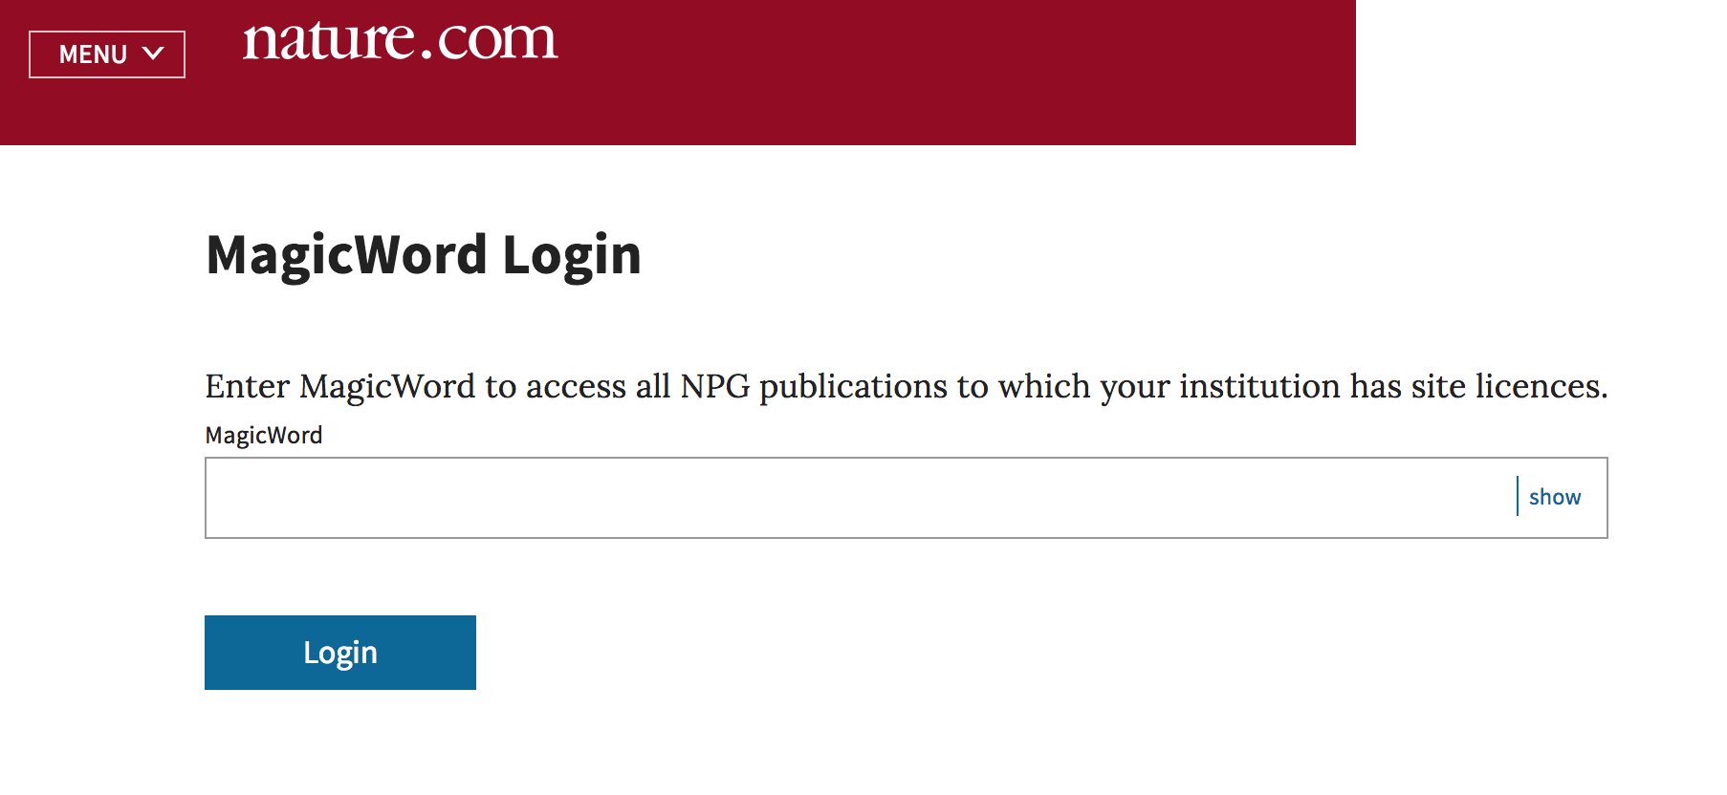
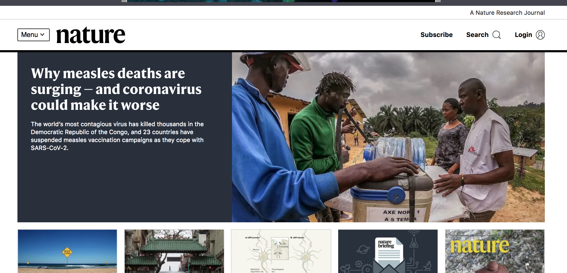
Token URL Access - Nature and Scientific American
Unique URL
Concurrency
Limit
Notes:
So I've got two more to talk through. Token URL Access and then Google Scholar CASA, and then I'll get on to some of the new things that we've built recently.
So Token URL Access, this is available only for Nature and Scientific American. This is a method in which a researcher has to navigate to what we call a MagicWord login page. It's a unique URL for your institution. And then they have to put it in a specific password, a word, a magic word as we term it, that you have set up, and once they've done so, we bring them through authenticated to nature.com or Scientific American.
It does have a concurrency limit on it, so you can only have a certain number of users logged in in this way, so that might be 10 or 20 or 30 users, depending on the size of your institution.

Slide 27
Token URL Access -
Pros and Cons
PROS
CONS
Simple to set up
Doesn’t fit well into the normal discovery and access journey
Can also be a vector for abuse
Notes:
The pros are that it's quite simple to set up. All you need to do is ask us to enable it and provide us with your preferred magic word or shared password and also make a suggestion about, based on the size of your user base, what the right concurrency limit would be.
The cons of it, it doesn't fit well into the normal discovery and access journey.
So again, if a user, if a researcher or a student is searching for a piece of content and they've found something in Google Scholar or online and they click through to our website, then they'll be denied access and they've got to go back to the unique URL and put in the password there and then come back to the site and search for the article again and come through that way.
It is also a very popular vector for abuse, so we often find people sharing the URL and password combination online…
…and then inevitably that will then influence your usage reports and you can very quickly hit the concurrency limit so that people who are actually members of your institution can't get in via this method to authenticate.
Again, along with referrer and associated user, I think these methods often fit sort of smaller organizations in which a VPN or proxy or a federated access isn't an option for some reason and they're more of a fallback option, so we often use Token URL Access for maybe some smaller corporations or also for high schools for example.

Slide 28
Token URL access -
How to set it up
Send a request to Online Services or your Licencing Manager with your ‘Magic Word’ and a proposed concurrency limit based on your number of patrons
Notes:
Again, if you want to set it up, I just described it, but you can send a request to Online Services or your Licensing Manager with your magic word and a proposed concurrency limit, and we can work on getting that set up for you. But again, I'd only recommend those last three methods as backups if the first two aren't possible for some reason.

Slide 29

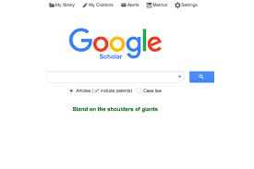

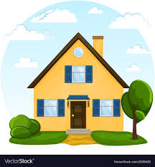
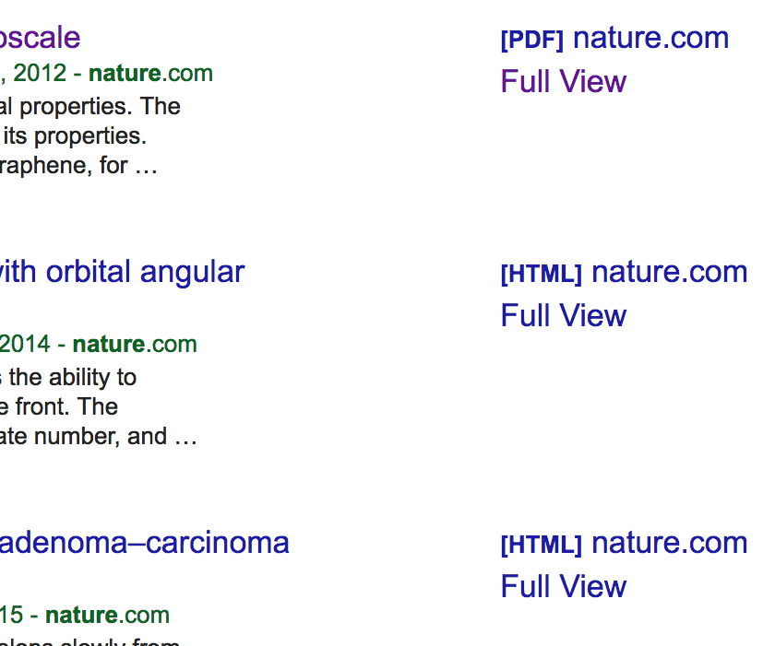
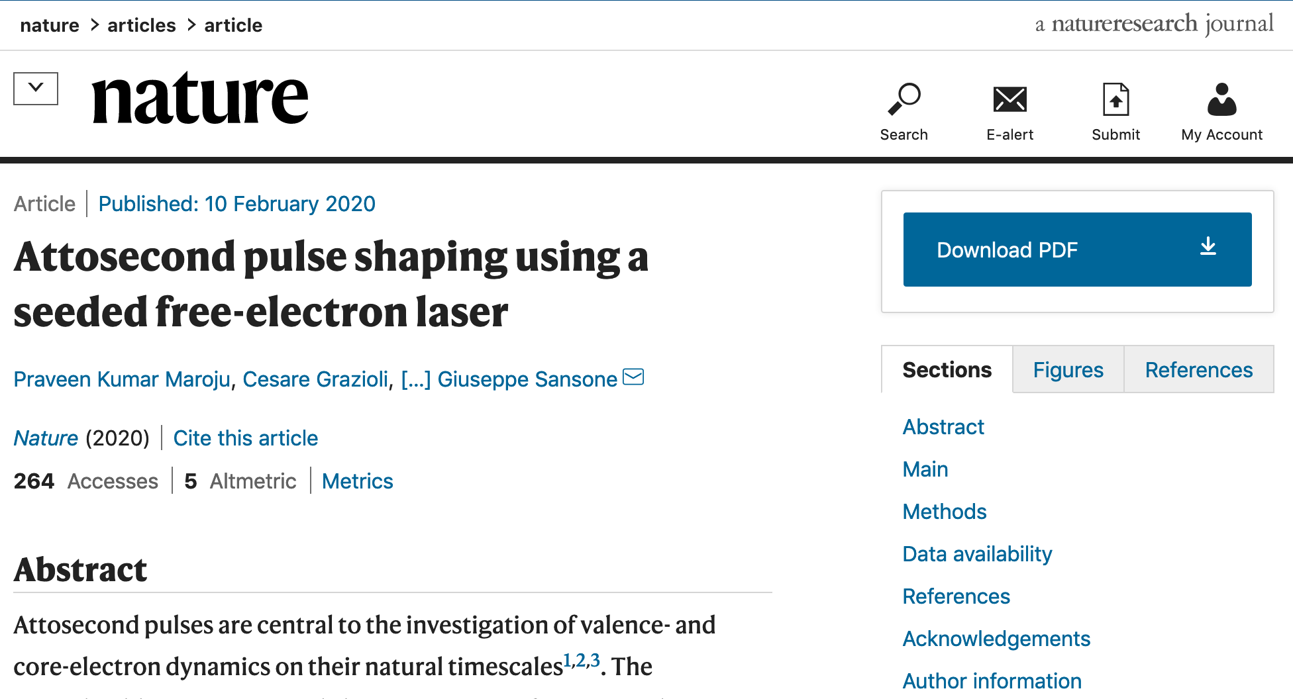
Google Scholar CASA -
Nature and SpringerLink
ONLY
IP 1.2.3.4 = Institution X = Nature Subscription
User ABC
IP 1.2.3.4
User ABC = Institution X
User ABC = Institution X
IP = 6.7.8.9
(Valid for 60 days)
Links created for Nature for Institution X
Authenticated as Institution X
Notes:
Finally, Google Scholar CASA. So this is enabled for Nature and SpringerLink, and it's enabled for all institutional customers, and I'll talk through how it works.
So the way that it works is you have a researcher who is on their institutional network IPs and if they use Google Scholar while they're on their institutional IPs, we, as with many other publishers, send institutional IP data and entitlements information to Google Scholar, and so Google Scholar knows that that user is a member of the institution and they create an association between the user's Google ID and their institution. And that association used to last for 30 days and the user could restart that 30 days by going through this initial process again, but it's been extended to 60 days because of the Covid-19 related campus closures.
Once the user has set up that connection, when the user then is, say, at home and not on their institutional IP and they use Google Scholar again, Google Scholar on the basis of this connection knows that the user is a member of the institution. They'll surface direct links through to nature.com or SpringerLink along the right-hand side of results. When a user clicks on one of those links, Google sends the user through to us with a token that says, hi, this user is a member of the institution based on them formally being on the institution's IP within this timeframe – you can trust that they are a member of an institution and go ahead and authenticate them to access the content. And we do so on that basis.
It isn't massively widely used is the truth. So we do get some traffic through this route, but it is still dwarfed by other methods, like IP certainly and by other things like federated access, but it does ease the authentication process for some users, obviously specifically Google Scholar users and that's one of our most popular referrers.

Slide 30
Google Scholar CASA -
Pros and Cons
PROS
CONS
Fits into a common discovery and access journey
Just works for researchers who use Google Scholar
Works cross-device
Can be disabled by researcher in their Google account settings
Dependent on the user being a Google Scholar user and being on their institutional network IP to work
Notes:
So some of the pros are that it really fits well into the common discovery and access journey if you are specifically a Google Scholar or a researcher who uses Google Scholar.
It's nice that it works cross-device, so if you're signed in with your Google ID on your laptop and you're also on your mobile, it will work cross-device.
It can be disabled by researchers in their Google account settings if they wish.
Obviously, though, the con is that it's dependent on the user being a Google Scholar user and being on their institutional network IP for it to work, and they obviously have to be logged in in their browser with their Google ID for it to work. So there are certain conditions under which it works for users, and not all users have all of those combinations enabled, being signed into your Google ID, being a Google Scholar user, and using Google Scholar while you're within your institutional IP range.

Slide 31
Google Scholar CASA -
How to set it up
Nothing to do. Auto-enabled for institutional customers.
Notes:
Okay, so there's nothing to do to enable this. It's auto-enabled for institutional customers.

Slide 32
Recent changes
Section breaks
Section breaks are available in each palette colour and in a neutral blue grey.
In most cases one section break colour should be used consistently throughout the deck – ideally following the colour of the Advancing Discovery bookmark on the cover page.
3.0
Notes:
moving on to recent changes.

Slide 33
Recent changes
Persisted access
Piloting Google Scholar Universal CASA
Encouraging federated access enablement
Notes:
So I'll talk about a few things that we've done really in response to Covid-19 and campus and office closures to try and ease remote access for researchers and students.
One thing is what we call persisted access, and I'll talk about how this works in a moment. We're piloting an extension of Google Scholar CASA called Google Scholar Universal CASA. And we're also encouraging institutions to enable federated access if they haven't already done so.

Slide 34
Persisted access
Institutional identifier stored against persistent cookie in the user’s browser, currently for 90-days
Institutionally authenticates
Same browser and device
Persisted identifier used if not authenticated in another way
Notes:
So let's dig into these.
So persisted access.
The idea with persisted access is when a user comes to nature.com or SpringerLink or one of the database products and they institutionally authenticate, so this might be because they're on their institution's IP and that might be via VPN or proxy because they've authenticated via federated access or via another method, we'll store the institutional identifiers for that user on the back end against a persistent cookie in the user's browser, and we set a duration on the storage of those institutional identifiers of 90 days.
The state of that 90 days is under regular review and it is possible for us to change the duration or even turn off this method. We really implemented it as sort of a temporary emergency measure because of the campus and office closures to try and ease authentication for researchers and students as they flocked home. So while it's 90 days at the moment, that duration can change really on the basis of the duration of the crisis, and we don't know how long that's going to go on for at the moment.
And so when the user comes back in the same browser and device, if they haven't already institutionally authenticated in another way, say, via IP or federated access or something else, we will look via the cookie at the institutional identifiers that we've persisted and stored, and we'll set those against this new session so that they are authenticated and can access an institutional subscription on that basis.

Slide 35
Persisted access
Implemented on 18th March for Nature and the Database Products
Implemented on 27th March for SpringerLink
Works for all institutional authentication methods on Nature
Works for IP (including VPN and proxy) and federated access on SpringerLink and the Database Products
Implemented for all institutional customers; Nothing special for librarians or researchers to do
Only works if user has cookies enabled and in the same browser on the same device
Planned to be a temporary measure for the crisis, reviewed weekly; 90-day duration can be changed and can be turned off
Notes:
So we implemented this on the 18th of March for Nature and the database products. We implemented it on the 27th of March for SpringerLink.
It works for all institutional authentication methods on Nature. It only works for IP, including VPN and proxy and federated access, on SpringerLink and the database products.
We implemented it for all institutional customers. There's nothing special for librarians or researchers to do to enable it.
It only works if the user has cookies enabled, so it accepts cookies on a website and has cookies enabled in their browser. And it only works in the same browser on the same device. If the user switches from their laptop to their mobile phone, if they haven't already authenticated it at some point and established the persistence, then it's not going to work for them there.
And again, it's planned to be a temporary measure for the crisis. We're reviewing it weekly. We set a 90-day duration, but that can be changed, and at a certain point we may turn off this or reduce the duration, but it's really on the basis of how long it can be useful for researchers and students.
That's the new persisted access. It is worth saying that it has been successful, so we can see in the numbers that it is a method that is easing remote access for researchers around the world as they come to our websites currently, which is a good thing, I think.

Slide 36
Google Scholar Universal CASA -
Nature and SpringerLink
ONLY
User ABC
IP 1.2.3.4
User ABC = Institution X
User ABC = Institution X
IP = 6.7.8.9
(Valid for 60 days)
Notes:
The next thing to say is that we're piloting something called Google Scholar Universal CASA.
So this is sort of an enhancement of Google Scholar CASA, which I just described, in which when the user comes to not just Google Scholar's website but comes to our website within their institution's IP address, we make a call out to Google so that if the user is logged in to their browser with their Google ID and they have not disabled the creation of links between their Google ID and their institutional affiliation, it will create the link.
So regardless of where the user is coming from – it doesn't have to be Google Scholar, it can be PubMed or it can be their library discovery service or it can be whatever it happens to be – that that connection will be made. And then when the user comes back and outside of their institutional IP ranges, we again make a call and the end-user is authenticated in another way, we again make a call out to Google to say, hey, does this user have a connection path between their Google ID and their institutional affiliation for these 60 days?

Slide 37
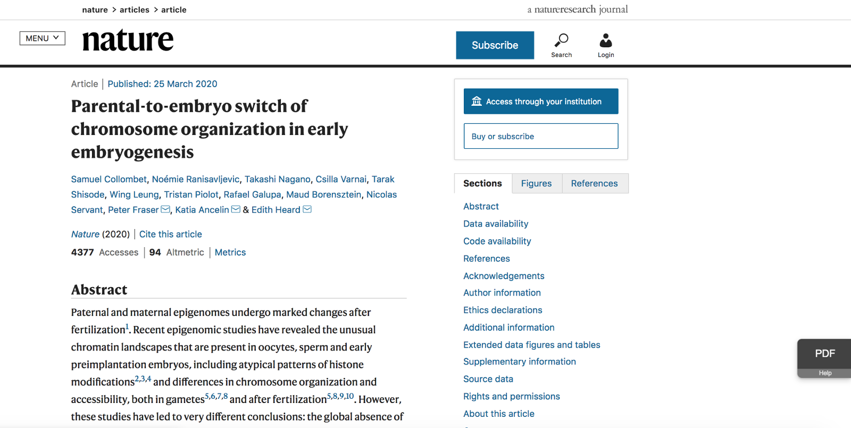
Google Scholar Universal CASA
Notes:
And if they do, then Google, based on some JavaScript on our pages, surfaces this PDF link, which you can see on the bottom right here on the page, and when the user clicks on that, that does a similar thing to clicking on a link within Google Scholar, so it sends a token to our site to say, hey, this user is a member of the institution – go ahead and authenticate them. And we do do so and the page reloads and the user has access.

Slide 38
Google Scholar Universal CASA
Implemented on 24th March for Nature and SpringerLink
Enabled for all institutional customers; Nothing for librarians or researchers to do
Works cross-browser and device
Monitoring effect
Notes:
So we've just started piloting this on Nature and SpringerLink on the 24th of March, and we're monitoring to see what the impact is, but it does appear to be making authentication access easier for some users, but again, at quite a small scale.
It's enabled for all institutional customers and there's nothing for librarians or researchers to do to enable it.
It's nice in that it works cross-browser and device again. Again, so unlike the persisted access approach, this one works as users move between devices, which they do.
And again, we're sort of monitoring the effectiveness. Again, it might end up just being a temporary measure that we have in place for the duration of the crisis to user remote access, but we'll see how things progress.

Slide 39
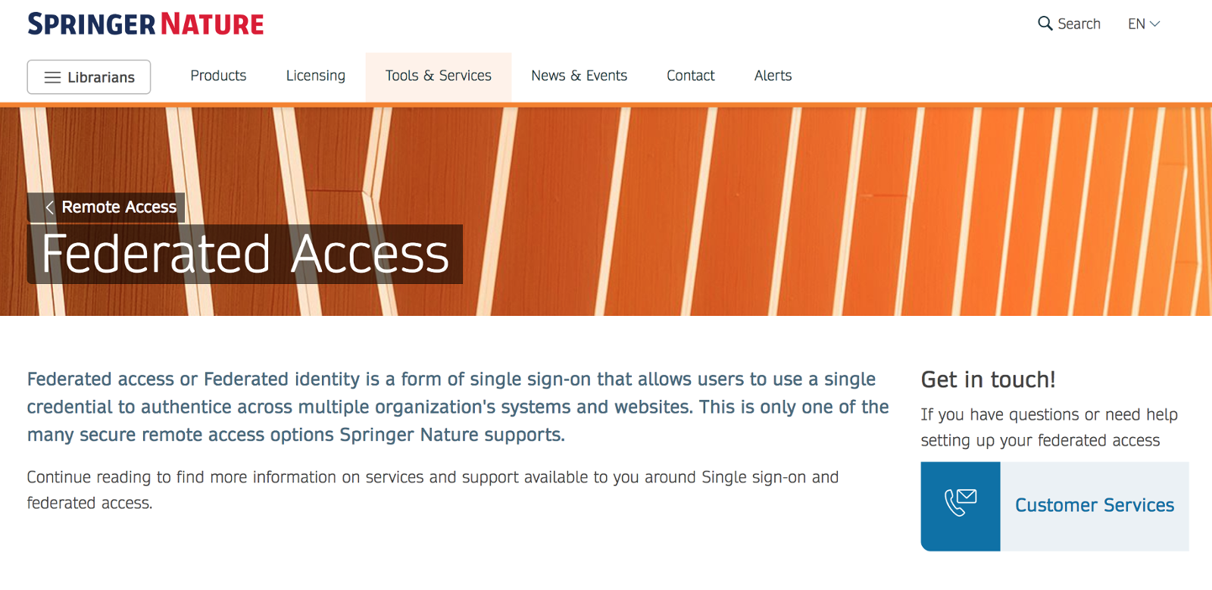
Encouraging federated access enablement
Search for: ‘Springer Nature Federated Access”
https://www.springernature.com/gp/librarians/tools-services/implement/federated-access
Notes:
And finally, we've been encouraging federated access enablement.
So we've got a new page set up with information about federated access and links through to our Online Services team. To get it set up, if you just search for Springer Nature Federated Access, you should be able to get through to the page. There's a link here. But it will provide you with some more information around enabling federated access if you're interested in doing so.

Slide 40
What’s next?
Section breaks
Section breaks are available in each palette colour and in a neutral blue grey.
In most cases one section break colour should be used consistently throughout the deck – ideally following the colour of the Advancing Discovery bookmark on the cover page.
4.0
Notes:
So what's next?

Slide 41
What’s next?
Communicate out the options and the work we’ve been doing to ease remote access during the crisis
Exploring looking back through stored historical authentications to ‘backfill’ persisted access to an earlier date
Exploring enabling federated access by default for federation members
Notes:
We're obviously trying to communicate out the options and the work we've been doing to ease remote access during the crisis.
We are exploring looking back through stored historical authentications in browser cookies to backfill persisted access to an earlier date. One of the concerns was that we implemented the persisted authentication quite late in some ways, so in mid- to late-March, in some cases after campuses and offices had closed globally, and that there are researchers and students out there who don't have a good remote access method set up and who are struggling to access at the moment, who usually access via IP while they're on campus and who are struggling at the moment, and so that group we think we might be able to help out by sort of backfilling for a period of months, that persisted method, so that when the user comes back we'll also look at sort of backfilled institutional applications and authenticate on that, or previous institutional authentications and use that for the current institutional authentication. But again, this would just be a temporary thing for the duration of the crisis.
We've explored enabling federated access by default to federation members as well. So this is something that some of our competitors, like the American Chemical Society or Wiley, have been doing, so in many cases where an institution is a member of a federation, and we are or through EduGAIN, we're already set up between us just to flip the switch and turn federated access on for an institution. We haven't done so historically because we've only enabled it by request, but just to try and ease authentication during this period, we've been looking, as our competitors have done, at enabling federation members by default.
So what we would do is really do the configuration that's necessary on our side, sort of inform institutions that we're turning on the method, and provide some user guides to how it worked for their members, and then turn on the method.
We've been looking at doing this in China to begin with because there is certainly enthusiasm for doing so there to make that process easier. And as I said, they're also ahead of the social distancing curve, so there's a need for it.

Slide 42
Thank you
Thank you page
Make sure you have the thank you page associated with the cover image you have chosen and move this slide to the end of your presentation
Updating the footer
To update the footer:
Go the slide master via View
Scroll to the first page
Change text in the footer
Close slide master
Laird Barrett
identity@springernature.com
Search for: ‘Springer Nature Remote Access’
Credit: Northampton University
Notes:
That is it.

