Slide 1
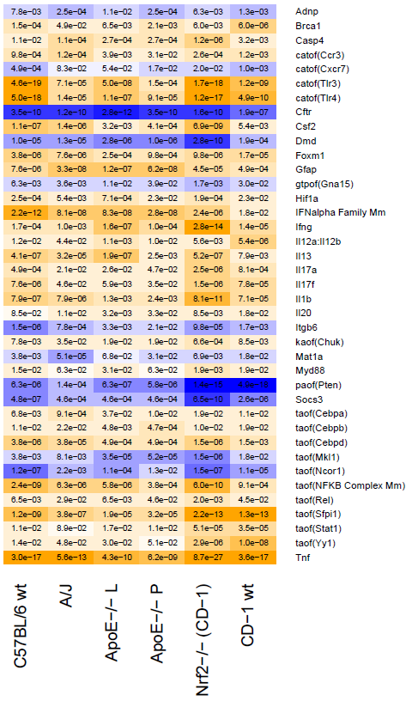
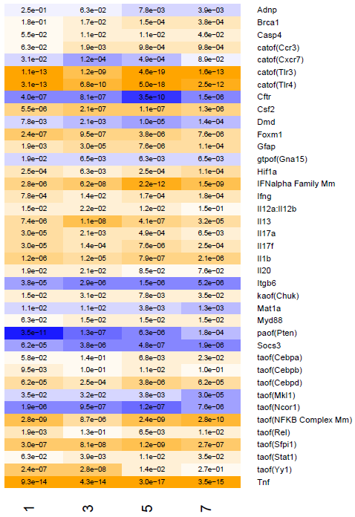
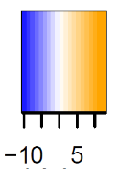
Comparison across mouse strains
Comparison across time points in C57BL/6 wt
minus log₁₀-concordance P-value * sign of concordance score

