Slide 1
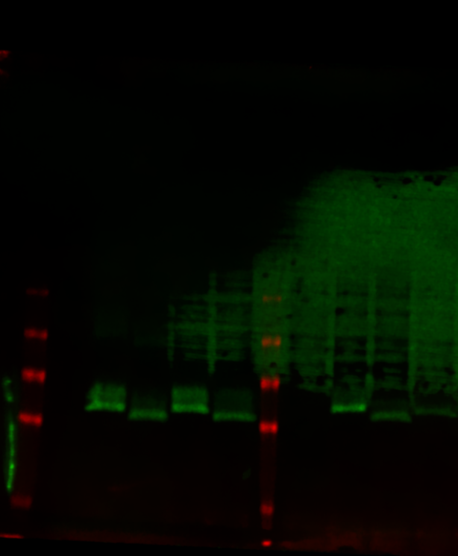
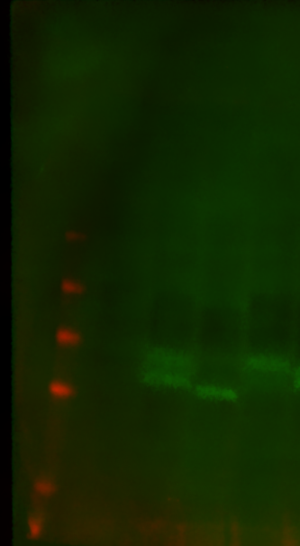
kDa
62
49
38
28
17
kDa
98
62
49
38
28
17
Neg
WT 100 mM NaClO₃ CCR5
PolySia 100 mM NaClO3 CCR5
WT 100 mM NaClO₃ 4xF
Neg
PolySia 4xF
Neg
5xKO 100 mM NaClO₃ CCR5
PolySia CCR5
WT CCR5
Neg
5xKO CCR5
WT 4xF
5xKO 4xF

