Slide 1




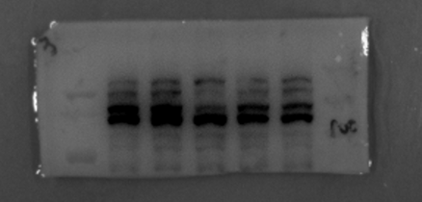
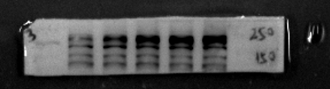

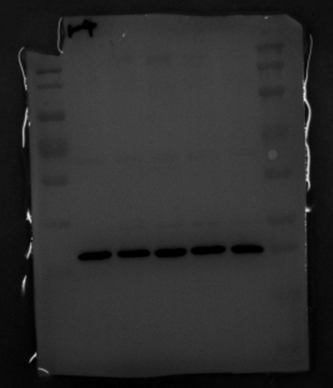
Fig 2B
TGF-α (100 ng/mL)
0 5 15 30 60 (min)
BP180
180 kDa
p-EGFR
170 kDa
EGFR
175 kDa
GAPDH
37 kDa
Original blots

Slide 2




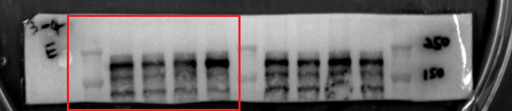
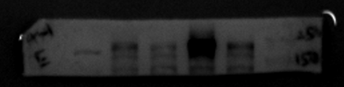
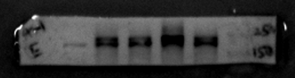
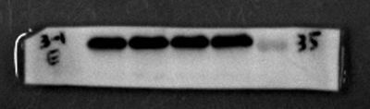
Fig 2C
Blank TGF-α
Erlotinib - + - +
BP180
180 kDa
p-EGFR
170 kDa
EGFR
175 kDa
GAPDH
37 kDa
Original blots

Slide 3




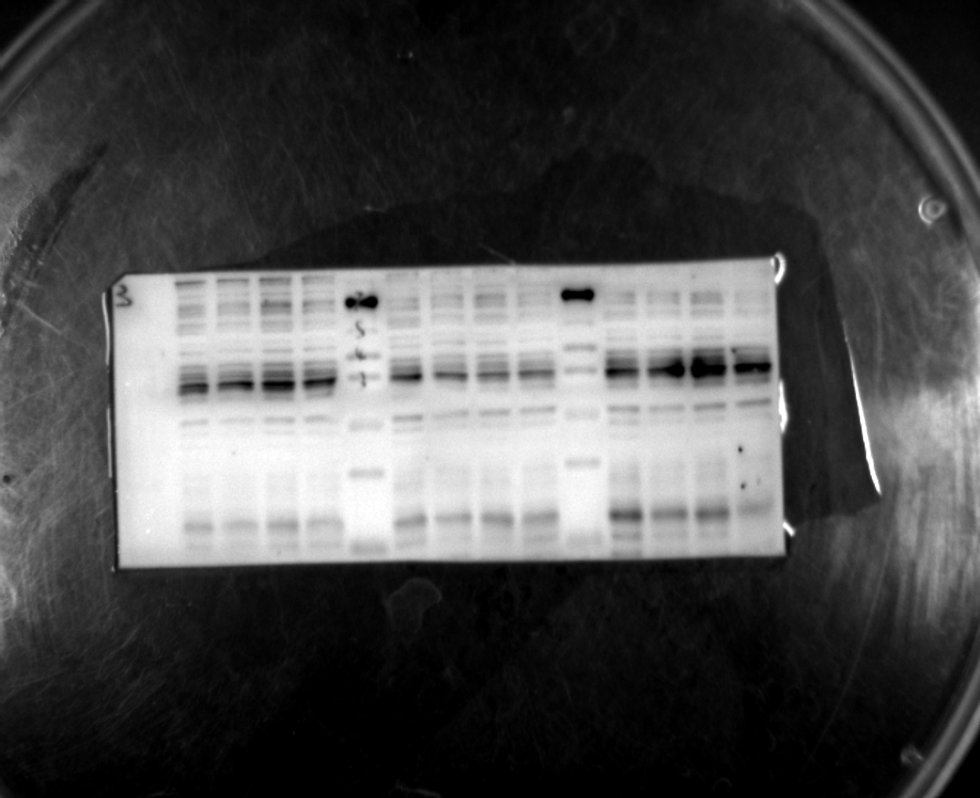
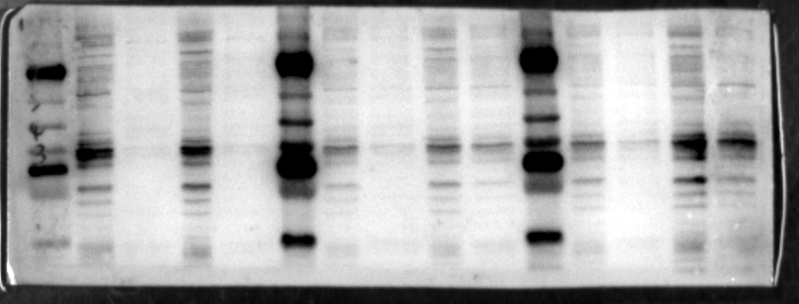
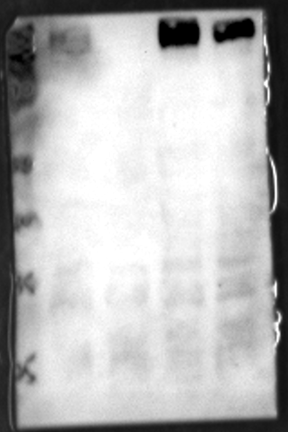
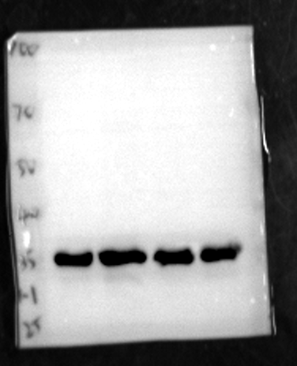
Fig 3B
Blank TGF-α
Erlotinib - + - +
MMP7
30 kDa
MMP8
53 kDa
MMP9
92 kDa
GAPDH
37 kDa
Original blots

Slide 4





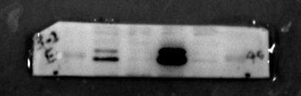
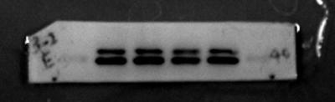
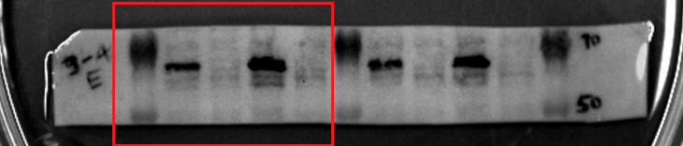
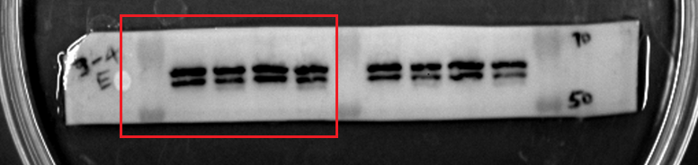
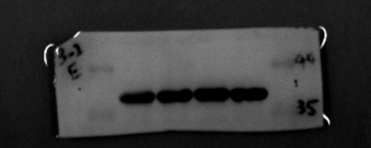
Fig 4A
Blank TGF-α
Erlotinib - + - +
P-Erk
42 kDa
44 kDa
Erk
42 kDa
44 kDa
P-Akt
60 kDa
Akt
60 kDa
GAPDH
37 kDa
Original blots

Slide 5






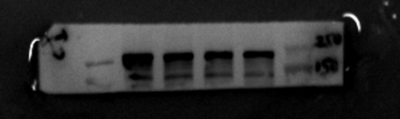
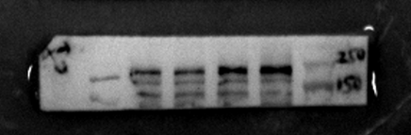
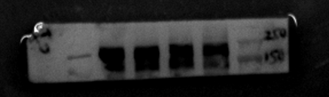
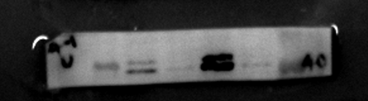
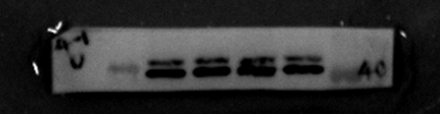
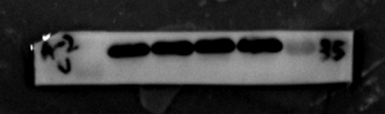
Fig 4B
Blank TGF-α
U0126 - + - +
BP180
180 kDa
p-EGFR
170 kDa
EGFR
175 kDa
p-Erk
42 kDa
44 kDa
Erk
42 kDa
GAPDH
44 kDa
37 kDa
Original blots

Slide 6
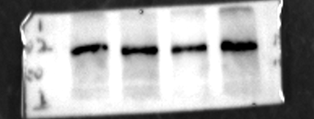








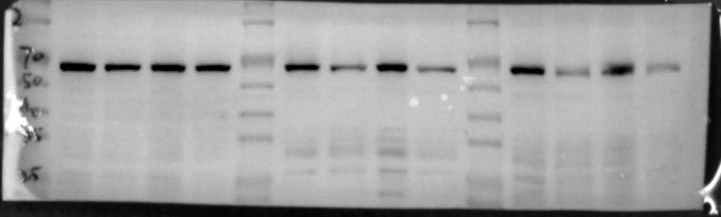
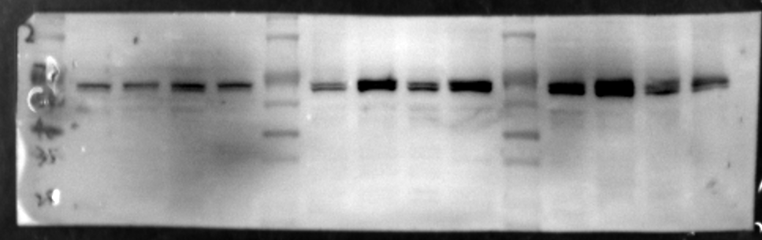
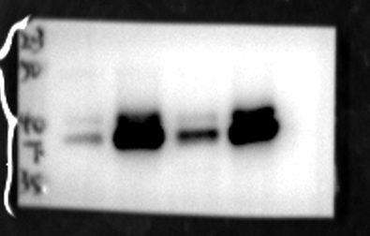
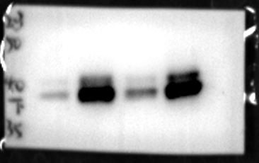
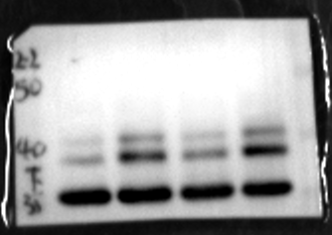
Fig 4C
Original blots
Blank TGF-α
Wortmannin - + - +
BP180
180 kDa
p-EGFR
170 kDa
EGFR
175 kDa
p-Akt
60 kDa
Akt
60 kDa
p-Erk
42 kDa
44 kDa
Erk
42 kDa
GAPDH
44 kDa
37 kDa

Slide 7





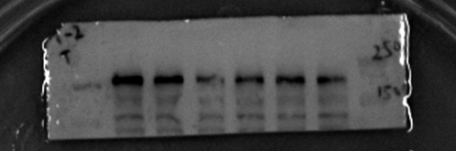





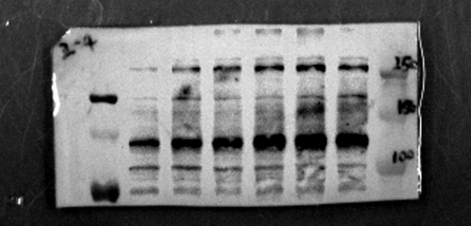

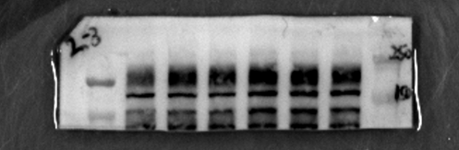
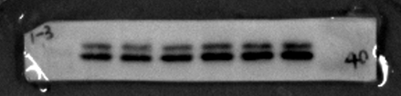
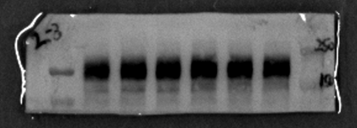
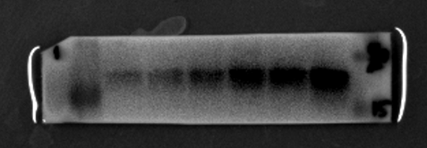
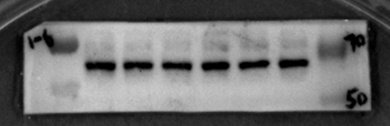
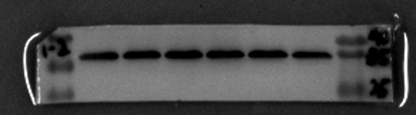
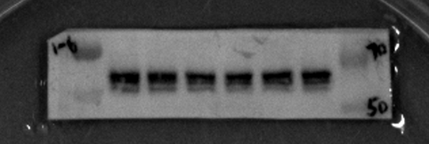
Fig 5C
TWEAK (48 h)
0 2 10 50 100 250 (ng/mL)
BP180
180 kDa
ADAM17
120 kDa
Original blots
p-EGFR
170 kDa
EGFR
175 kDa
p-Akt
60 kDa
Akt
60 kDa
p-Erk
42 kDa
44 kDa
Erk
42 kDa
Fn14
44 kDa
15 kDa
GAPDH
37 kDa

Slide 8

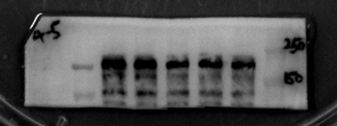






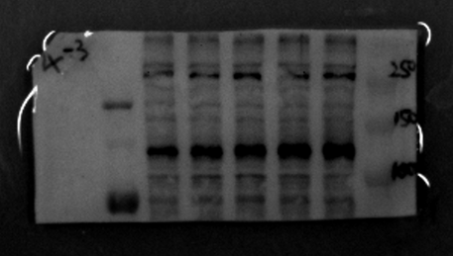



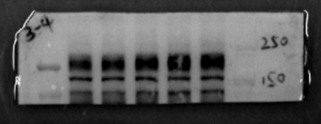
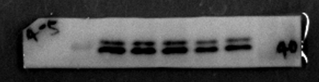
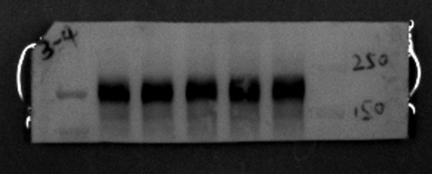
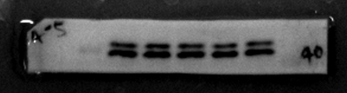
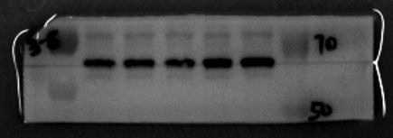
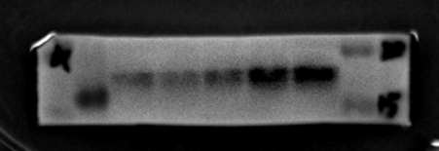
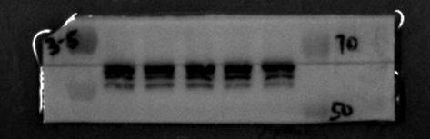
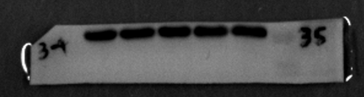
Fig 5E
Original blots
TWEAK (100 ng/mL)
0 6 24 48 72 (h)
BP180
180 kDa
ADAM17
120 kDa
p-EGFR
170 kDa
EGFR
175 kDa
p-Akt
60 kDa
Akt
60 kDa
p-Erk
42 kDa
44 kDa
Erk
42 kDa
Fn14
44 kDa
15 kDa
GAPDH
37 kDa

Slide 9


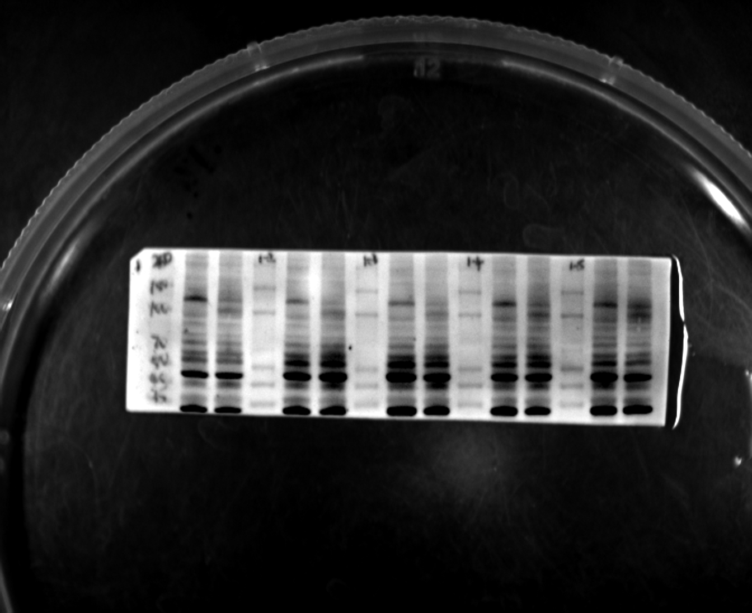
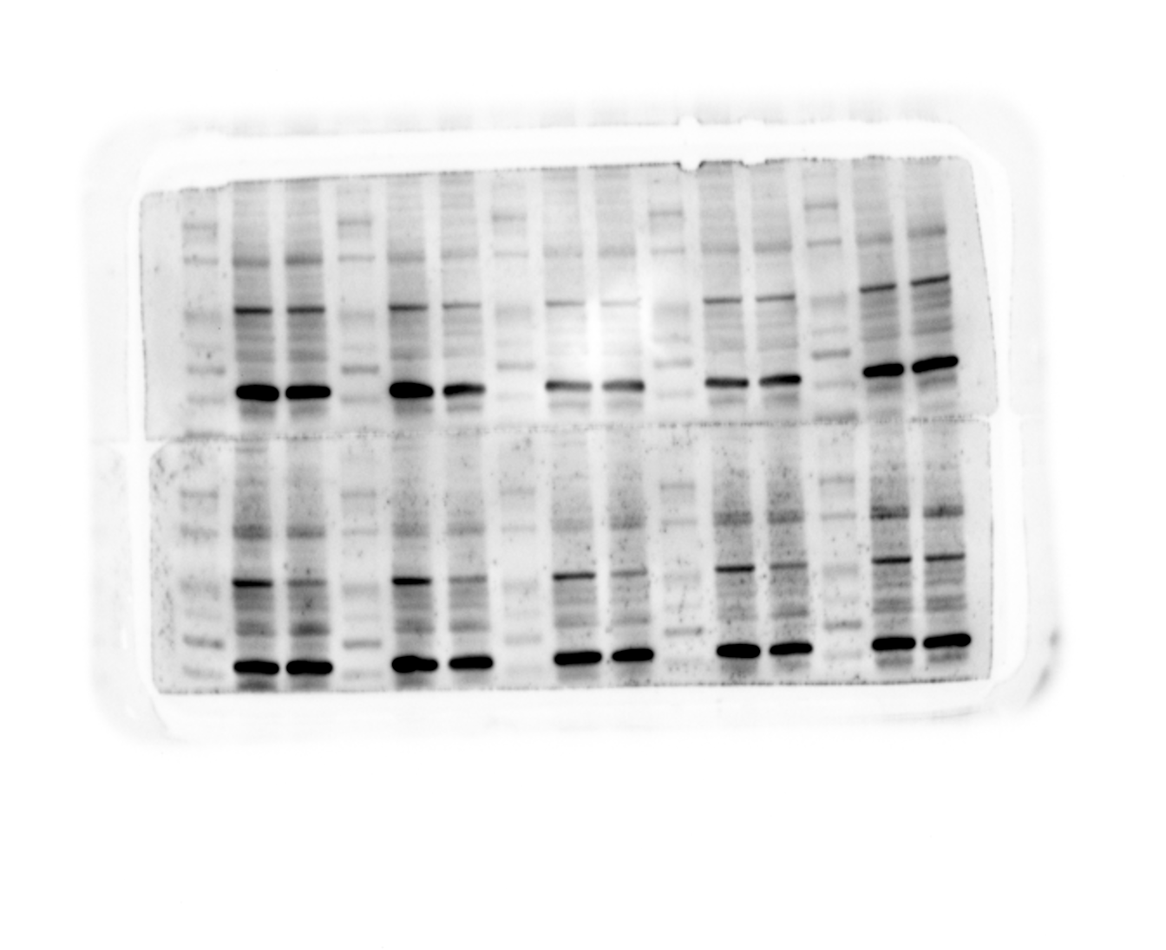
Fig 6B
Original blots
Blank TGF-α
ADAM17
120 kDa
GAPDH
37 kDa
PBS
TGF-α
PBS
TGF-α
PBS
TGF-α
ADAM17
135kDa
PBS
TGF-α
PBS
TGF-α
PBS
TGF-α
GAPDH
36kDa

Slide 10

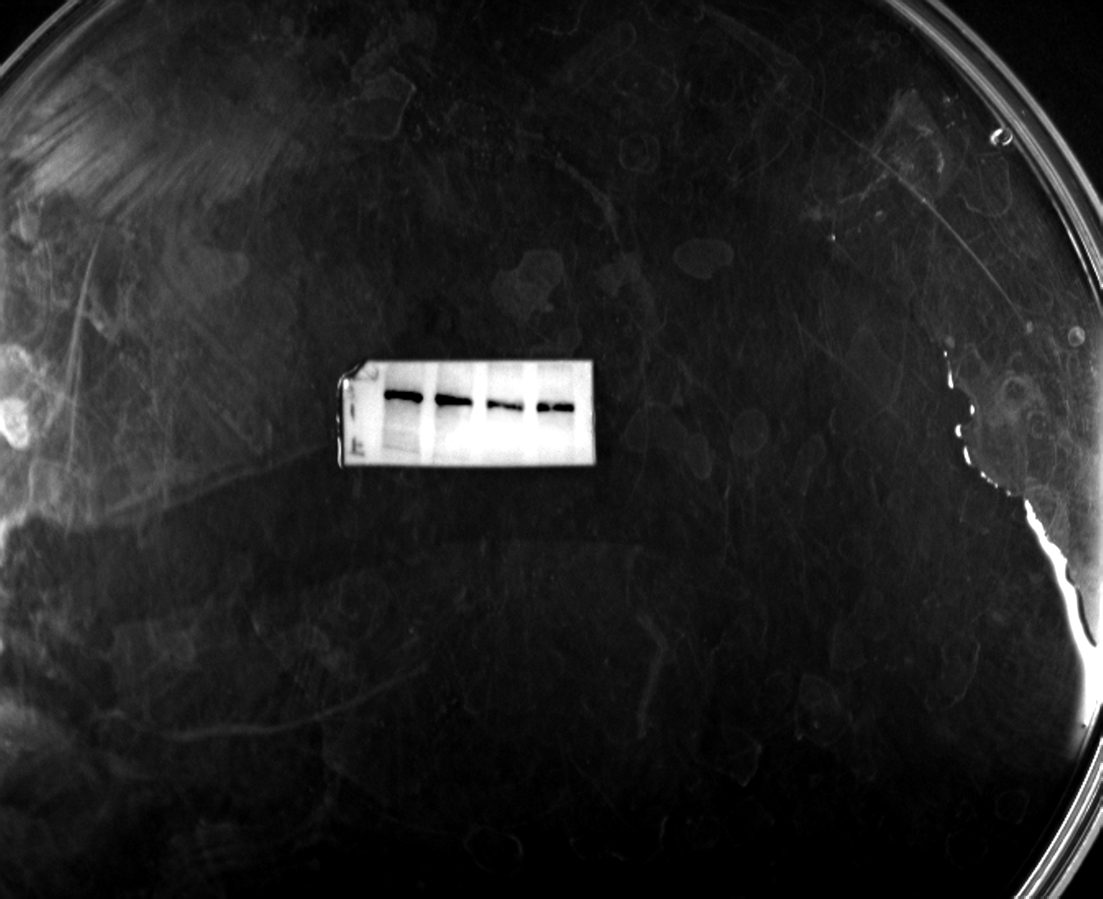











Fig 6C
Original blots
Blank TWEAK
TAPI-2 - + - +
BP180
180 kDa
p-EGFR
170 kDa
EGFR
175 kDa
MMP7
30 kDa
MMP8
53 kDa
MMP9
92 kDa
GAPDH
37 kDa

Slide 11




Fig S2E
Blank TGF-α
CHX - + - +
BP180
180 kDa
Original blots
GAPDH
37 kDa
PBS
CHX
TGF-α
CHX+TGF-α
BP180
180kDa
PBS
CHX
TGF-α
CHX+TGF-α
37kDa

Slide 12




Fig S2F
Blank TGF-α
Original blots
MG132 - + - +
BP180
180 kDa
GAPDH
37 kDa
PBS
MG132
TGF-α
MG132+TGF-α
BP180
180kDa
PBS
MG132
TGF-α
MG132+TGF-α
GAPDH
37kDa

Slide 13



Fig S4A
Original blots

