Slide 1



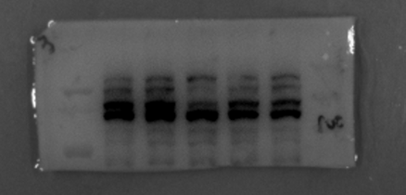
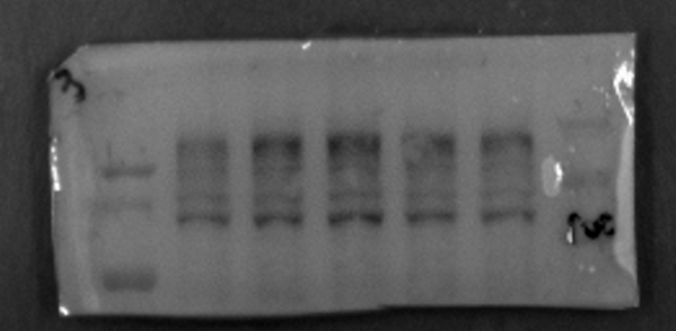
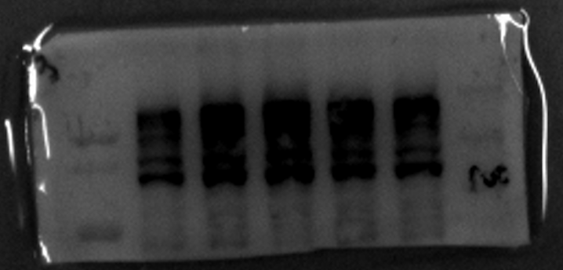
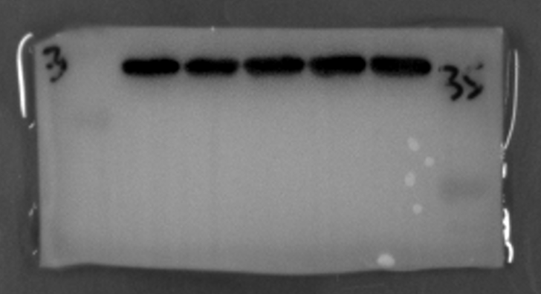
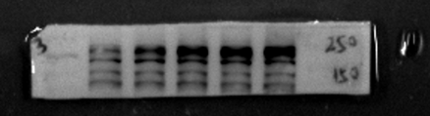
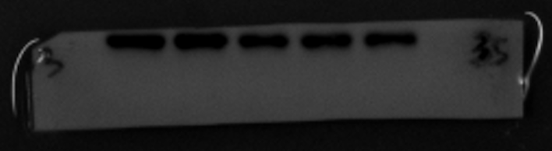

Fig2C
TGF-α (100 ng/mL)
0 5 15 30 60 (min)
180 kDa
BP180
120 kDa
p-EGFR
170 kDa
EGFR
175 kDa
GAPDH
37 kDa
a
Original blots
p-EGFR
BP180
p-EGFR
d
GAPDH for BP180
b
P-EGFR
GAPDH for p-EGFR and EGFR
c
EGFR

Slide 2




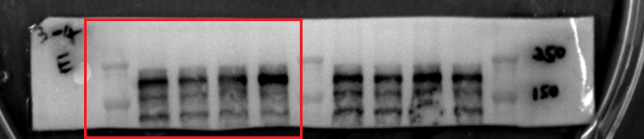
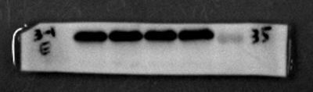
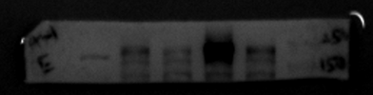
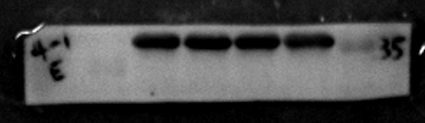
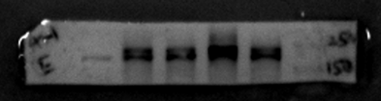
Fig2D
Blank TGF-α
Erlotinib - + - +
BP180
180 kDa
p-EGFR
170 kDa
EGFR
175 kDa
GAPDH
37 kDa
Original blots
a
BP180
d
GAPDH for BP180
b
p-EGFR
GAPDH for P-EGFR and EGFR
c
EGFR

Slide 3




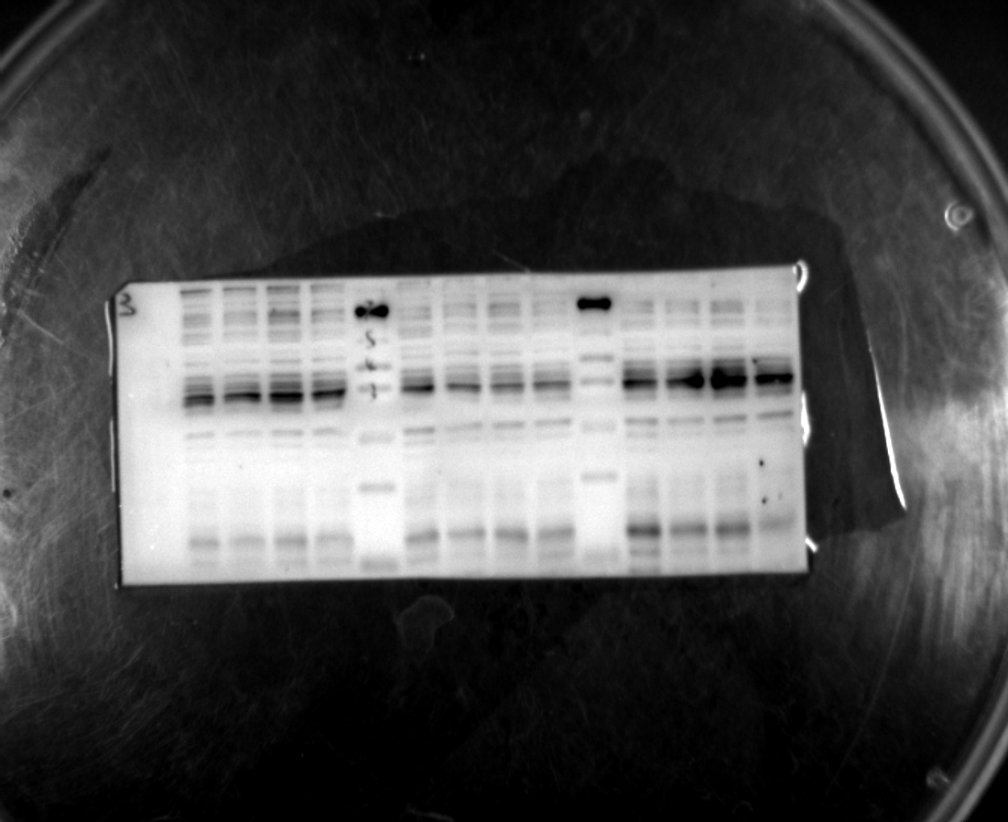
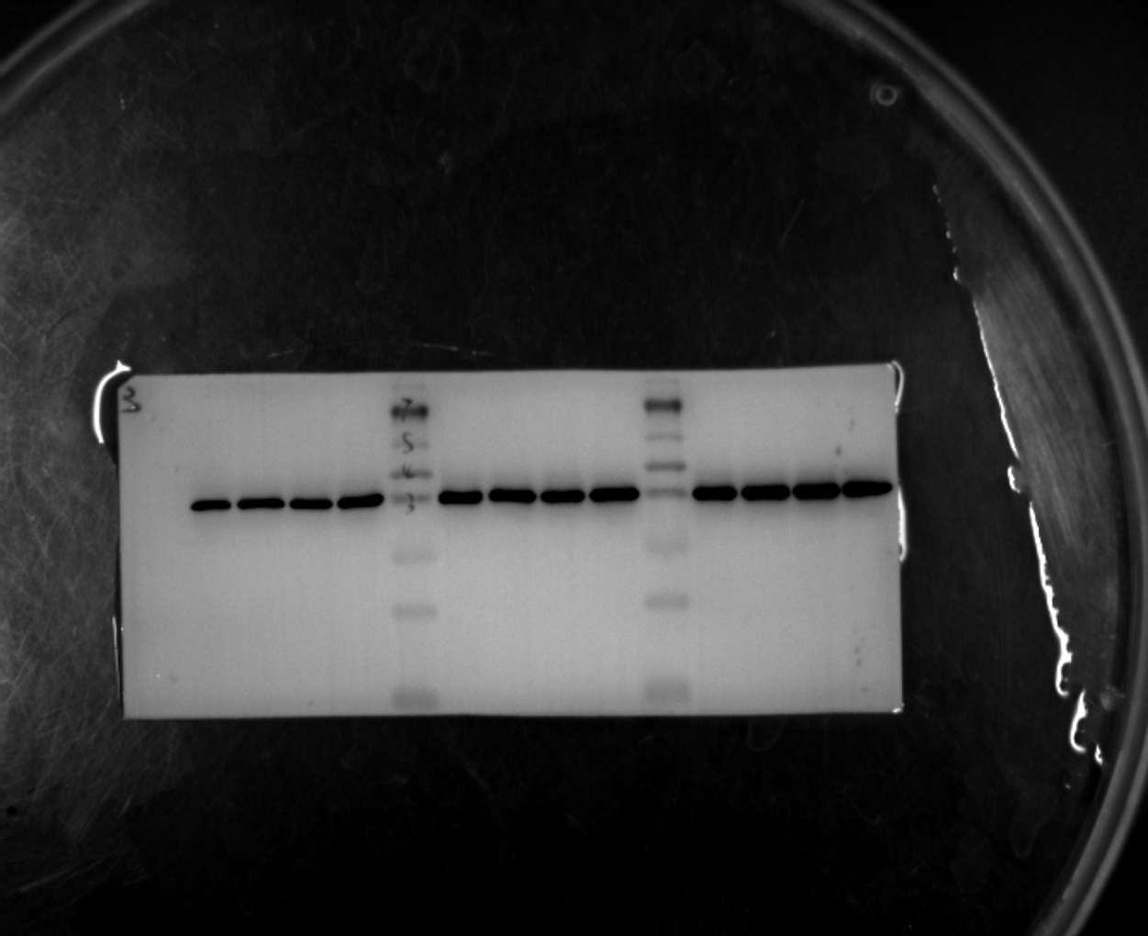
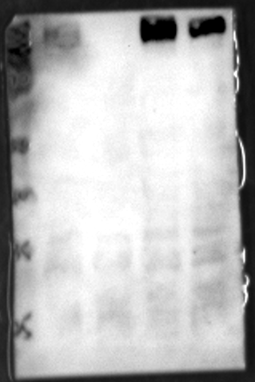
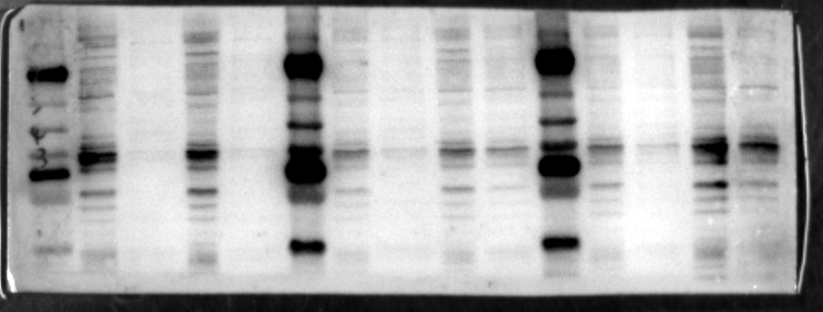
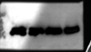
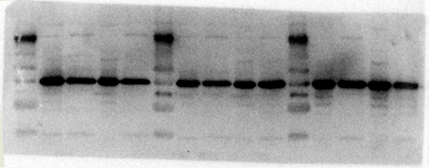
Fig3B
Blank TGF-α
Erlotinib - + - +
MMP7
30 kDa
MMP8
53 kDa
MMP9
92 kDa
GAPDH
37 kDa
Original blots
a
MMP7
b
GAPDH
e
MMP9
c
MMP8
d
GAPDH
f
GAPDH

Slide 4





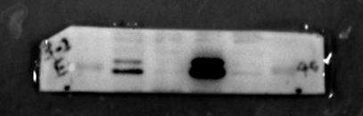
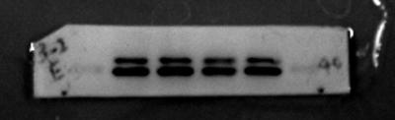
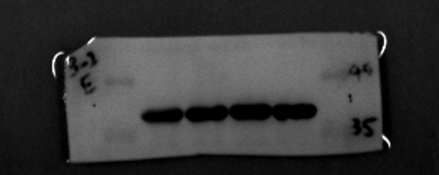
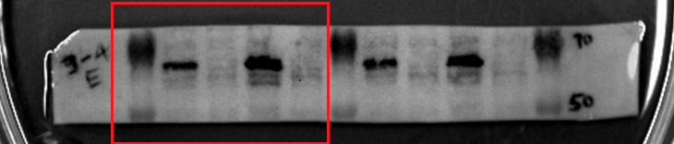
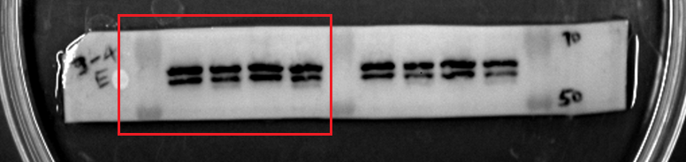
Fig4 A
Blank TGF-α
Erlotinib - + - +
P-Erk
42 kDa
44 kDa
Erk
42 kDa
44 kDa
P-Akt
60 kDa
Akt
60 kDa
GAPDH
37 kDa
Original blots
a
P-ERK
b
ERK
e
GAPDH
c
P-AKT
d
AKT

Slide 5






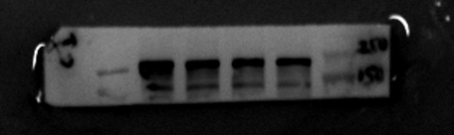
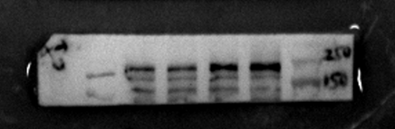
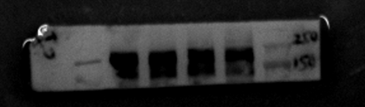
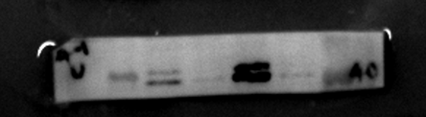
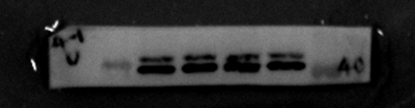
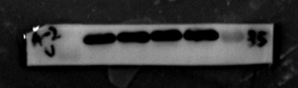
Fig4 B
Blank TGF-α
U0126 - + - +
BP180
180 kDa
p-EGFR
170 kDa
EGFR
175 kDa
p-Erk
42 kDa
44 kDa
Erk
42 kDa
GAPDH
44 kDa
37 kDa
Original blots
a
BP180
b
P-EGFR
c
EGFR
d
P-ERK
e
ERK
f
GAPDH

Slide 6
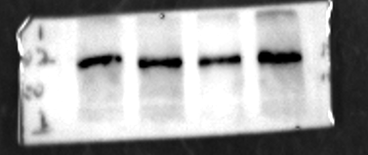

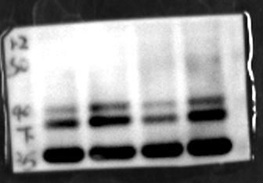






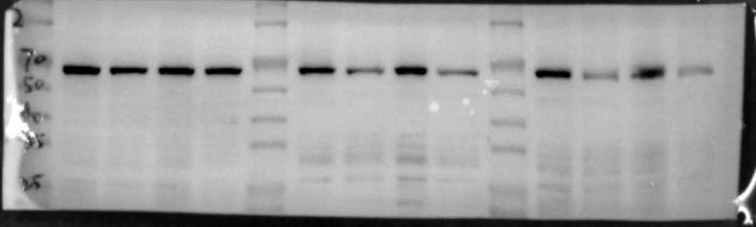
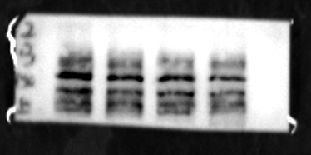
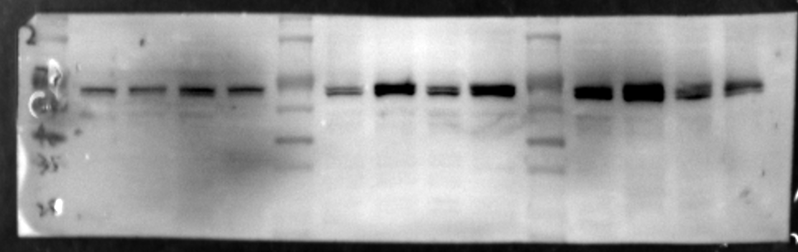
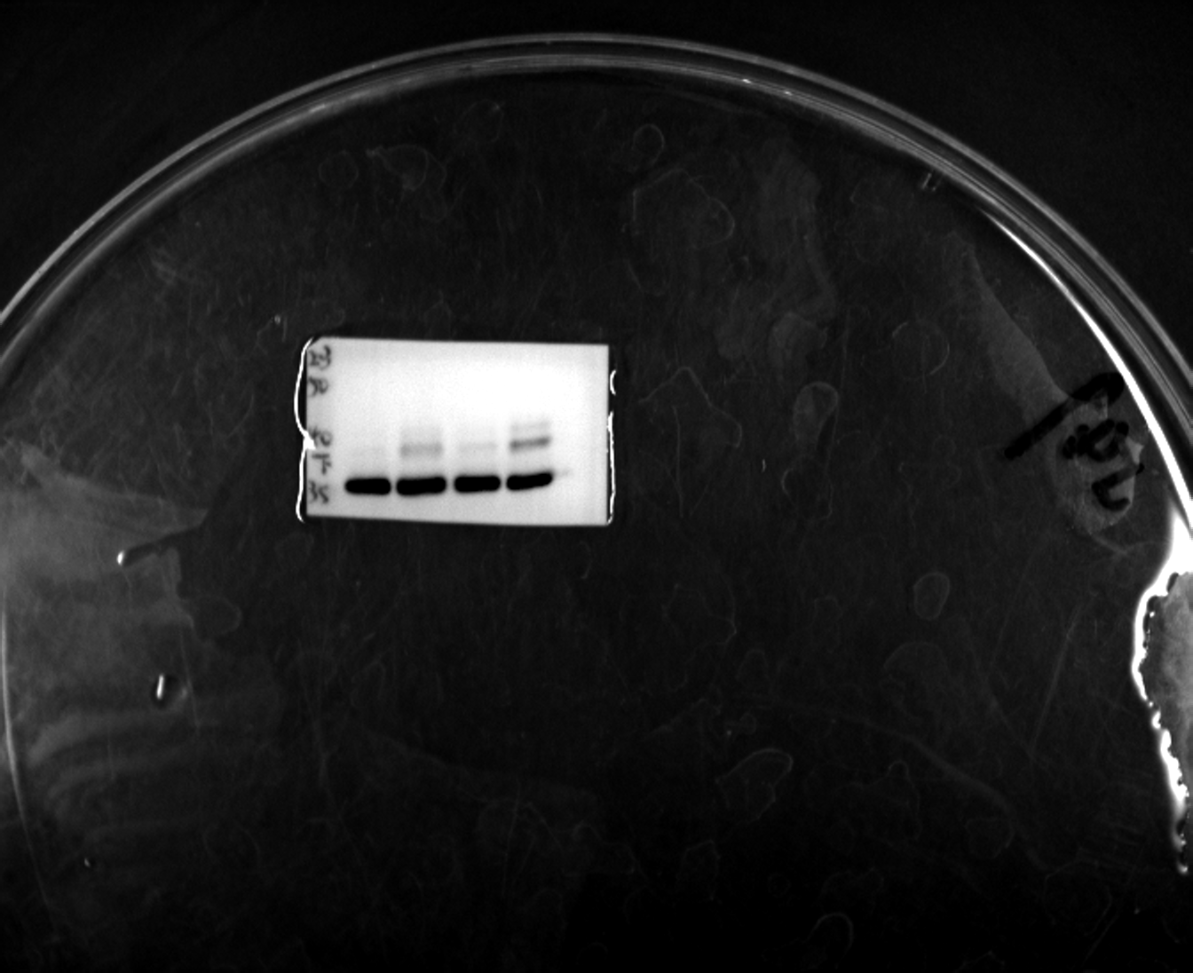
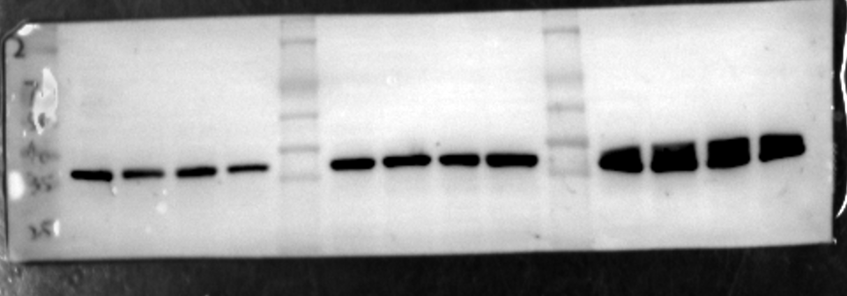
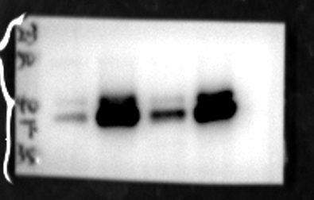
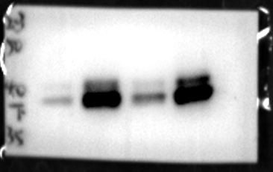
Fig4C
a
BP180
Blank TGF-α
Wortmannin - + - +
b
BP180
180 kDa
GAPDH
p-EGFR
170 kDa
EGFR
175 kDa
p-Akt
60 kDa
Akt
60 kDa
p-Erk
42 kDa
44 kDa
c
Erk
42 kDa
p-EGFR
GAPDH
44 kDa
37 kDa
f
p-Akt
d
EGFR
g
Akt
e
GAPDH
h
GAPDH
i
p-Erk
j
Erk
k
GAPDH

Slide 7
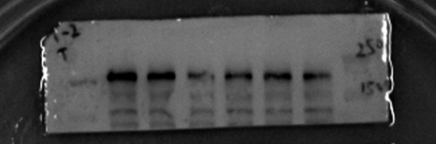





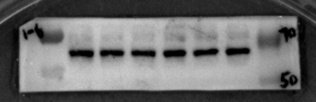





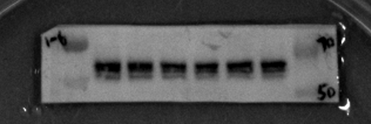
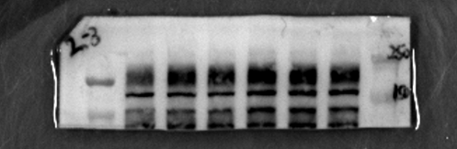
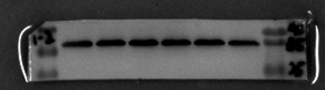
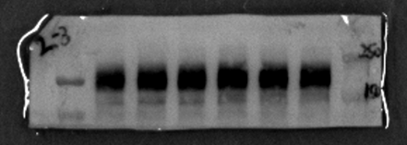
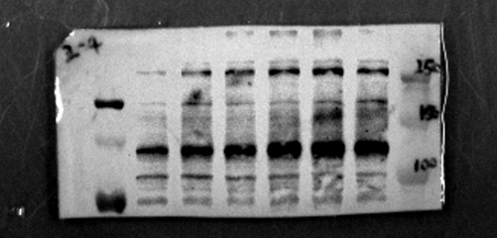

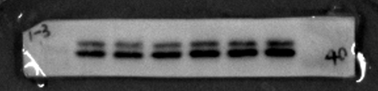
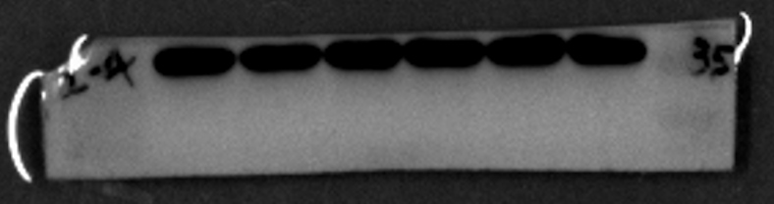
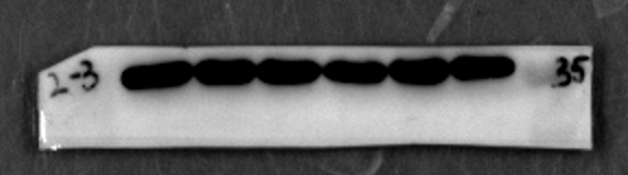
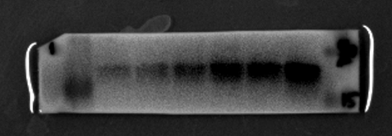
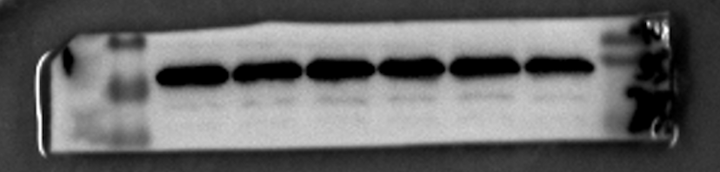
Fig5C
TWEAK (48 h)
a
Original blots
0 2 10 50 100 250 (ng/mL)
BP180
BP180
180 kDa
ADAM17
120 kDa
p-EGFR
170 kDa
EGFR
175 kDa
b
p-Akt
60 kDa
P-AKT
Akt
60 kDa
p-Erk
42 kDa
44 kDa
Erk
42 kDa
Fn14
44 kDa
c
15 kDa
AKT
i
GAPDH
37 kDa
P-EGFR
d
GAPDH
j
EGFR
e
ADAM17
k
P-ERK
l
ERK
f
m
GAPDH
GAPDH
g
Fn14
h
GAPDH

Slide 8
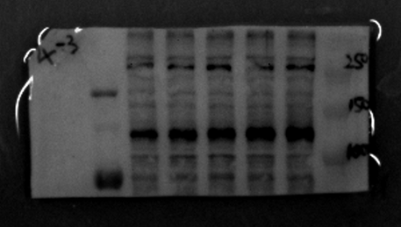






















Fig5E
Original blots
TWEAK (100 ng/mL)
g
ADAM17
0 6 24 48 72 (h)
BP180
180 kDa
ADAM17
120 kDa
p-EGFR
170 kDa
EGFR
175 kDa
p-Akt
60 kDa
Akt
60 kDa
p-Erk
42 kDa
44 kDa
h
Erk
42 kDa
GAPDH
Fn14
44 kDa
15 kDa
a
GAPDH
37 kDa
BP180
i
P-EGFR
b
P-AKT
j
EGFR
c
AKT
k
GAPDH
d
P-ERK
e
ERK
l
FN14
f
GAPDH
m
GAPDH

Slide 9




Fig6B
Original blots
Blank TGF-α
ADAM17
120 kDa
GAPDH
37 kDa
a
PBS
TGF-α
PBS
TGF-α
PBS
TGF-α
ADAM17
135kDa
b
PBS
TGF-α
PBS
TGF-α
PBS
TGF-α
GAPDH
36kDa

Slide 10
















Fig6C
a
BP180
Blank TWEAK
TAPI-2 - + - +
BP180
180 kDa
b
GAPDH
p-EGFR
170 kDa
EGFR
175 kDa
MMP7
30 kDa
MMP8
53 kDa
MMP9
92 kDa
GAPDH
37 kDa
e
p-EGFR
c
MMP8
f
EGFR
d
GAPDH
g
GAPDH
h
MMP7
j
MMP9
i
GAPDH
k
GAPDH

Slide 11




FigS2E
Blank TGF-α
CHX - + - +
BP180
180 kDa
Original blots
GAPDH
37 kDa
PBS
CHX
TGF-α
CHX+TGF-α
BP180
180kDa
PBS
CHX
TGF-α
CHX+TGF-α
37kDa

Slide 12




FigS2F
Blank TGF-α
Original blots
MG132 - + - +
BP180
180 kDa
GAPDH
37 kDa
PBS
MG132
TGF-α
MG132+TGF-α
BP180
180kDa
PBS
MG132
TGF-α
MG132+TGF-α
GAPDH
37kDa

Slide 13



FigS4A
Original blots

