Slide 1
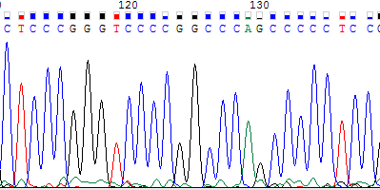
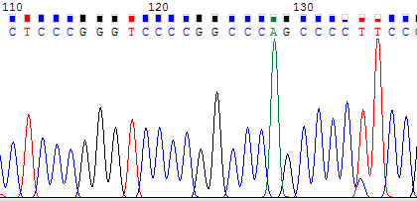
Supplementary Figure 2
SFT-24
→
→
SFT-28
→
-124C＞T
→

