Slide 1
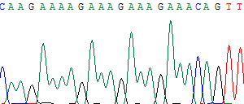
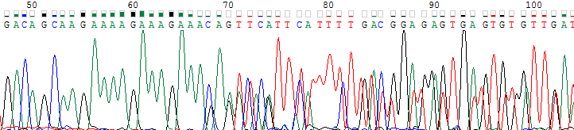
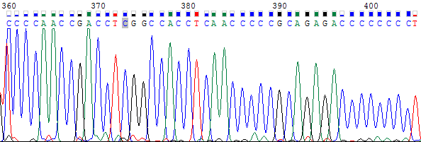
Supplementary Figure 3
Primary tumor
Metastatic tumor
DNAH8
N·A
SYNJ2

