Slide 1
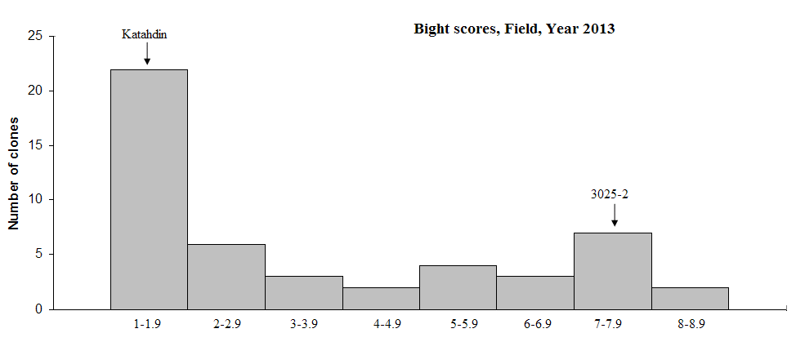
Supplementary figure 1
Notes:
Table 2. Segregation of disease resistance and co-segregating marker 184-81 in the BC1 populations (MaR9 x Concurrent) x Katahdin
In population3154, the resistance to IPO-C is fully co-segregating to marker 184-81, whereas in population3151 six plants which were resistant
but had no marker band were observed. R: resistant, S: susceptible, ab: presence of the marker band, aa: absence of the marker band

