Slide 1
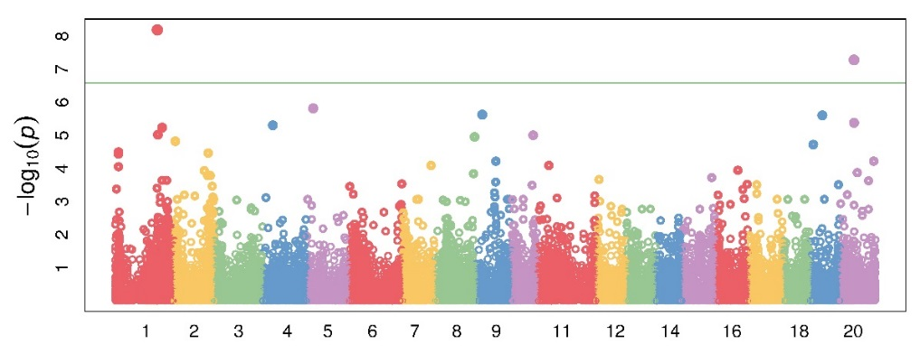
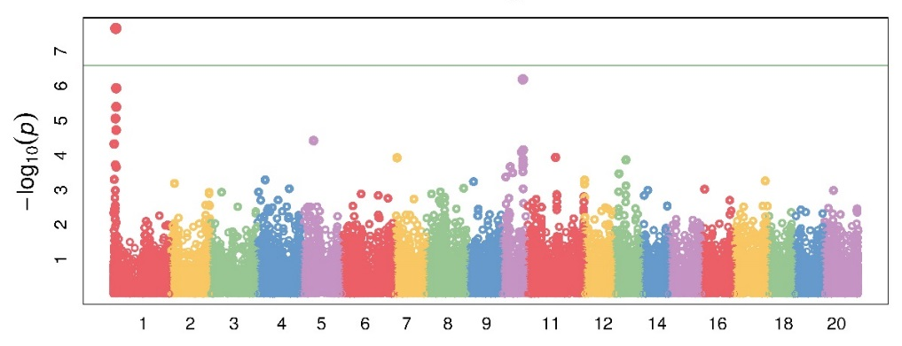
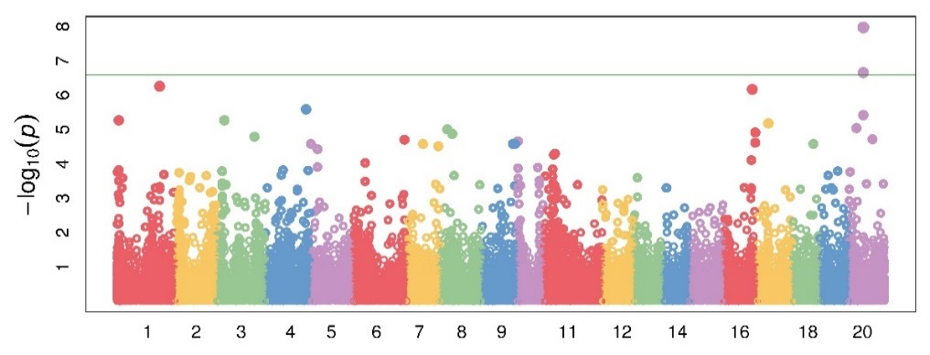
Alkaloid
Flowering time
Flower colour
Online Resource 8 Manhattan plots of genome-wide association study (GWAS) using 38,948 SNPs markers for alkaloid status, flowering time and flower colour on 231 wild and domesticated narrow-leafed lupin accessions. The X-axis represents physical distance (Kb) along the 20 narrow-leafed lupin chromosomes, NLL-01 to NLL-20. SNPs above the threshold line (green line; -log10(p)=6) are significantly associated with related traits

