Slide 1
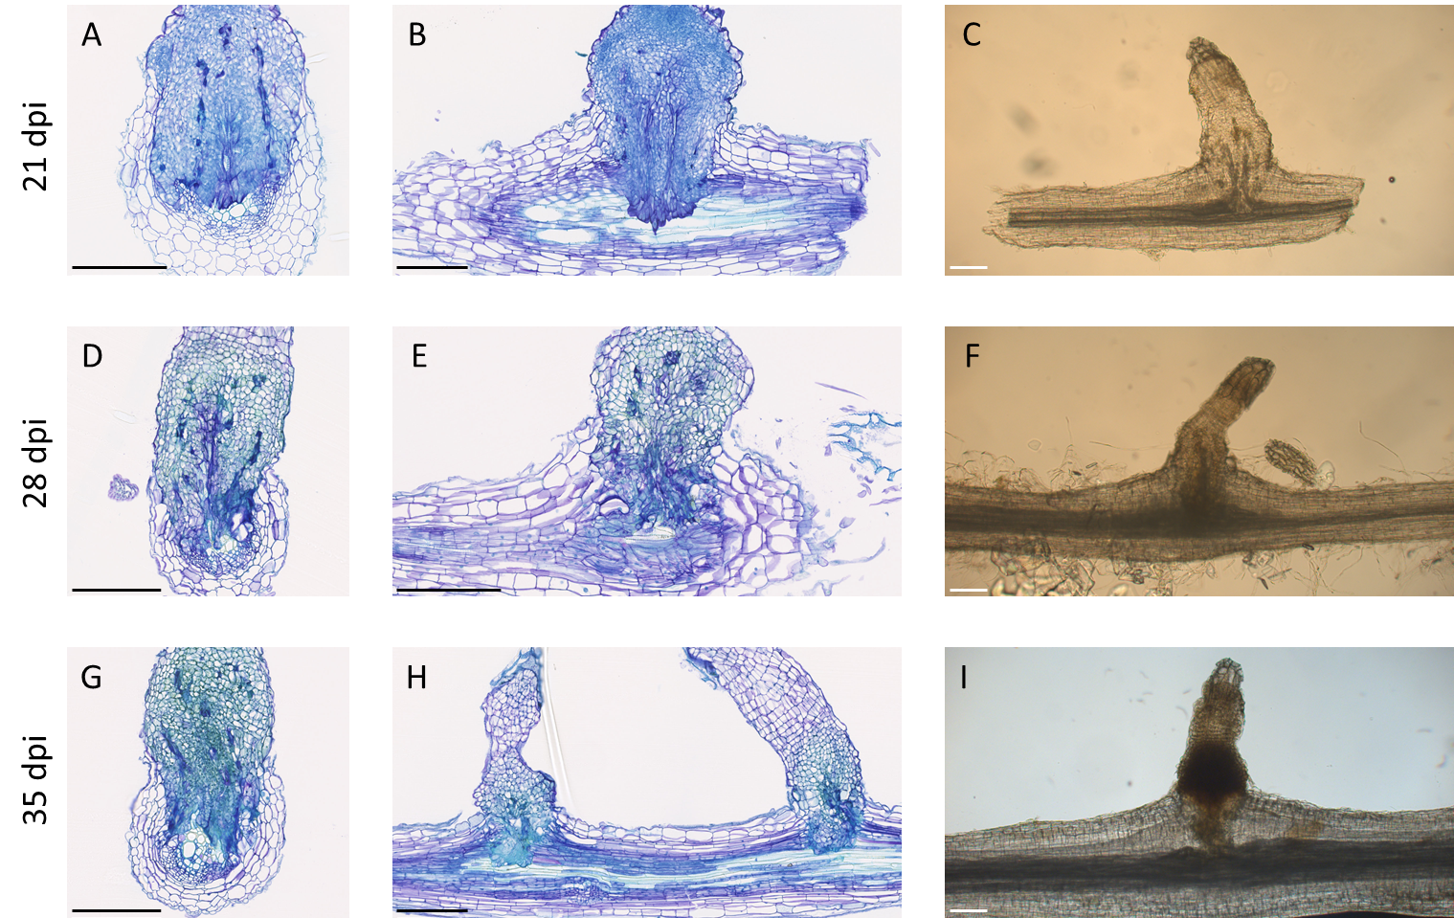
Figure S4. O cumana connected to the sunflower root of ANOM1 resistant line at 21 (A-C), 28 (D-F) and 35 (G-I) dpi. Transversal and longitudinal thin sections stained with TBO shows xylem in light blue and phenolic compounds accumulation in green. Whole cleared samples shows xylem in dark grey and phenolic compounds in brownish staining. Black scale = 250µm; white scale= 100µm

