Slide 1
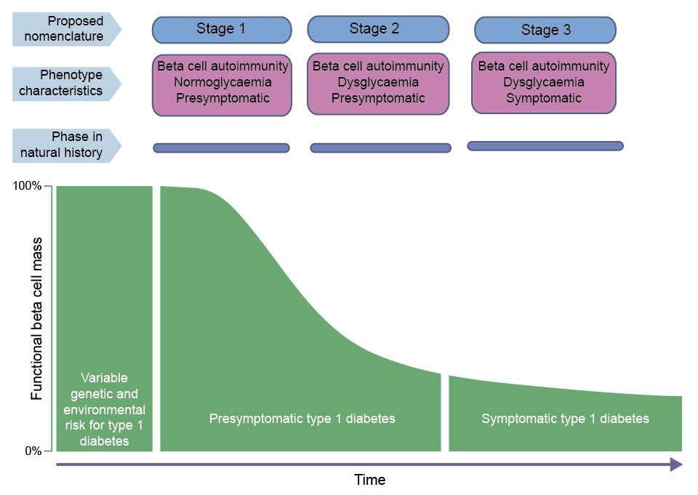
Insert figure
Proposed staging of type 1 diabetes
© 2015 The American Diabetes Association. Adapted with permission from Insel et al
Diabetologia DOI 10.1007/s00125-017-4308-1

Slide 2
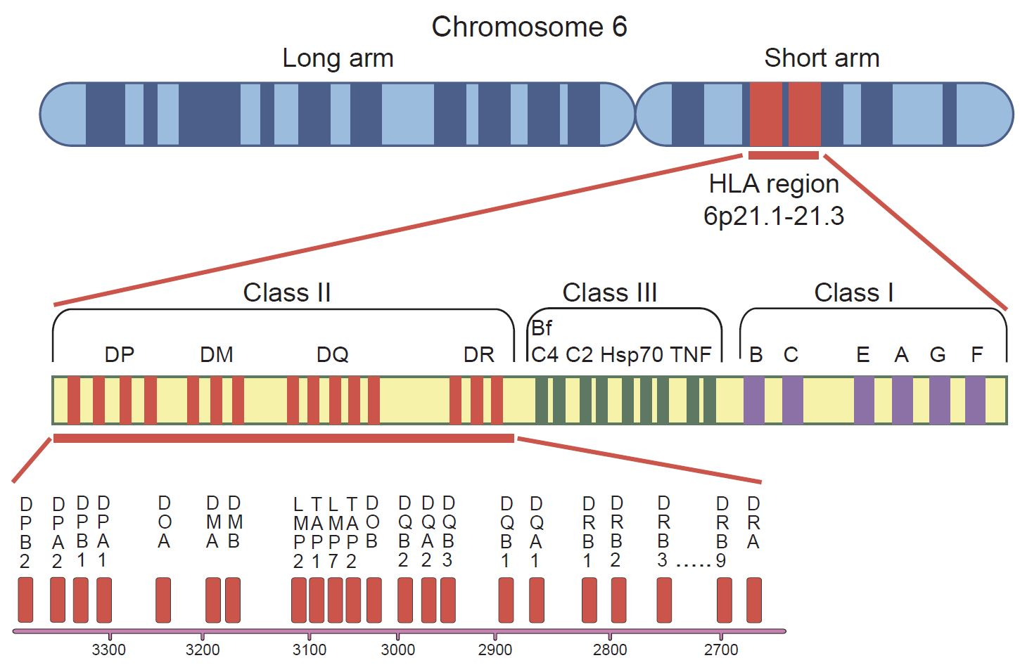
Insert figure
Map of the HLA DR-DQ-DP complex region on human chromosome 6
© Regnell and Lernmark 2017
Diabetologia DOI 10.1007/s00125-017-4308-1

