Slide 1
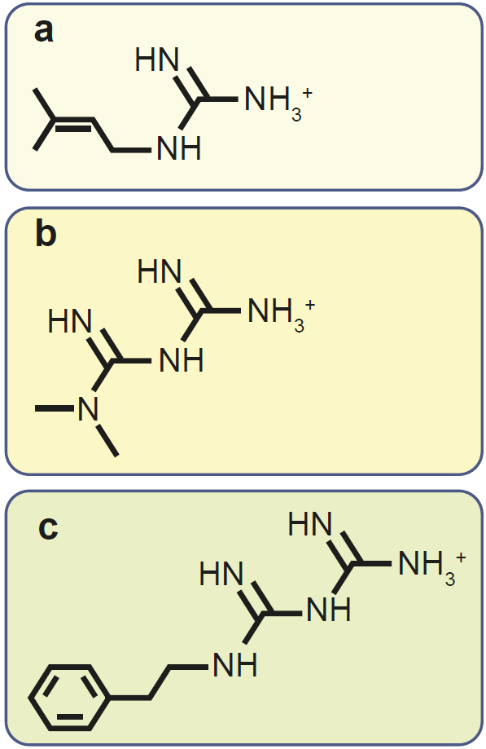
Chemical structures of galegine, metformin and phenformin
Rena et al (2017) Diabetologia DOI 10.1007/s00125-017-4342-z
© The Authors

Slide 2
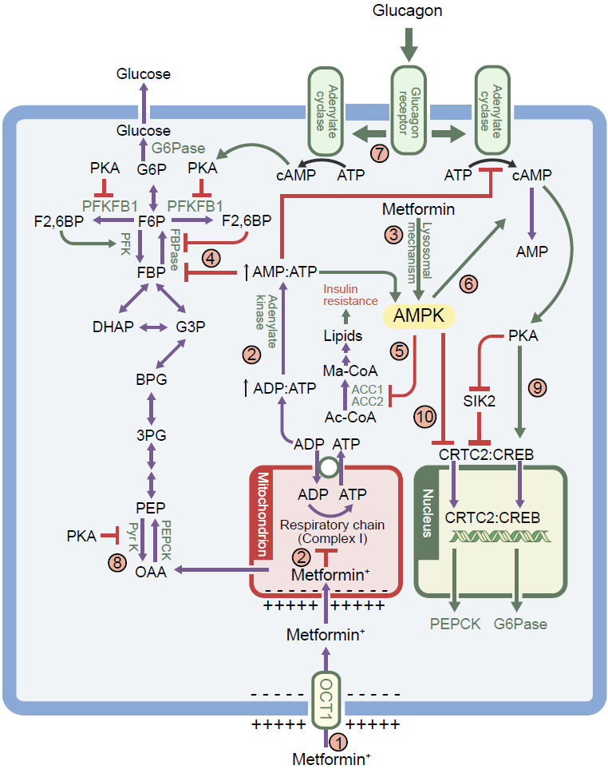
The multiple mechanism via which metformin affects liver metabolism
Rena et al (2017) Diabetologia DOI 10.1007/s00125-017-4342-z
© The Authors

Slide 3
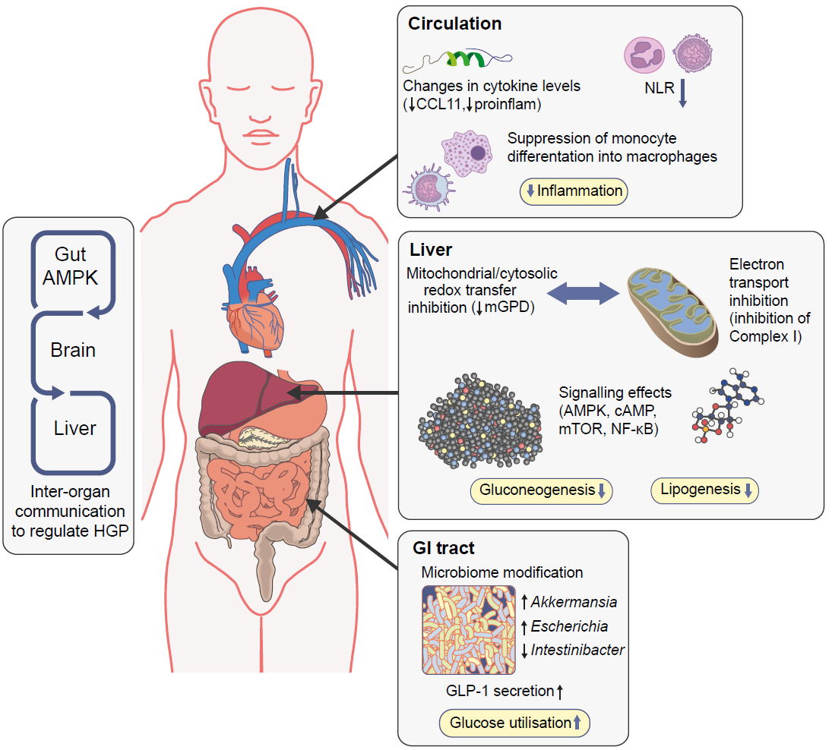
Actions of metformin on metabolism and inflammation
Rena et al (2017) Diabetologia DOI 10.1007/s00125-017-4342-z
© The Authors

