Slide 1
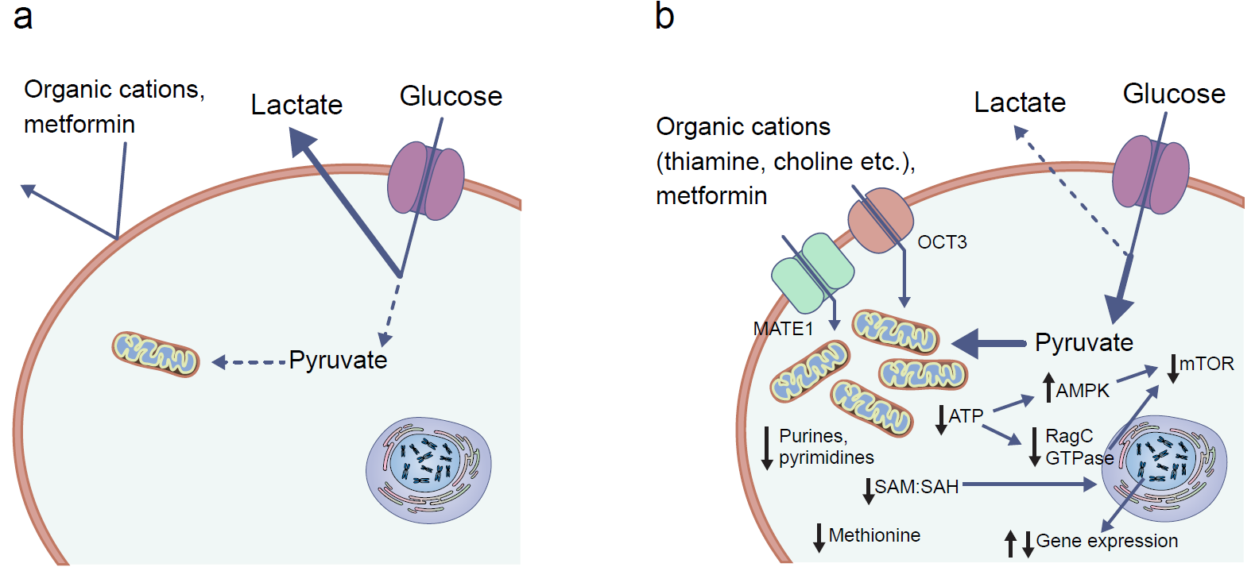
Model showing that susceptibility to metformin depends on the presence of metformin transporters and maturity of mitochondrial function
Lindsay and Loeken (2017) Diabetologia DOI 10.1007/s00125-017-4351-y
© The Authors

