Slide 1
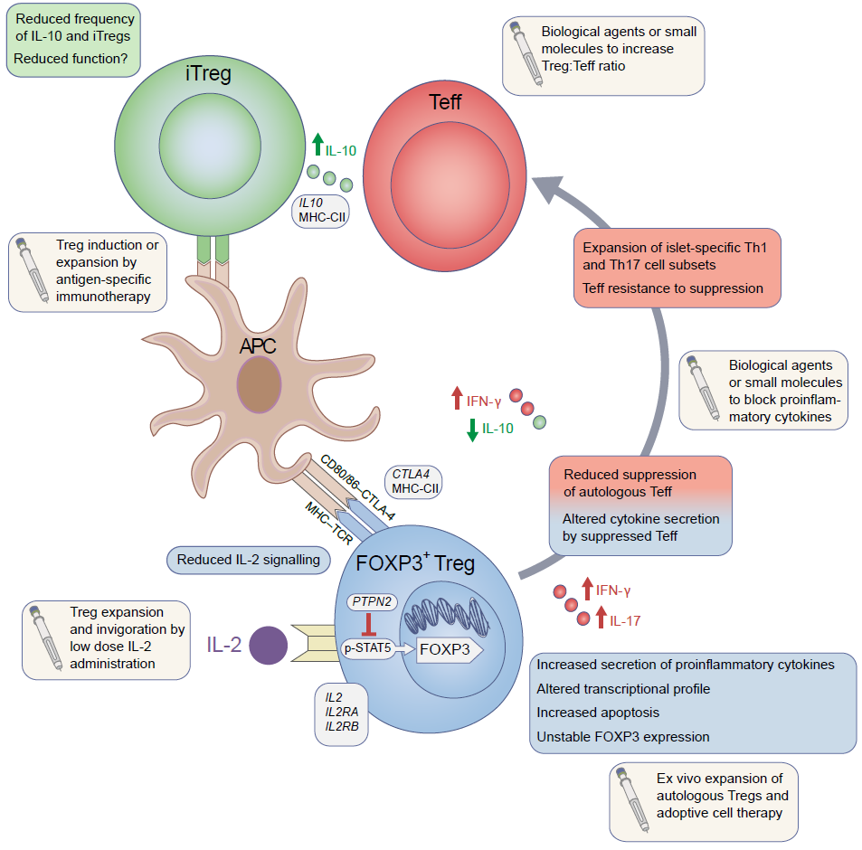
Alterations in Treg phenotype and function observed in type 1 diabetes
Hull et al (2017) Diabetologia DOI 10.1007/s00125-017-4377-1
© The Authors

