Slide 1
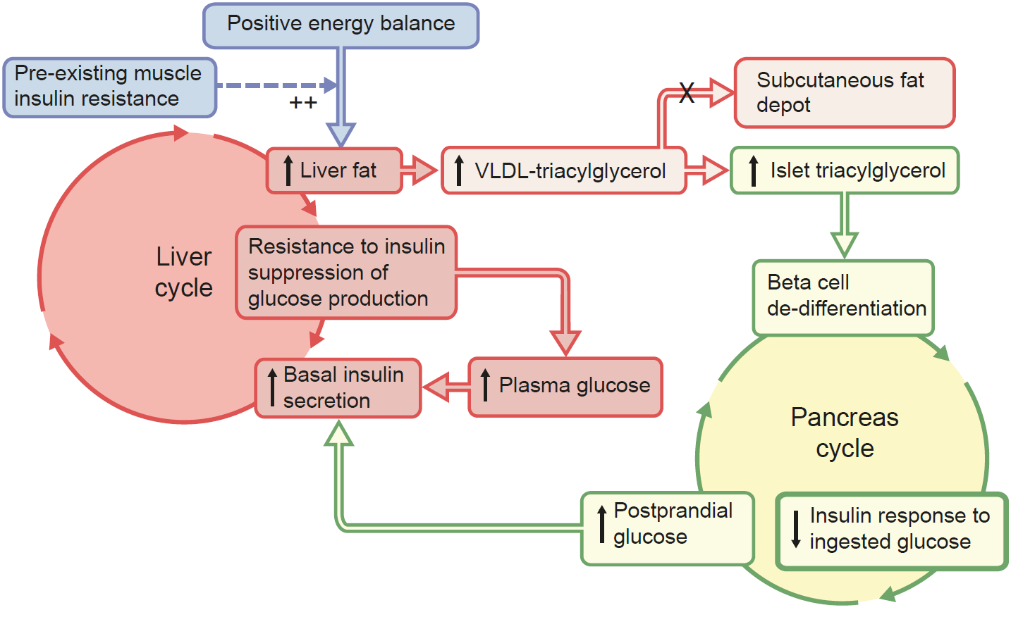
The 2008 twin cycle hypothesis
Taylor and Barnes (2017) Diabetologia DOI 10.1007/s00125-017-4504-z
© 2008 Taylor. Adapted from Taylor

Slide 2
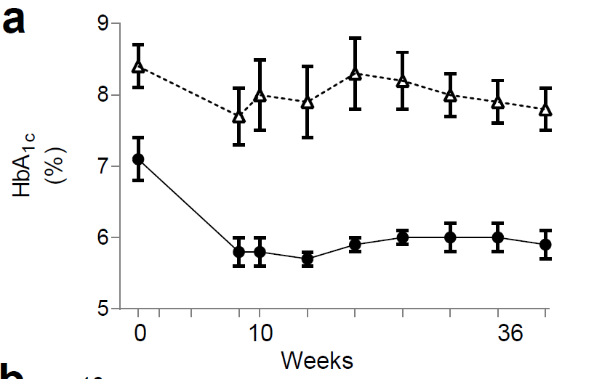
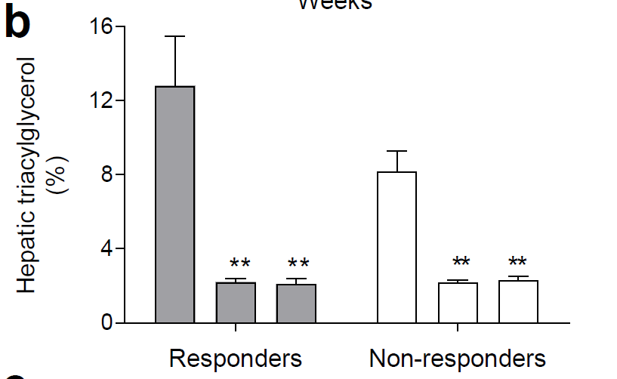

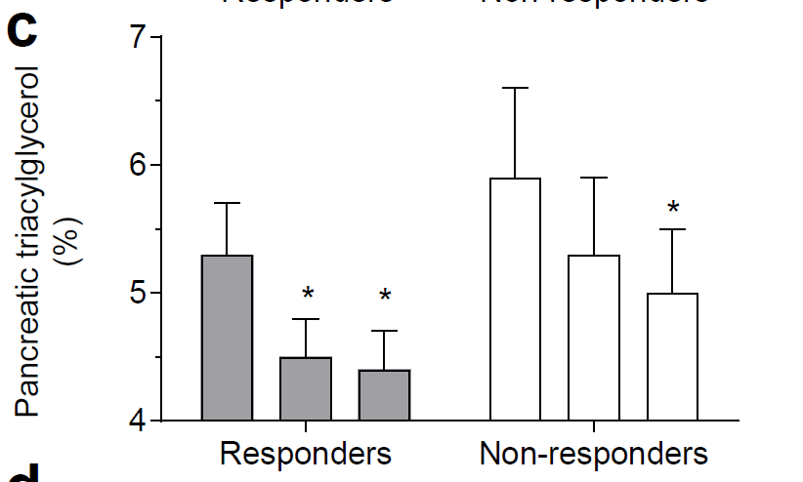
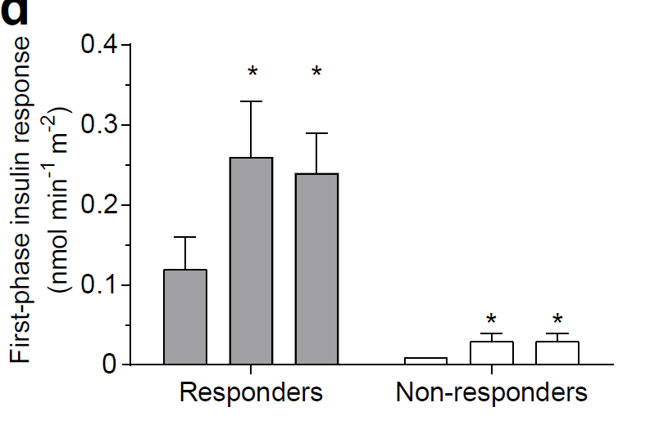
The Counterbalance study
Hepatic triglyceride
Pancreatic triglyceride
Line graph: circles, responders; triangles, non-responders
Bar charts: the columns for each group represent (from left to right): (1) baseline on usual drug therapy; (2) after weight loss, on an isoenergetic diet; and (3) after a further 6 months of weight stability
Taylor and Barnes (2017) Diabetologia DOI 10.1007/s00125-017-4504-z
© 2016 ADA. Copyright and all rights reserved. Published with permission from Steven et al

Slide 3
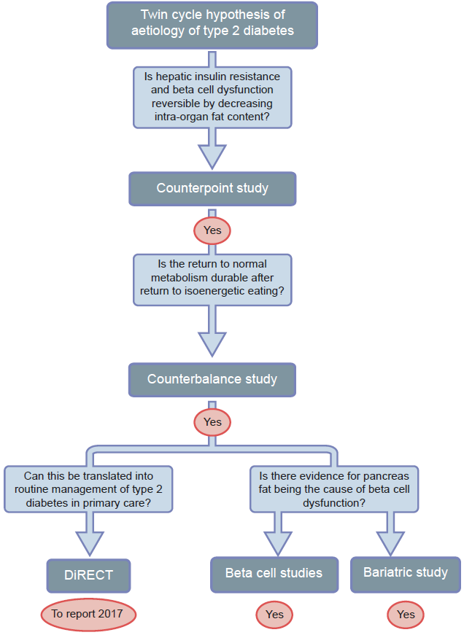
Testing the twin cycle hypothesis
Taylor and Barnes (2017) Diabetologia DOI 10.1007/s00125-017-4504-z
© The Authors

Slide 4
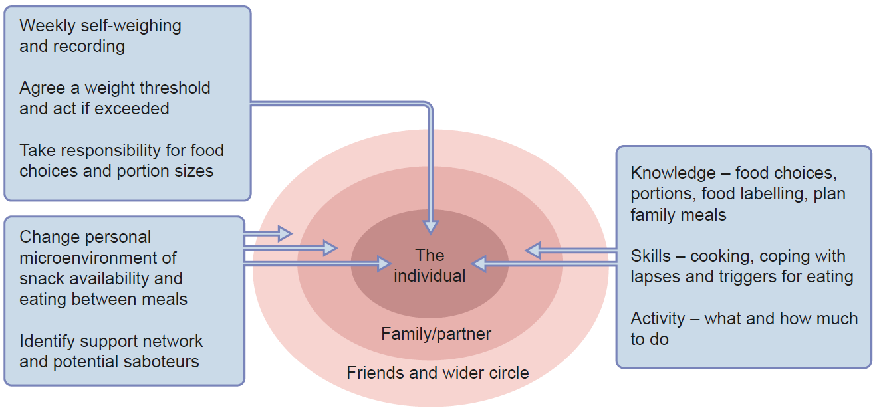
Components of support to provide long-term weight stability
Taylor and Barnes (2017) Diabetologia DOI 10.1007/s00125-017-4504-z
© The Authors

