Slide 1
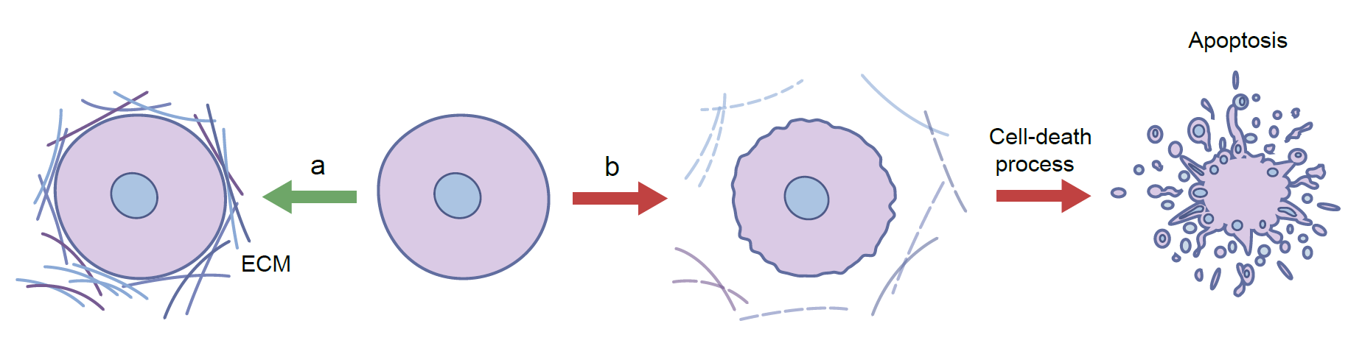
Cell function and survival is determined by ECM–cell interactions
Llacua et al (2017) Diabetologia DOI 10.1007/s00125-017-4524-8
© The Author(s) 2017

Slide 2
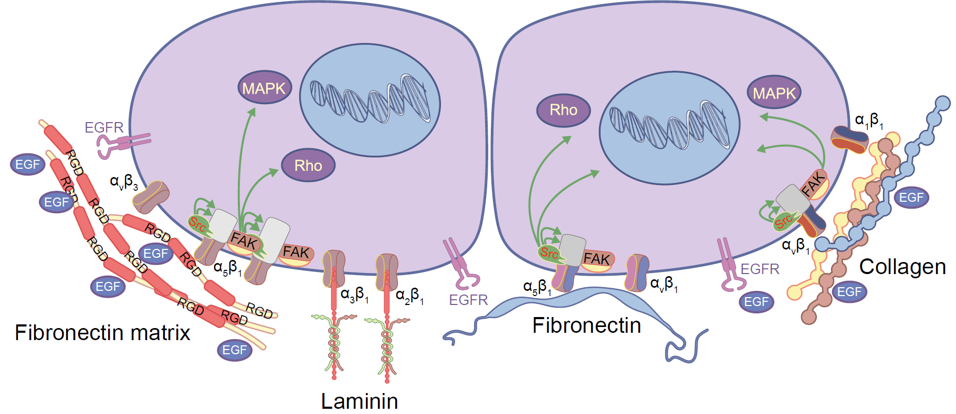
Summary of the current knowledge on ECM–cell interactions within islets
Llacua et al (2017) Diabetologia DOI 10.1007/s00125-017-4524-8
© The Author(s) 2017

Slide 3
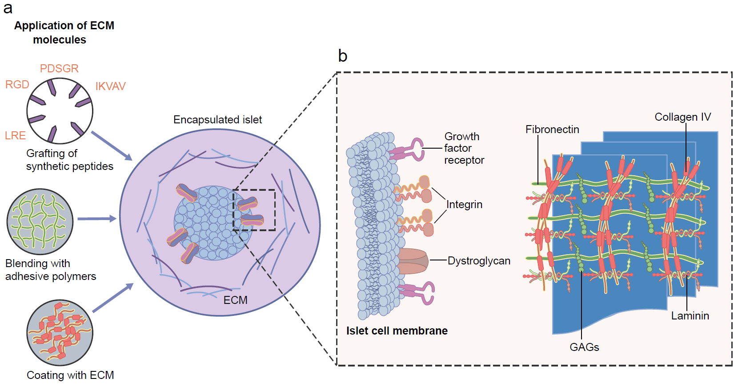
Supplementation of ECM in capsules for immuno-isolation of pancreatic islets enhance functional survival of the graft
Llacua et al (2017) Diabetologia DOI 10.1007/s00125-017-4524-8
© The Author(s) 2017

