Slide 1
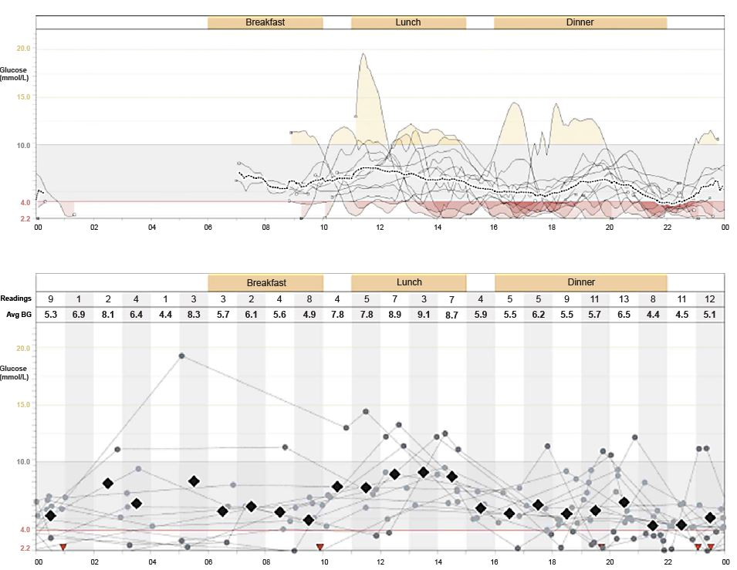
Download of data from a continuous glucose sensor (above) and capillary glucose monitoring (below) for a woman with long-duration type 1 diabetes
FIGURE HERE
Author Choudhary and Amiel (2018) Diabetologia DOI 10.1007/s00125-018-4566-6
© The Authors 2018. Distributed under the terms of the CC BY 4.0 Attribution License (http://creativecommons.org/licenses/by/4.0/)

