Slide 1
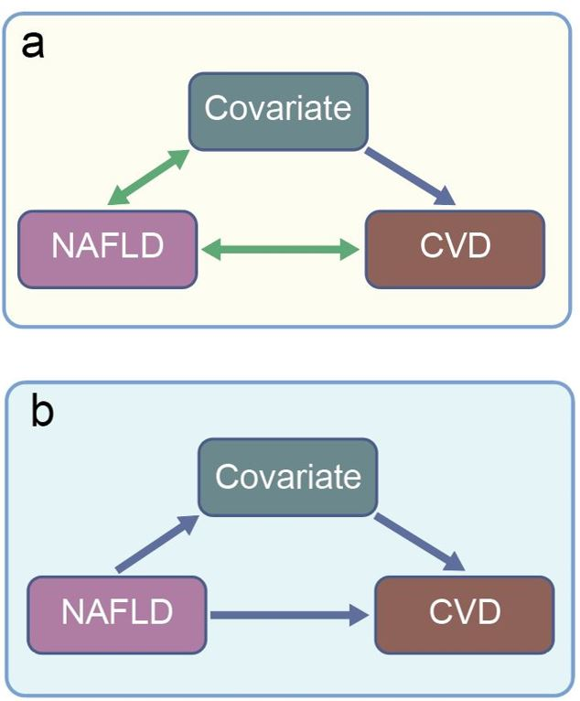
Confounding and mediation. The relationship between NAFLD and CVD, as reported in observational studies, can be explained by confounding or mediation
Brouwers et al (2020) Diabetologia DOI 10.1007/s00125-019-05024-3
©The Authors 2019. Distributed under the terms of the CC BY 4.0 Attribution License (http://creativecommons.org/licenses/by/4.0/)

Slide 2
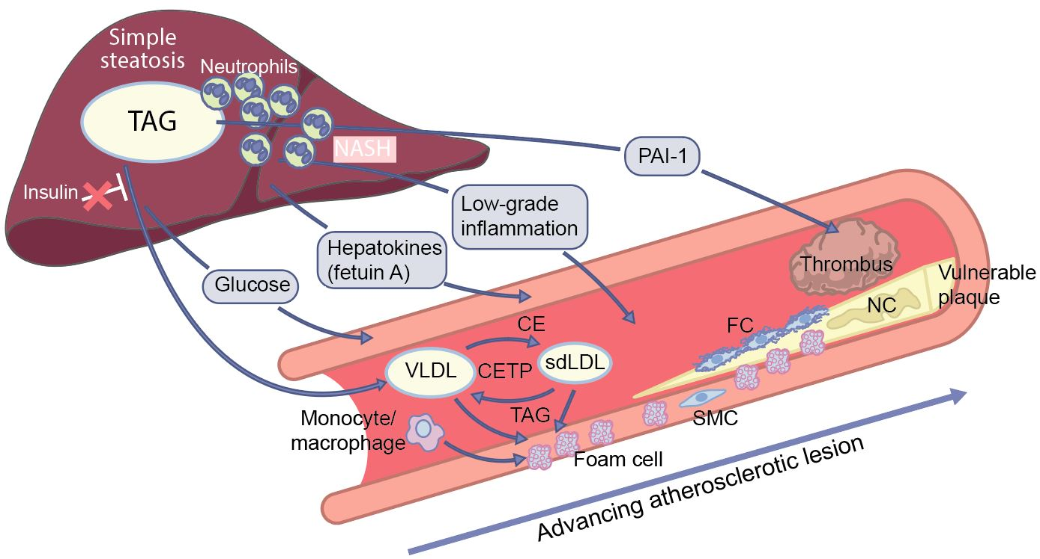
Biologically plausible mechanisms that link NAFLD to the pathogenesis of an atherosclerotic lesion
Brouwers et al (2020) Diabetologia DOI 10.1007/s00125-019-05024-3
©The Authors 2019. Distributed under the terms of the CC BY 4.0 Attribution License (http://creativecommons.org/licenses/by/4.0/)

Slide 3
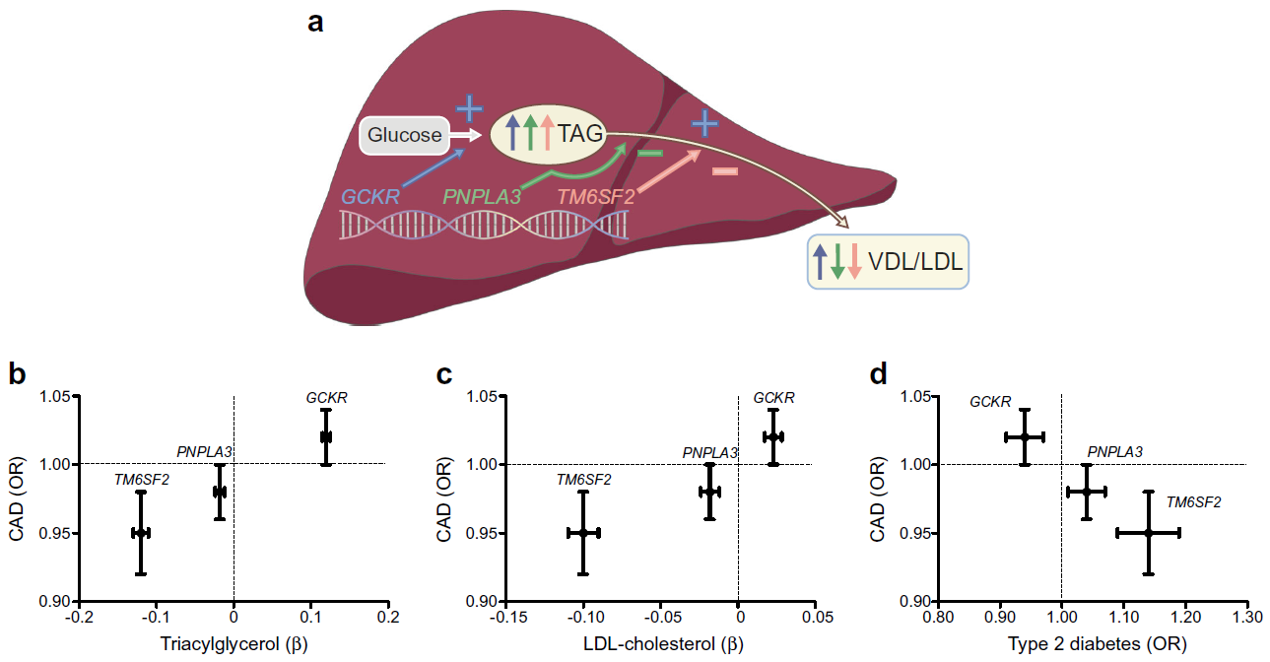
Relationship of GCKR, PNPLA3 and TM6SF2 with plasma lipids, type 2 diabetes and CAD
Brouwers et al (2020) Diabetologia DOI 10.1007/s00125-019-05024-3
©The Authors 2019. Distributed under the terms of the CC BY 4.0 Attribution License (http://creativecommons.org/licenses/by/4.0/)

