Slide 1
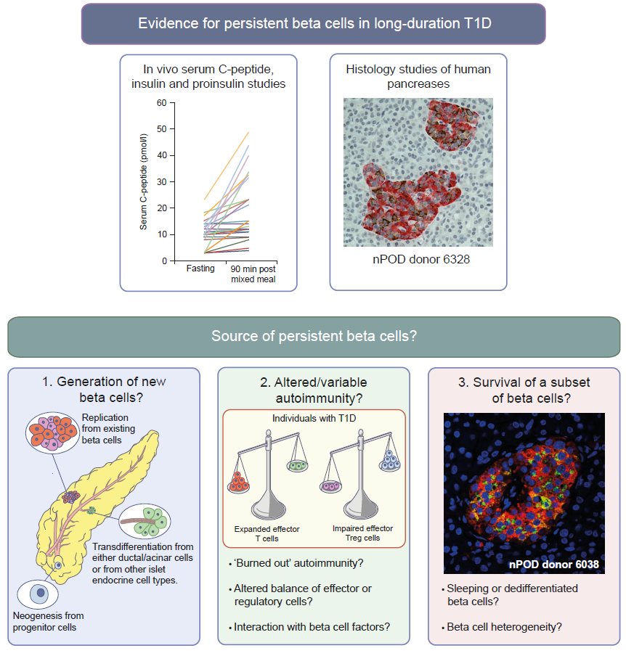
Persistent beta cells in type 1 diabetes
Oram et al (2019) Diabetologia DOI 10.1007/s00125-019-4822-4
C-peptide graph: from Oram et al (2014), distributed under the CC BY 4.0 Attribution License (http://creativecommons.org/licenses/by/4.0/); Generation of new beta cells image: © 2005 Springer Nature. Adapted with permission from Bonner-Weir and Weir; altered/variable autoimmunity image: © 2014 Springer Nature. Adapted with permission from Roep and Tree

