Slide 1
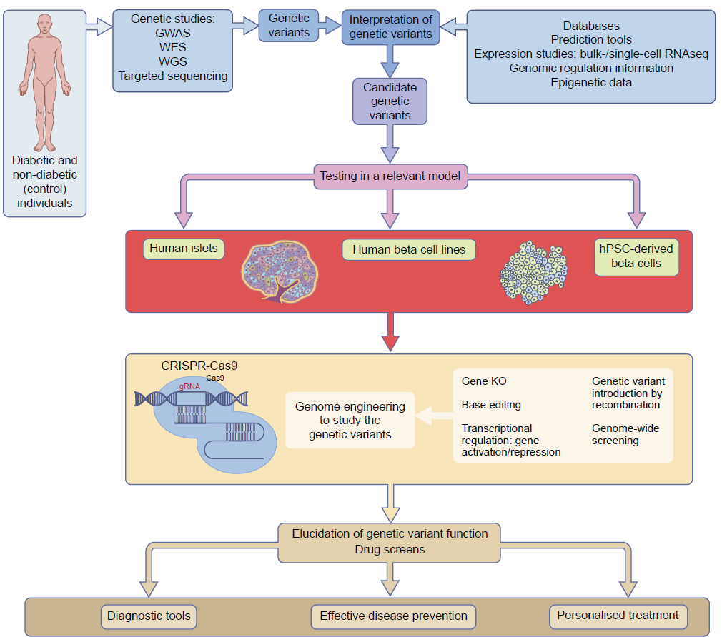
The central role of human beta cell models in the functional analysis of diabetes-associated genotypes
Balboa et al (2019) Diabetologia DOI 10.1007/s00125-019-4908-z
© The Authors. Distributed under the terms of the CC BY 4.0 Attribution License (http://creativecommons.org/licenses/by/4.0/)

