Slide 1
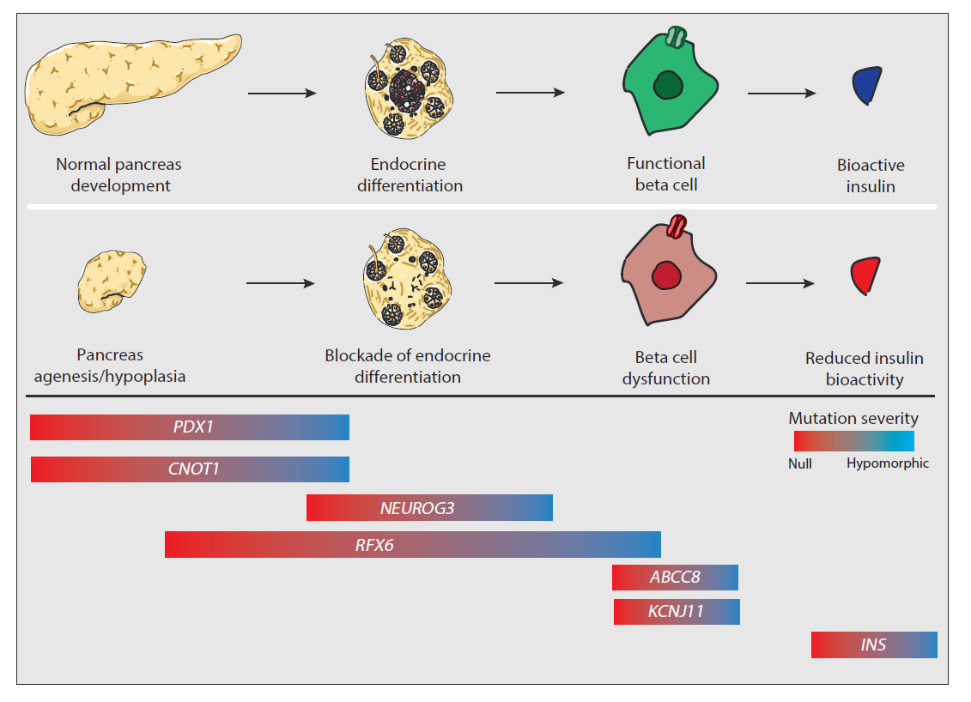
Developmental classification of permanent neonatal diabetes
Jennings et al (2020) Diabetologia DOI 10.1007/s00125-020-05161-0
©The Authors 2020. Distributed under the terms of the CC BY 4.0 Attribution License (http://creativecommons.org/licenses/by/4.0/)

