Slide 1
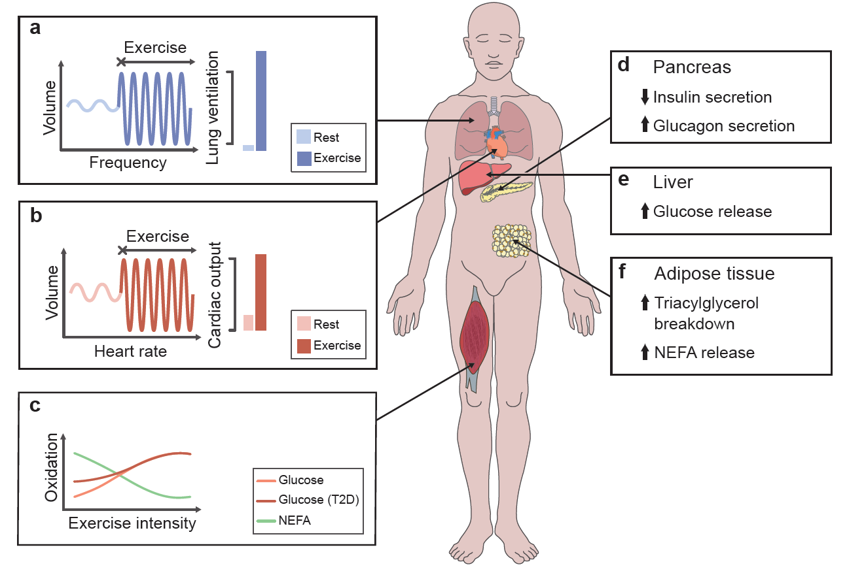
Acute response to an exercise bout
Savikj and Zierath (2020) Diabetologia DOI 10.1007/s00125-020-05166-9
©The Authors 2020. Distributed under the terms of the CC BY 4.0 Attribution License (http://creativecommons.org/licenses/by/4.0/)

Slide 2
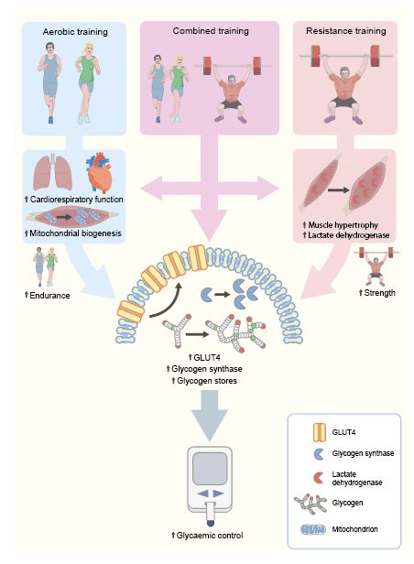
Adaptations to different training types
Savikj and Zierath (2020) Diabetologia DOI 10.1007/s00125-020-05166-9
©The Authors 2020. Distributed under the terms of the CC BY 4.0 Attribution License (http://creativecommons.org/licenses/by/4.0/)

Slide 3
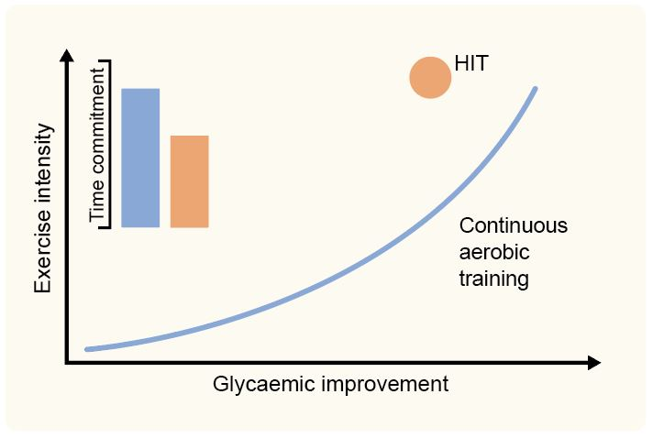
Glycaemic effects of different training intensity
Savikj and Zierath (2020) Diabetologia DOI 10.1007/s00125-020-05166-9
©The Authors 2020. Distributed under the terms of the CC BY 4.0 Attribution License (http://creativecommons.org/licenses/by/4.0/)

Slide 4
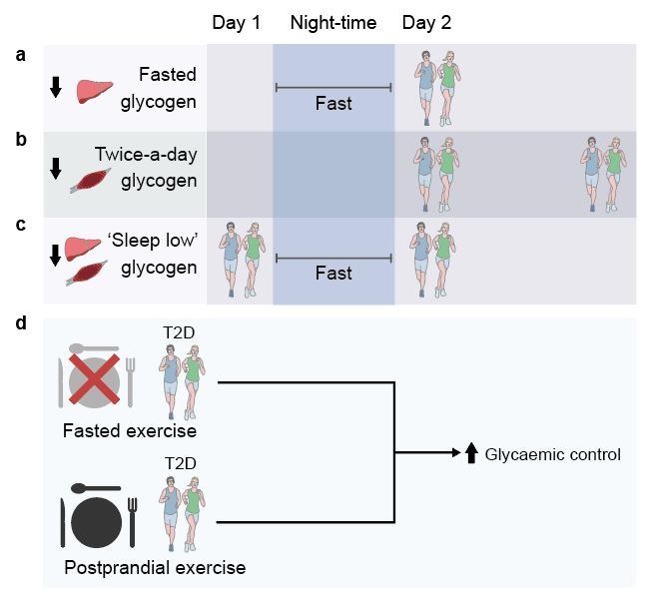
Training with low carbohydrate availability
Savikj and Zierath (2020) Diabetologia DOI 10.1007/s00125-020-05166-9
©The Authors 2020. Distributed under the terms of the CC BY 4.0 Attribution License (http://creativecommons.org/licenses/by/4.0/)

