Slide 1
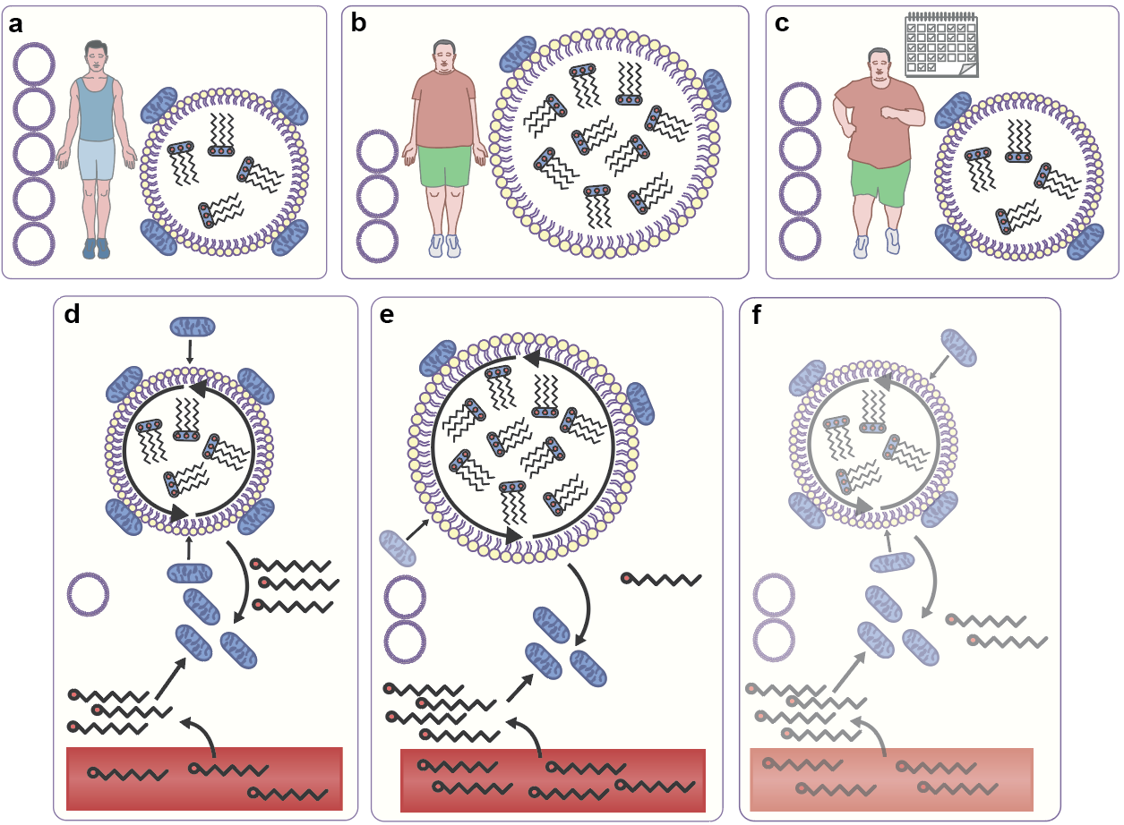
Skeletal muscle lipid metabolism: acute exercise and endurance training effects
Gemmink et al (2020) Diabetologia DOI 10.1007/s00125-020-05170-z
©The Authors 2020. Distributed under the terms of the CC BY 4.0 Attribution License (http://creativecommons.org/licenses/by/4.0/)

Slide 2
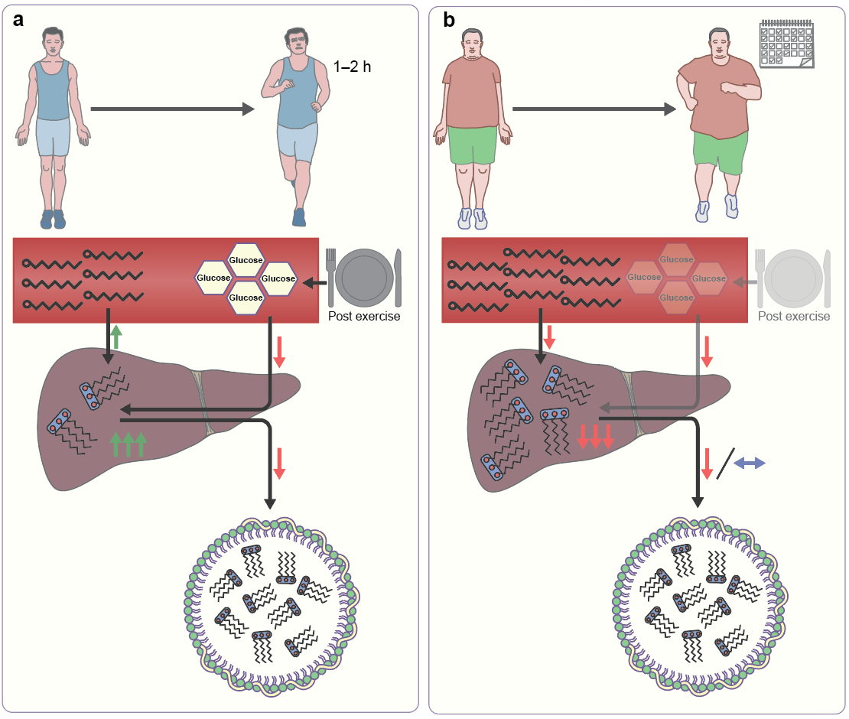
Liver lipid metabolism: acute exercise and endurance training effects
Gemmink et al (2020) Diabetologia DOI 10.1007/s00125-020-05170-z
©The Authors 2020. Distributed under the terms of the CC BY 4.0 Attribution License (http://creativecommons.org/licenses/by/4.0/)

