Slide 1
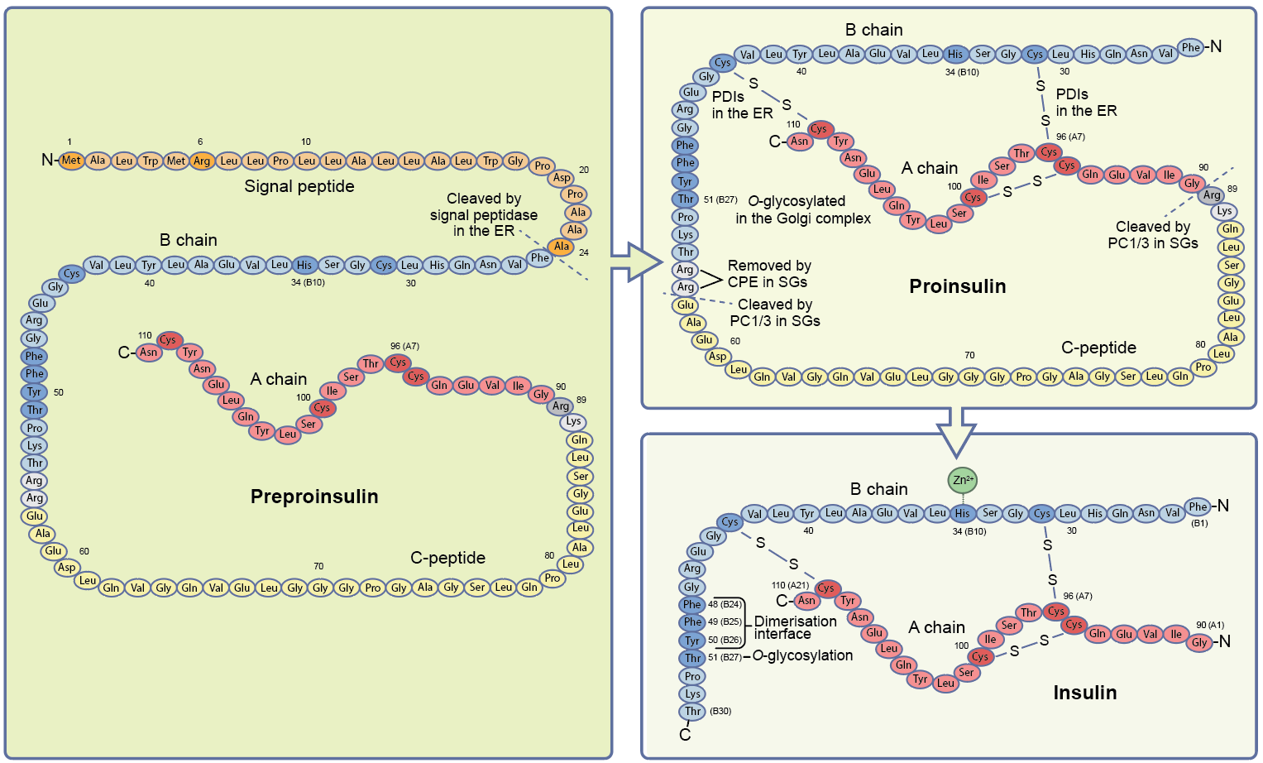
The insulin peptide
Vasiljević et al (2020) Diabetologia DOI 10.1007/s00125-020-05192-7
© The Author(s) 2020

Slide 2
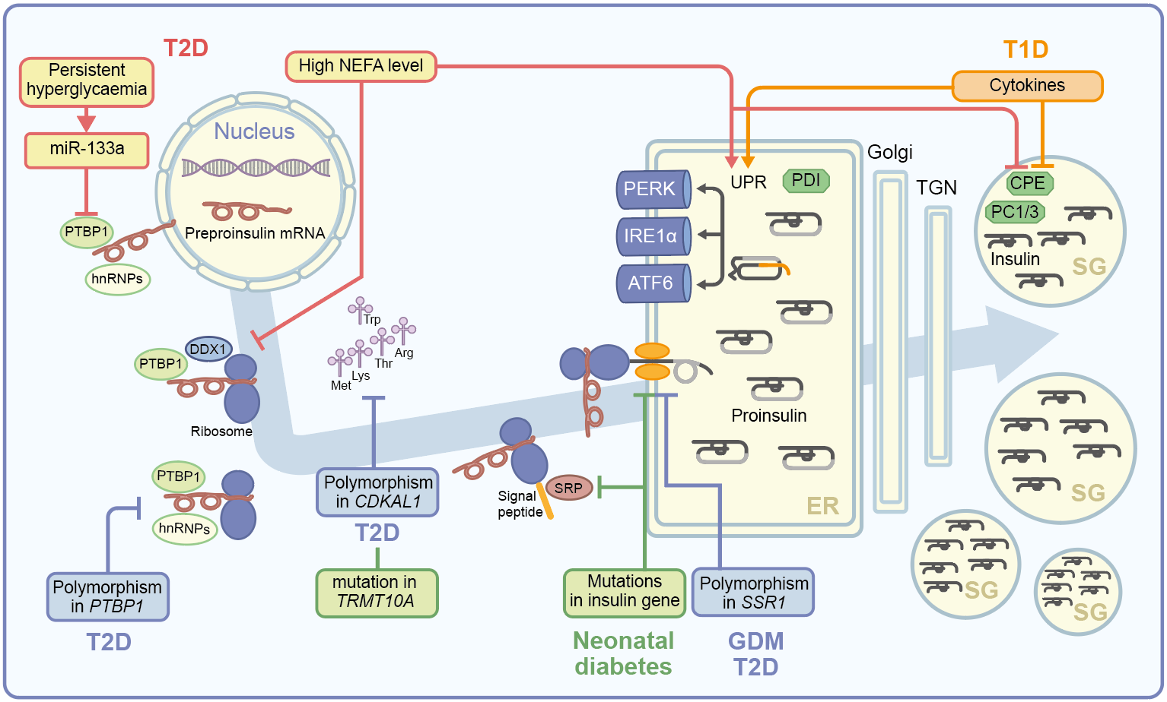
Schematic of insulin production and secretion, from mRNA to the mature hormone
Vasiljević et al (2020) Diabetologia DOI 10.1007/s00125-020-05192-7
© The Author(s) 2020

