Slide 1
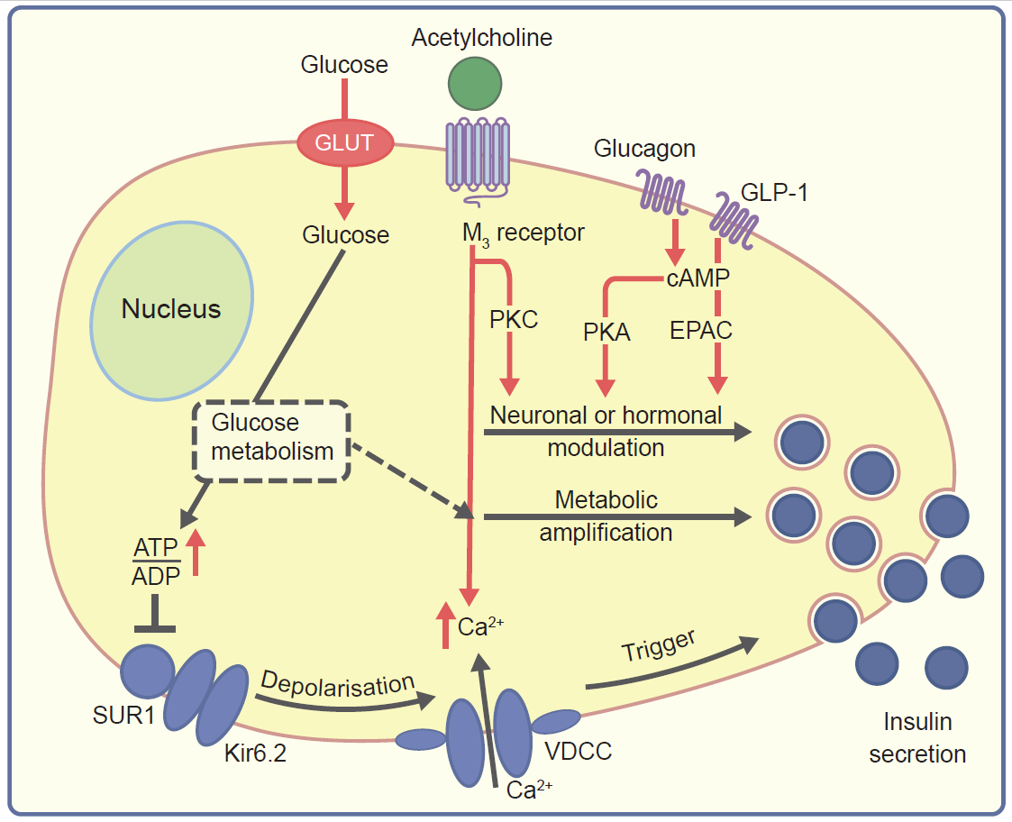
Simplified scheme of stimulus–secretion-coupling pathways in the pancreatic beta cell and possible interaction points for alpha cell-derived paracrine signals
Moede et al (2020) Diabetologia DOI 10.1007/s00125-020-05196-3
© The Authors 2020

Slide 2
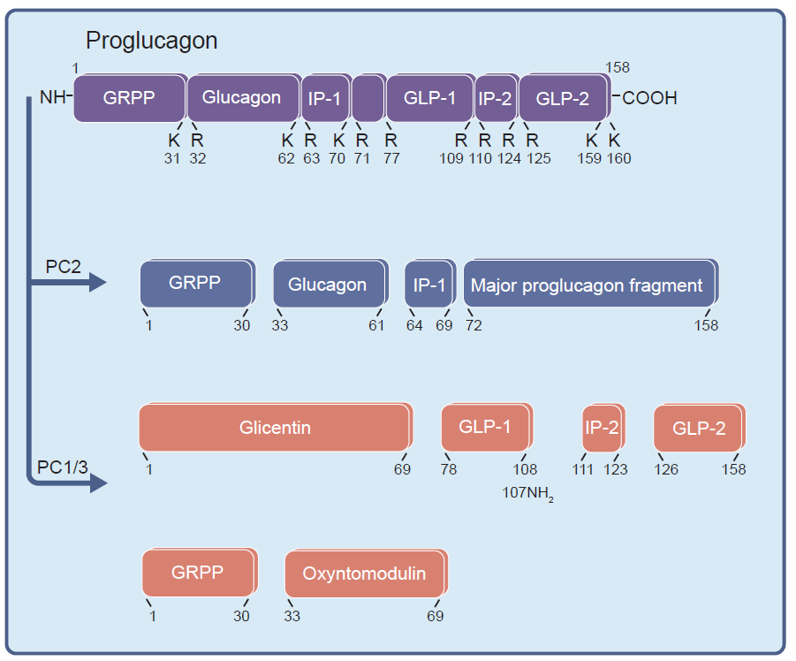
Schematic representation of the post-translational processing of proglucagon
Moede et al (2020) Diabetologia DOI 10.1007/s00125-020-05196-3
© The Authors 2020

Slide 3
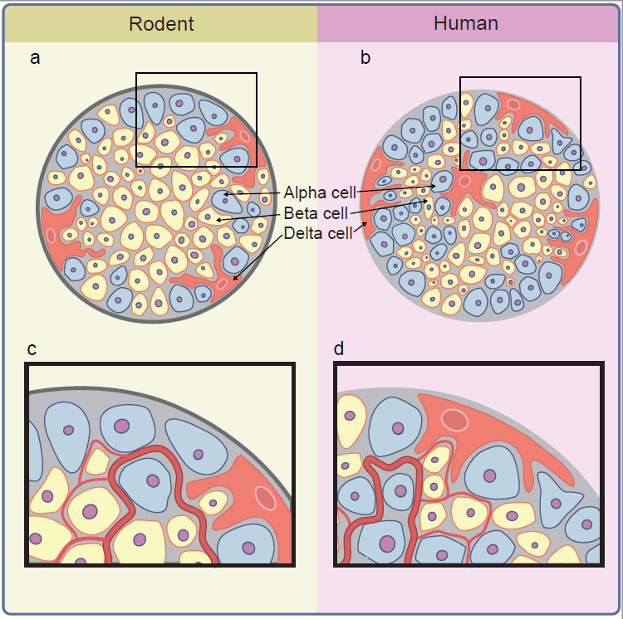
Schematic representation of the structure (a, b) and vasculature (c, d) of rodent and human islets
Moede et al (2020) Diabetologia DOI 10.1007/s00125-020-05196-3
© The Authors 2020

Slide 4
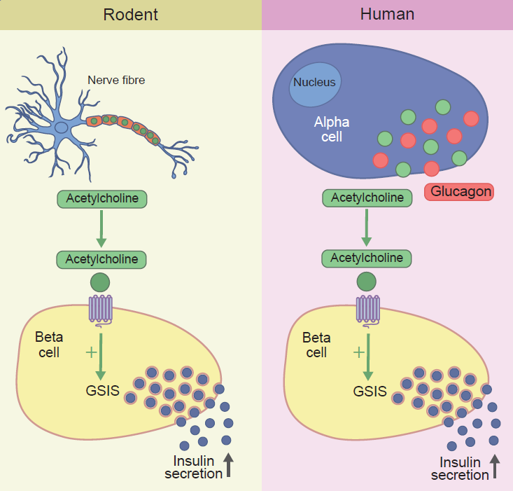
Schematic representation of the difference in cholinergic signalling in mouse and human islets
Moede et al (2020) Diabetologia DOI 10.1007/s00125-020-05196-3
© The Authors 2020

Slide 5
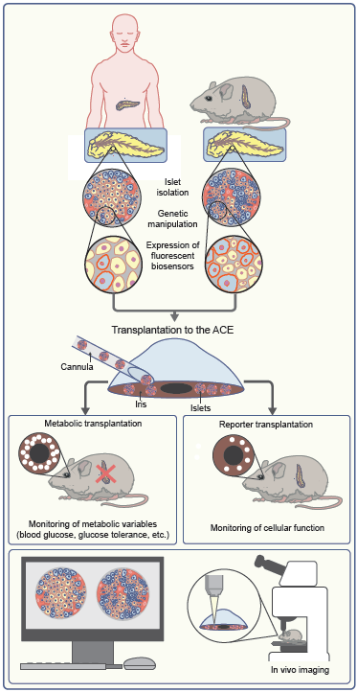
Islet transplantation into the anterior chamber of the eye (ACE) as a tool to study human islet physiology/pathology in vivo
Moede et al (2020) Diabetologia DOI 10.1007/s00125-020-05196-3
© The Authors 2020

