Slide 1
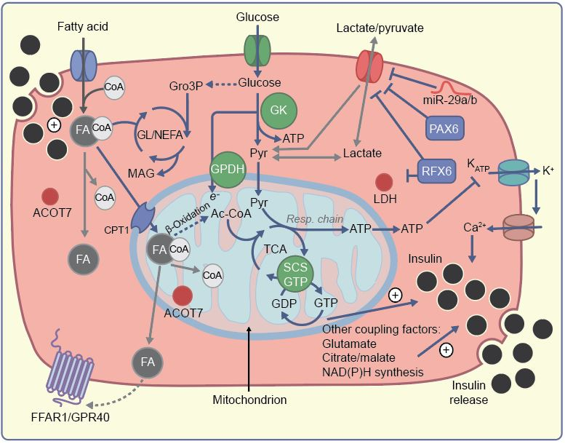
Signalling mechanisms and the role of disallowed genes in beta cell insulin secretion in response to glucose
Rutter et al (2020) Diabetologia DOI 10.1007/s00125-020-05205-5
©The Authors 2020. Distributed under the terms of the CC BY 4.0 Attribution License (http://creativecommons.org/licenses/by/4.0/)

Slide 2
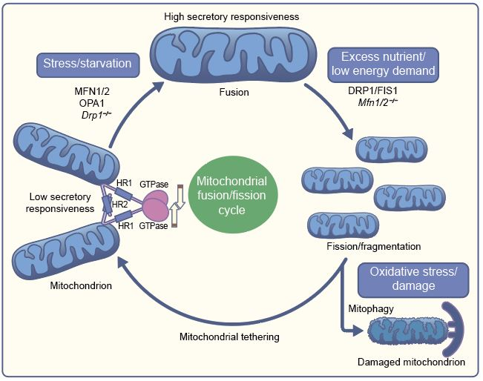
Putative roles for proteins controlling mitochondrial shape and dynamics in beta cells
Rutter et al (2020) Diabetologia DOI 10.1007/s00125-020-05205-5
©The Authors 2020. Distributed under the terms of the CC BY 4.0 Attribution License (http://creativecommons.org/licenses/by/4.0/)

Slide 3
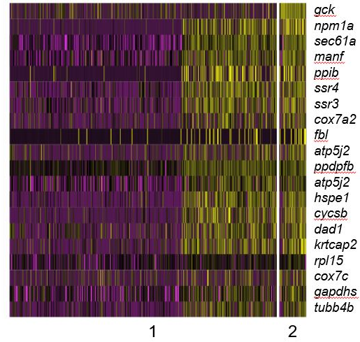
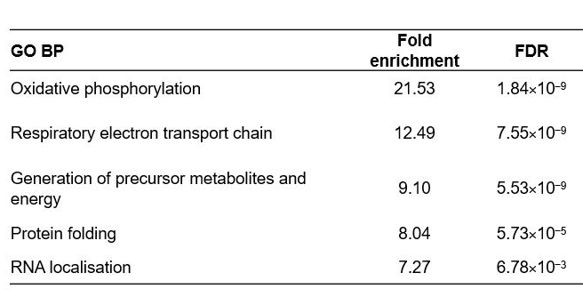
Single cell RNA-seq analysis of islets from the zebrafish (Danio rario) to identify putative hub/leader cells
Rutter et al (2020) Diabetologia DOI 10.1007/s00125-020-05205-5
© 2019 Springer Nature. Adapted from Salem et al with permission

Slide 4
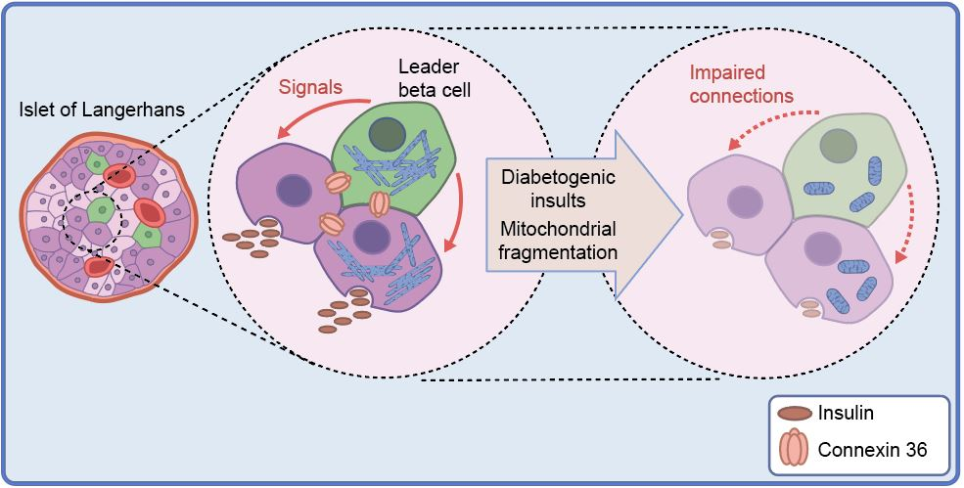
Beta cell network model depicting impairment of insulin secretion following external or genetic alterations to mitochondrial fusion protein expression
Rutter et al (2020) Diabetologia DOI 10.1007/s00125-020-05205-5
©The Authors 2020. Distributed under the terms of the CC BY 4.0 Attribution License (http://creativecommons.org/licenses/by/4.0/)

