Slide 1
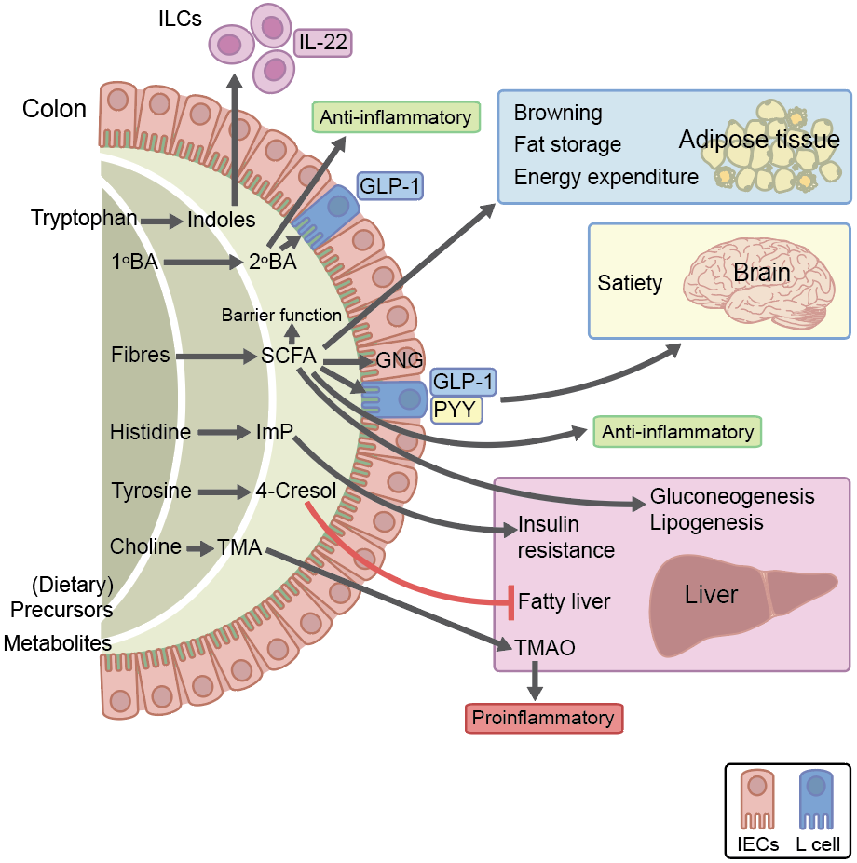
Gut-derived microbial metabolites influence host responses in the context of the metabolic syndrome and type 2 diabetes
Herrema and Niess (2020) Diabetologia DOI 10.1007/s00125-020-05268-4
©The Authors 2020. Distributed under the terms of the CC BY 4.0 Attribution License (http://creativecommons.org/licenses/by/4.0/)

