Slide 1
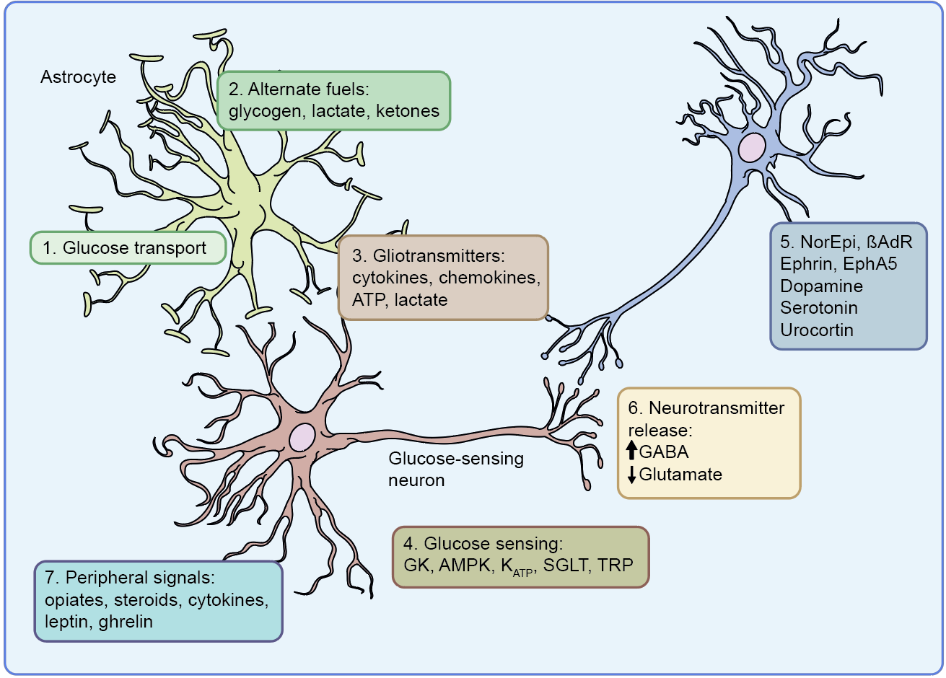
Potential mechanisms of cerebral adaptation to recurrent hypoglycaemia
Rory J. McCrimmon (2021) Diabetologia DOI 10.1007/s00125-020-05369-0
© The Author 2021

Slide 2
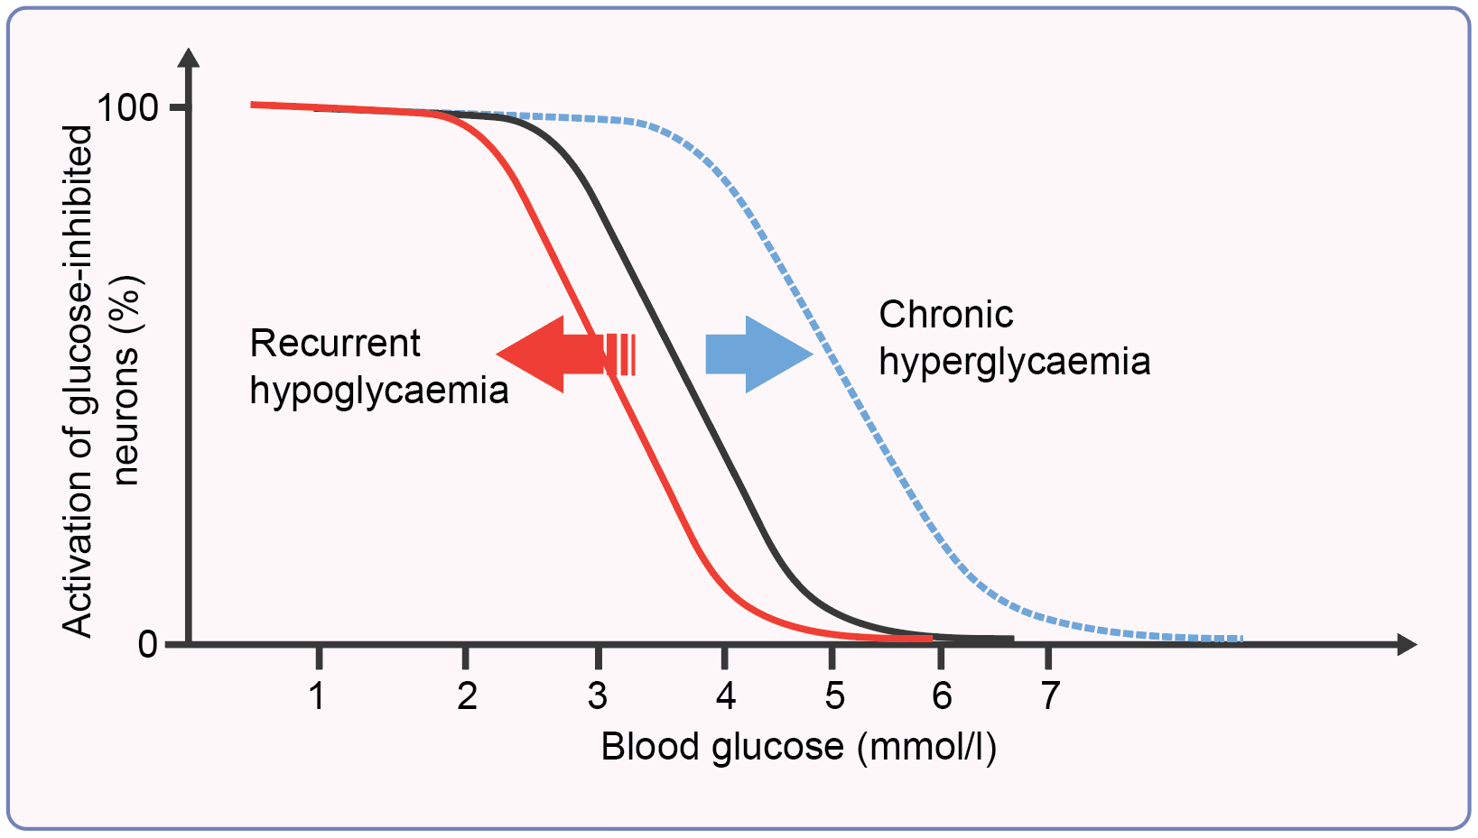
Shifting thresholds for hypoglycaemia detection
Rory J. McCrimmon (2021) Diabetologia DOI 10.1007/s00125-020-05369-0
© The Author 2021

Slide 3
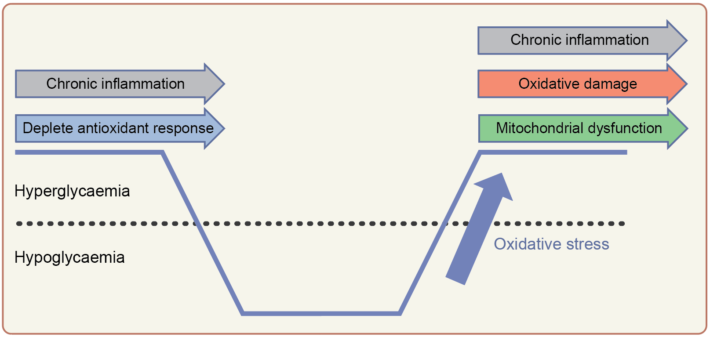
Impact of glycaemic variability, hypoglycaemia and hypoglycaemia recovery on the brain
Rory J. McCrimmon (2021) Diabetologia DOI 10.1007/s00125-020-05369-0
© The Author 2021

