Slide 1
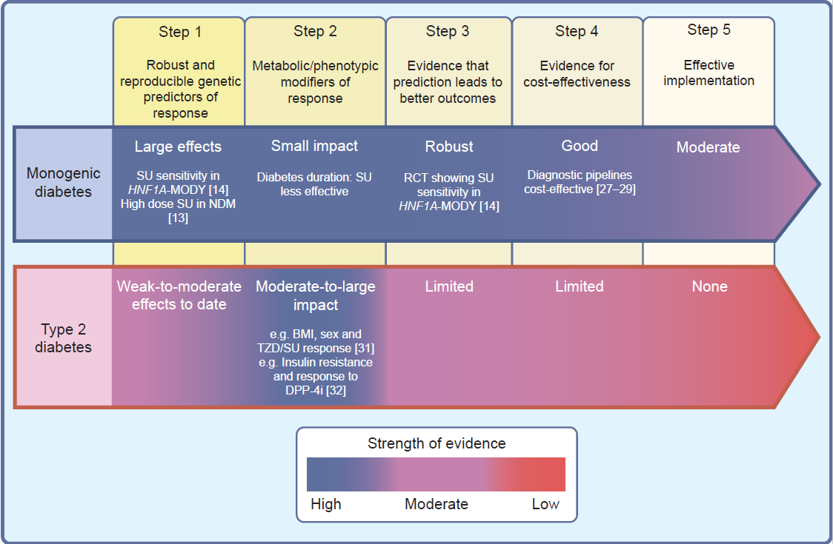
Roadmap to achieve pharmacological precision medicine in diabetes
Florez and Pearson (2022) Diabetologia DOI 10.1007/s00125-022-05732-3
©The Authors 2022. Distributed under the terms of the CC BY 4.0 Attribution License (http://creativecommons.org/licenses/by/4.0/)

Slide 2
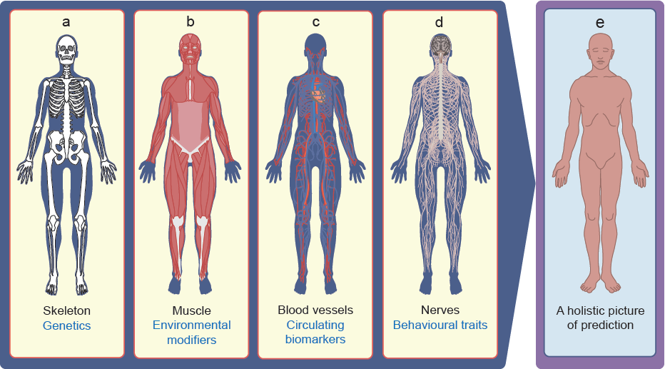
Anatomical analogy of a predictive tool for precision prediction that incorporates relevant axes of biology
Florez and Pearson (2022) Diabetologia DOI 10.1007/s00125-022-05732-3
©The Authors 2022. Distributed under the terms of the CC BY 4.0 Attribution License (http://creativecommons.org/licenses/by/4.0/)

