Slide 1
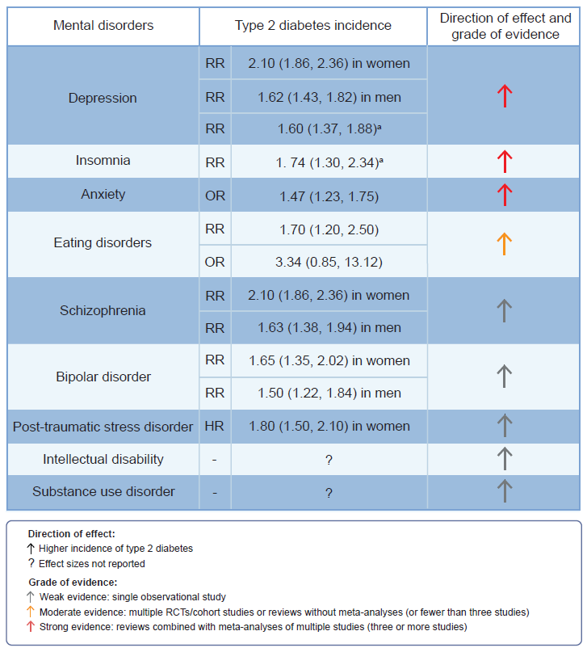
Association between mental disorders and incidence of type 2 diabetes (precision prevention)
Kremers et al (2022) Diabetologia DOI 10.1007/s00125-022-05738-x
©The Authors 2022. Distributed under the terms of the CC BY 4.0 Attribution License (http://creativecommons.org/licenses/by/4.0/)

Slide 2
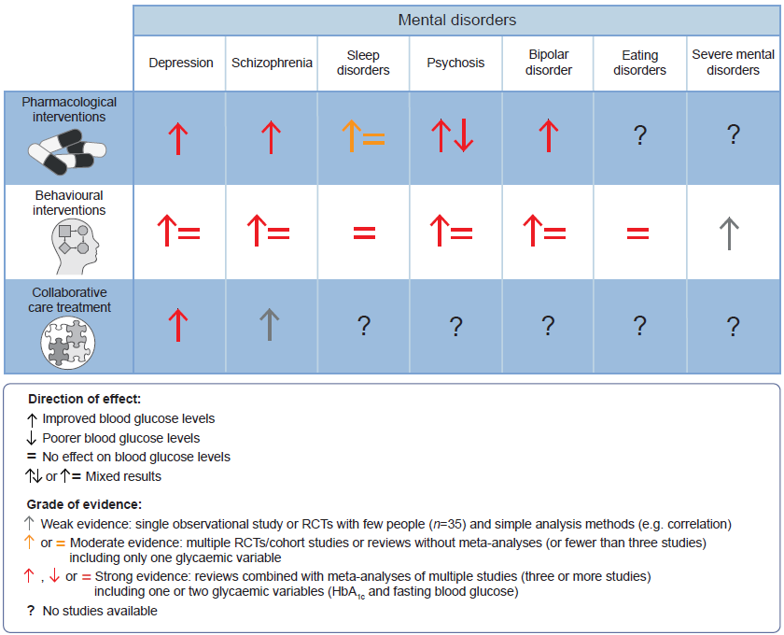
Effect of treatment for mental disorders on glycaemic variables in diabetes (precision treatment)
Kremers et al (2022) Diabetologia DOI 10.1007/s00125-022-05738-x
©The Authors 2022. Distributed under the terms of the CC BY 4.0 Attribution License (http://creativecommons.org/licenses/by/4.0/)

