Slide 1
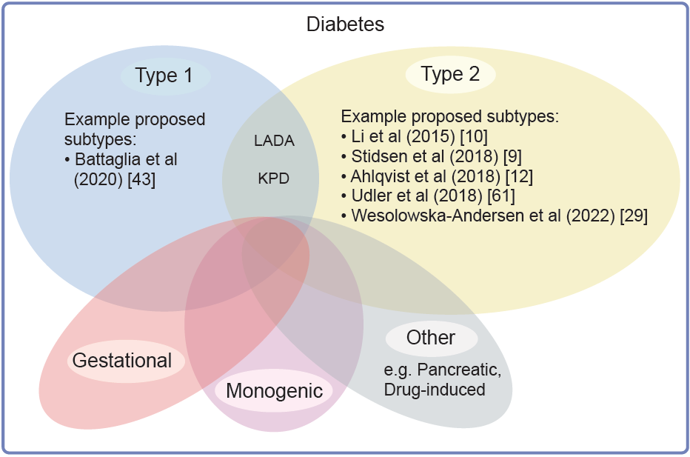
Diabetes subtypes
Deutsch et al (2022) Diabetologia DOI 10.1007/s00125-022-05769-4
©The Authors 2022. Distributed under the terms of the CC BY 4.0 Attribution License (http://creativecommons.org/licenses/by/4.0/)

Slide 2
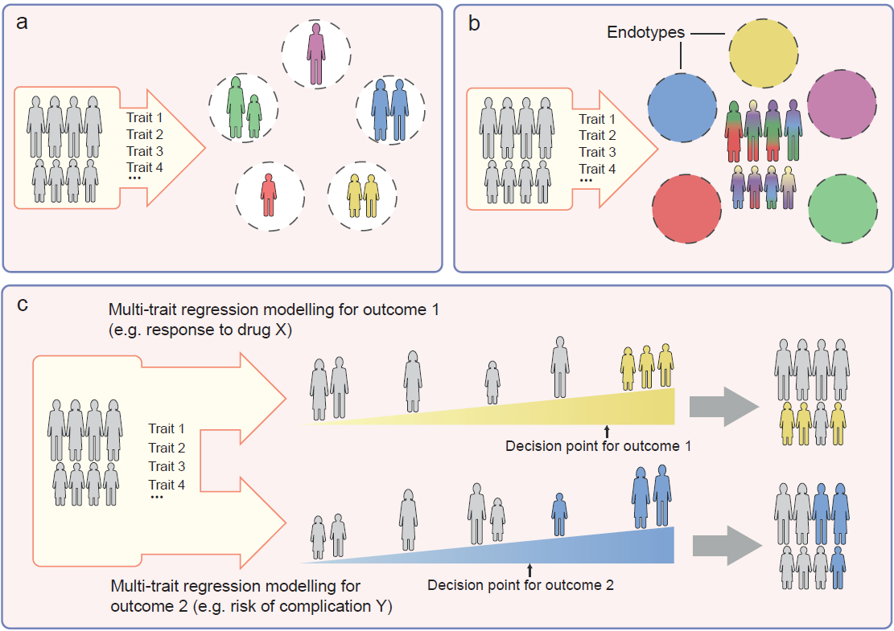
Strategies for identifying diabetes subtypes
Deutsch et al (2022) Diabetologia DOI 10.1007/s00125-022-05769-4
©The Authors 2022. Distributed under the terms of the CC BY 4.0 Attribution License (http://creativecommons.org/licenses/by/4.0/)

