Slide 1
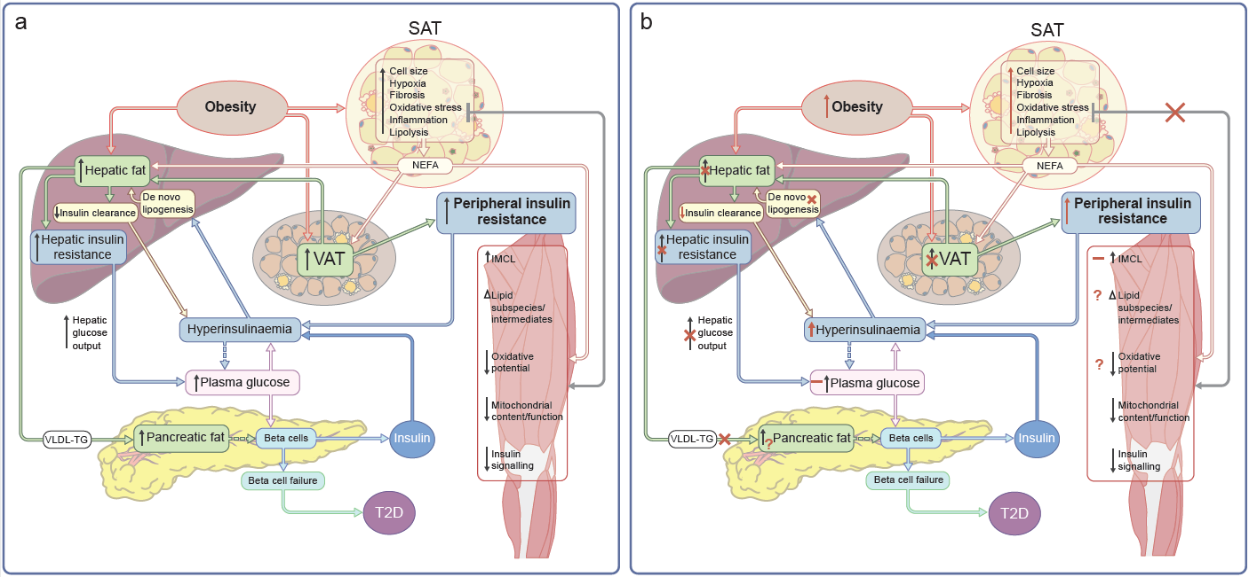
Conventional paradigm of type 2 diabetes (a) compared with findings from studies of Black Africans from sub-Saharan Africa (b)
Goedecke and Mendham (2022) Diabetologia DOI 10.1007/s00125-022-05795-2
©The Authors 2022. Distributed under the terms of the CC BY 4.0 Attribution License (http://creativecommons.org/licenses/by/4.0/)

Slide 2
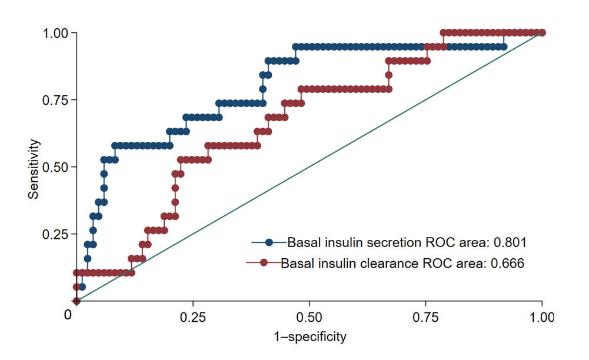
ROC curves of basal insulin secretion and clearance to predict dysglycaemia in middle-aged Black South African women 1.5 years later
Goedecke and Mendham (2022) Diabetologia DOI 10.1007/s00125-022-05795-2
©The Authors 2022. Distributed under the terms of the CC BY 4.0 Attribution License (http://creativecommons.org/licenses/by/4.0/)

Slide 3
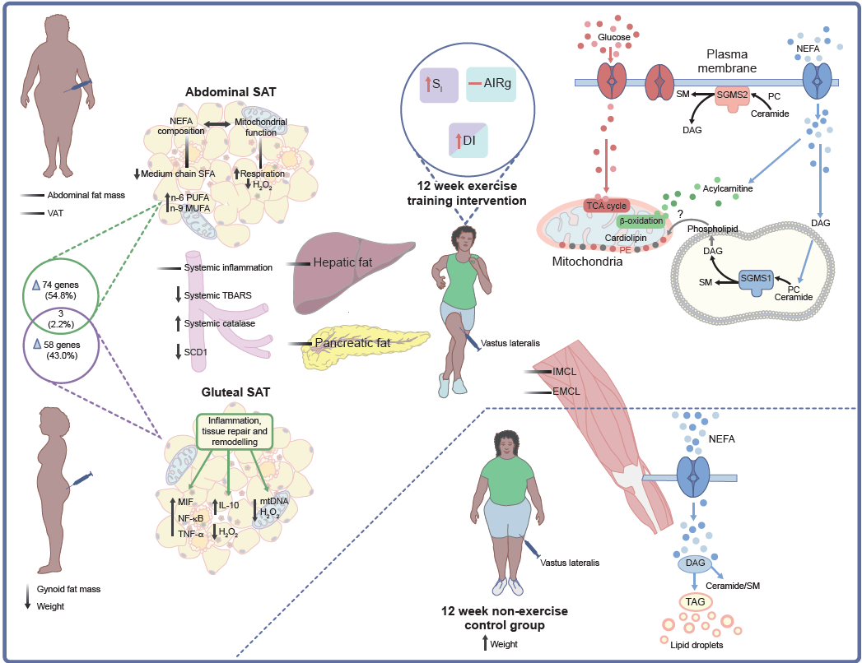
Response to a 12 week combined aerobic and resistance exercise training intervention in Black South African women with obesity
Goedecke and Mendham (2022) Diabetologia DOI 10.1007/s00125-022-05795-2
©The Authors 2022. Distributed under the terms of the CC BY 4.0 Attribution License (http://creativecommons.org/licenses/by/4.0/)

Slide 4
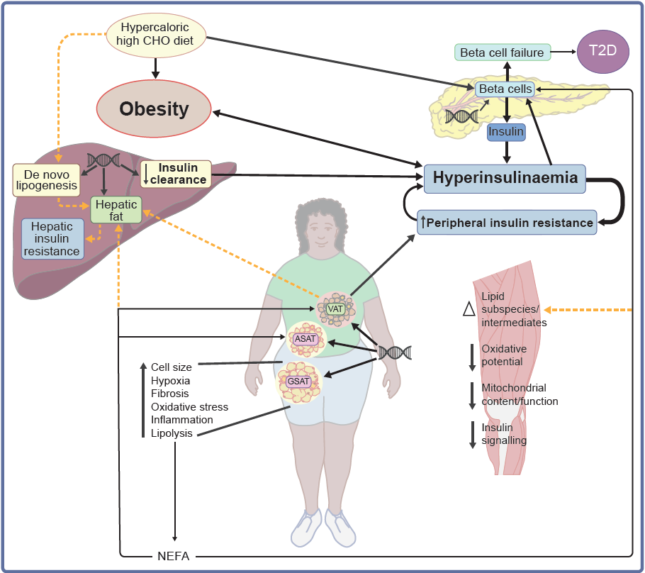
Model of the pathogenesis of type 2 diabetes in sub-Saharan African populations
Goedecke and Mendham (2022) Diabetologia DOI 10.1007/s00125-022-05795-2
©The Authors 2022. Distributed under the terms of the CC BY 4.0 Attribution License (http://creativecommons.org/licenses/by/4.0/)

