Slide 1
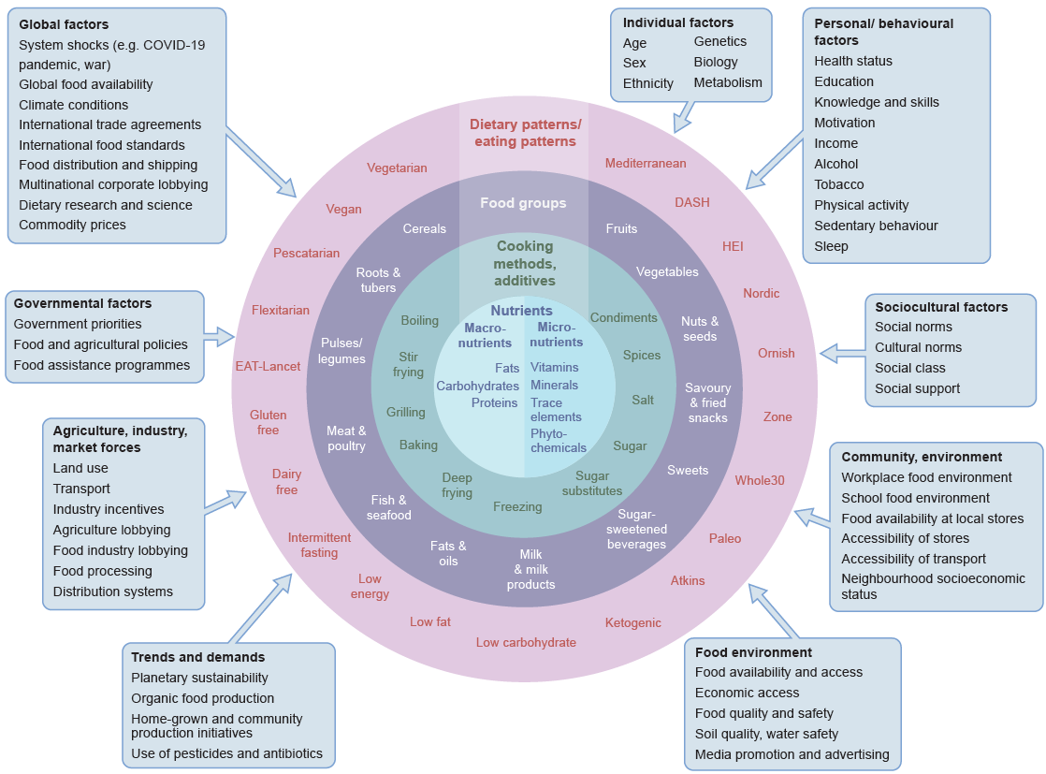
Complexity of diets and multiple influences affecting food intakes
Forouhi (2023) Diabetologia DOI 10.1007/s00125-023-05873-z
© The Authors 2023. Distributed under the terms of the CC BY 4.0 Attribution License (http://creativecommons.org/licenses/by/4.0/)

