Slide 1
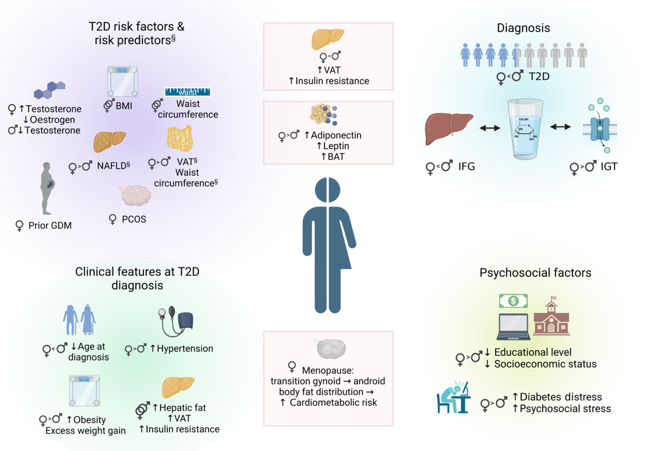
Sex-specific risks and sex and gender differences in risk factors and clinical features of men and women with type 2 diabetes
Kautzky-Willer et al (2023) Diabetologia DOI 10.1007/s00125-023-05891-x
© The Authors 2023. Distributed under the terms of the CC BY 4.0 Attribution License (http://creativecommons.org/licenses/by/4.0/). Created in BioRender.com

Slide 2
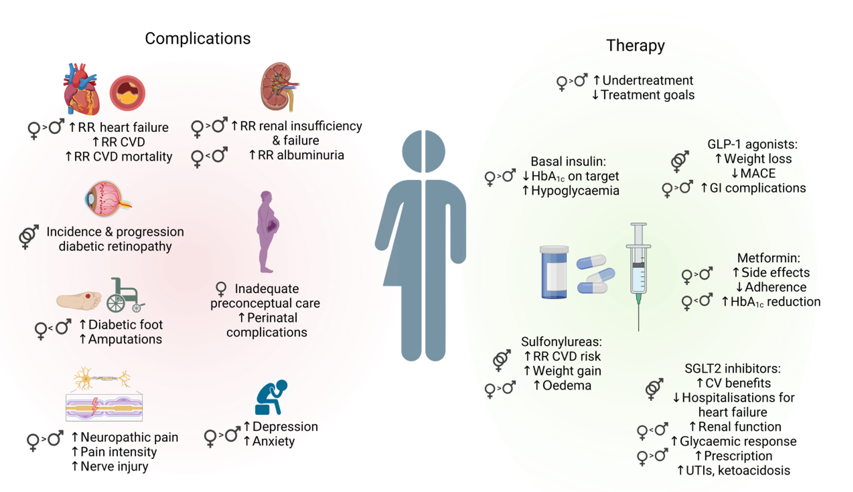
Illustration of the most important sex differences in the complications and possible effects of pharmacological therapy and management of patients with type 2 diabetes
Kautzky-Willer et al (2023) Diabetologia DOI 10.1007/s00125-023-05891-x
© The Authors 2023. Distributed under the terms of the CC BY 4.0 Attribution License (http://creativecommons.org/licenses/by/4.0/). Created in BioRender.com

