Slide 1
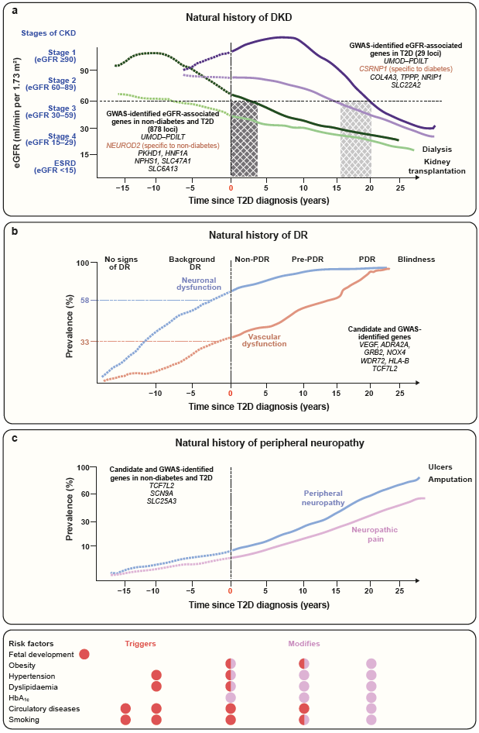
The natural history of the development of DKD, retinopathy and peripheral neuropathy complications in individuals with type 2 diabetes
Lyssenko and Vaag (2023) Diabetologia DOI 10.1007/s00125-023-05964-x
© The Authors 2023. Distributed under the terms of the CC BY 4.0 Attribution License (http://creativecommons.org/licenses/by/4.0/)

