Slide 1
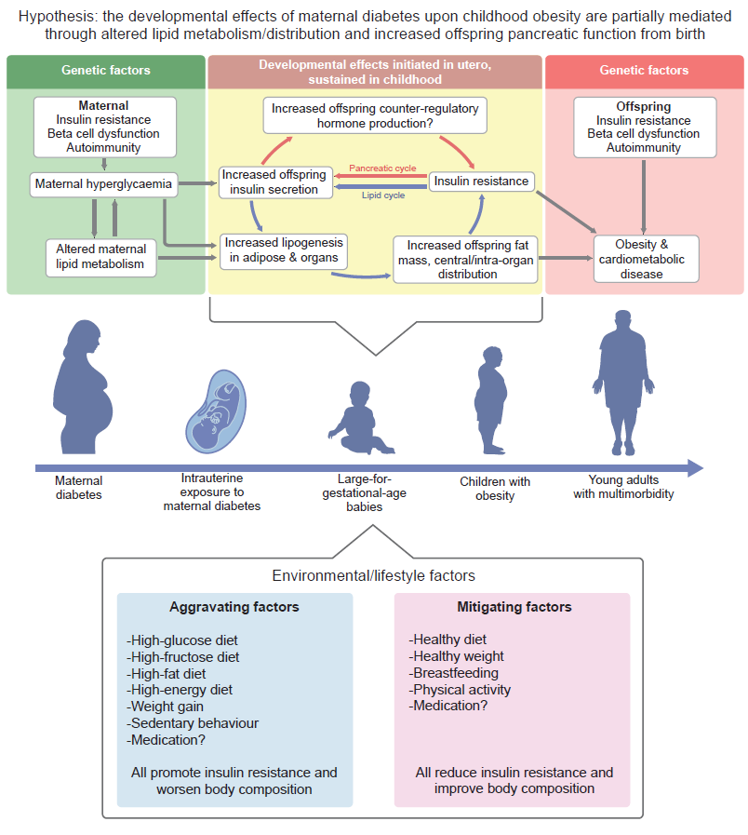
A unifying hypothesis for the development of large-for-gestational-age and childhood obesity after exposure to intrauterine hyperglycaemia
Meek (2023) Diabetologia DOI 10.1007/s00125-023-05965-w
©The Authors 2023. Distributed under the terms of the CC BY 4.0 Attribution License (http://creativecommons.org/licenses/by/4.0

