Slide 1
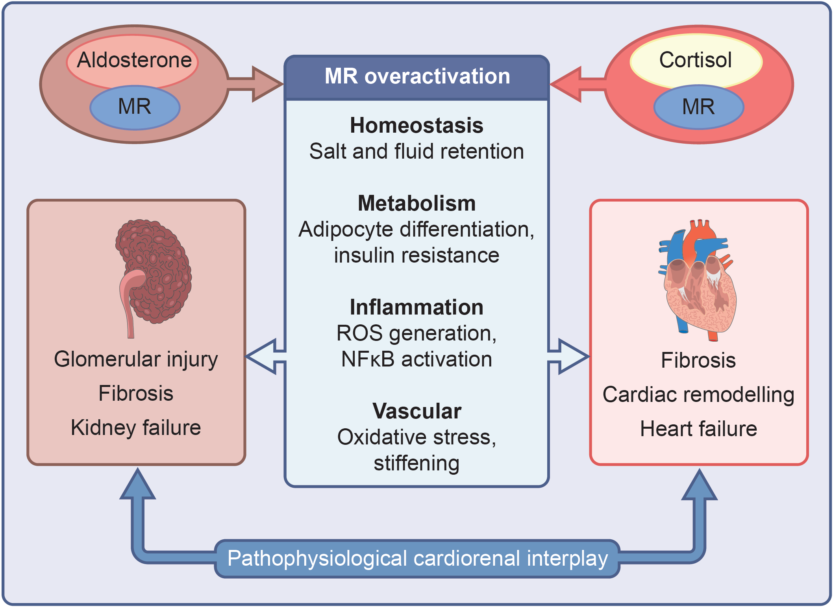
Role of MR overactivation in cardiorenal disease
Savarese et al (2023) Diabetologia DOI 10.1007/s00125-023-06031-1
© The Authors 2023. Distributed under the terms of the CC BY 4.0 Attribution License (http://creativecommons.org/licenses/by/4.0/)

Slide 2
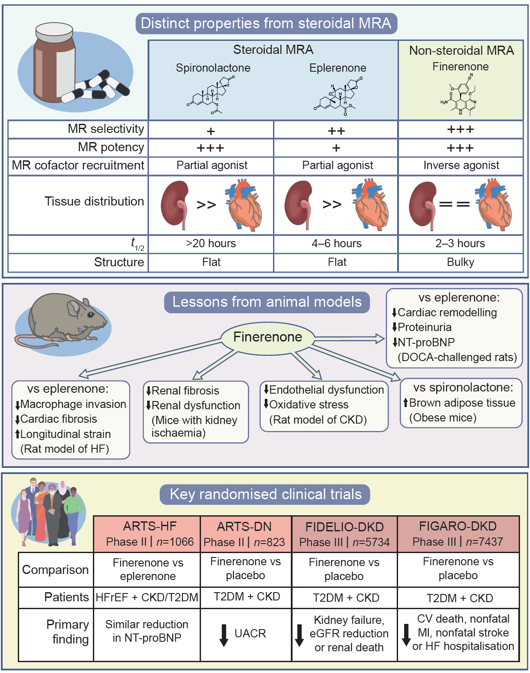
Distinct characteristics and mechanisms of finerenone vs classical steroidal MRA
Savarese et al (2023) Diabetologia DOI 10.1007/s00125-023-06031-1
©The Authors 2023. Distributed under the terms of the CC BY 4.0 Attribution License (http://creativecommons.org/licenses/by/4.0/)

