Slide 1
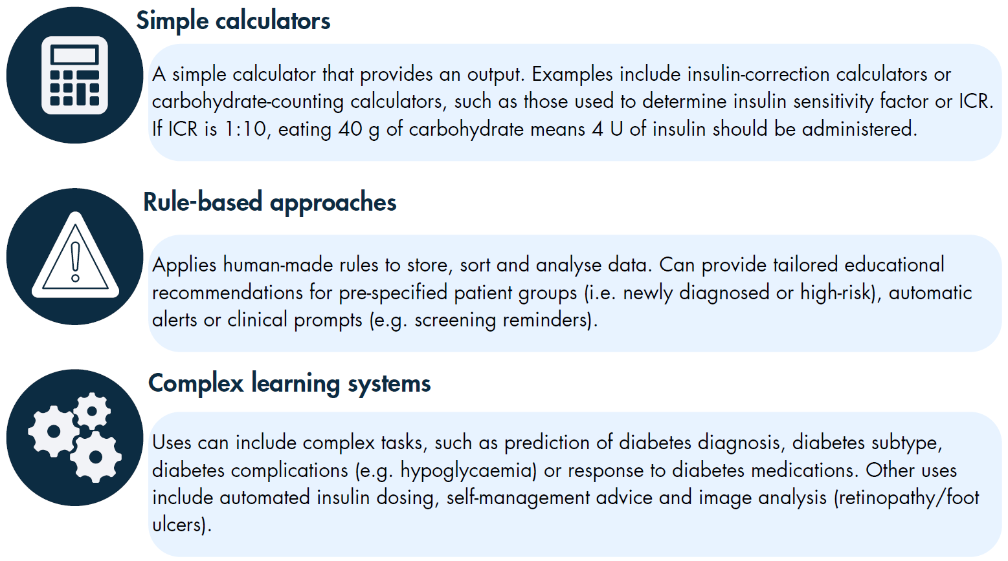
Data-driven tools can include simple calculators, rule-based approaches and AI-driven approaches
Mackenzie et al (2023) Diabetologia DOI 10.1007/s00125-021-06038-8
©The Authors 2023. Distributed under the terms of the CC BY 4.0 Attribution License (http://creativecommons.org/licenses/by/4.0/)

Slide 2
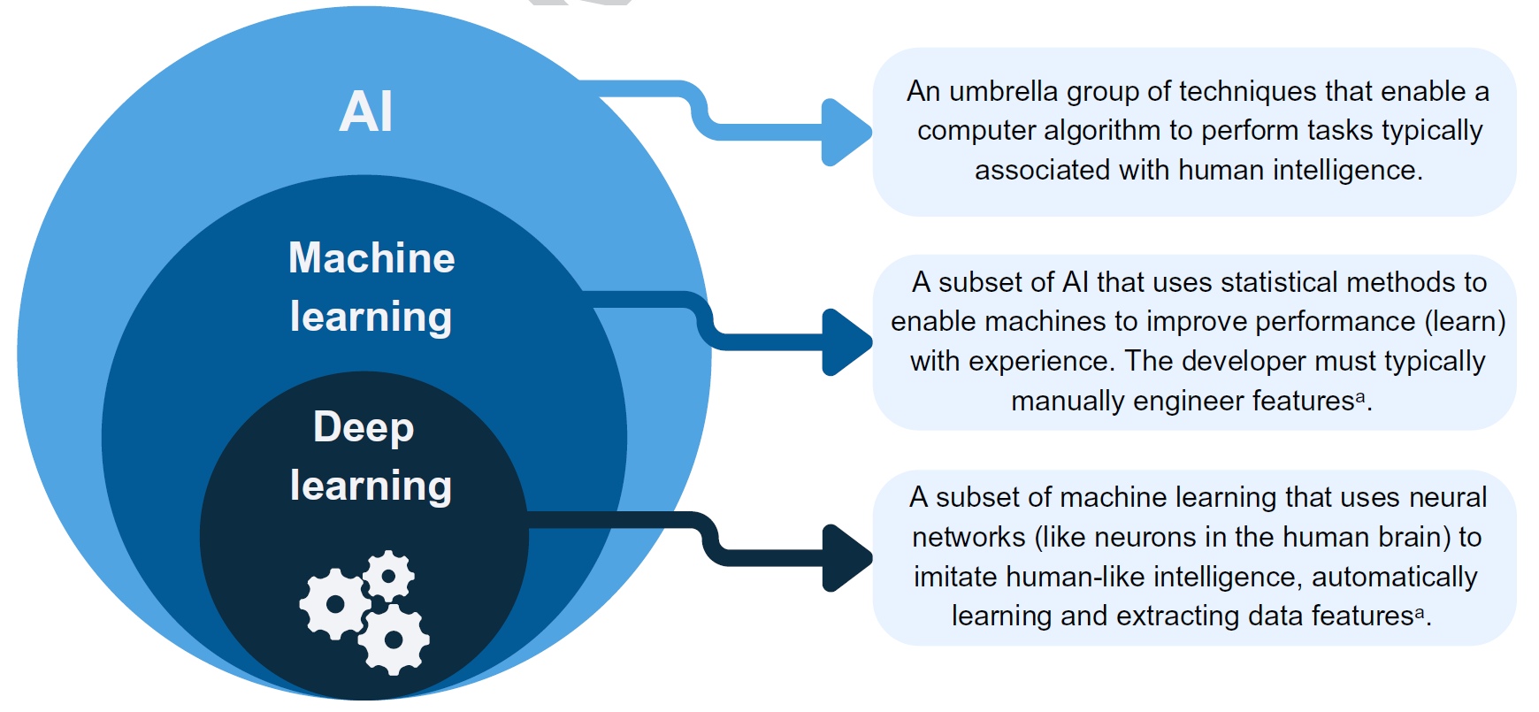
An overview of AI and its subcomponents, including machine learning and deep learning
ªA feature refers to an individual and measurable characteristic of data and is typically numerical or categorical
Mackenzie et al (2023) Diabetologia DOI 10.1007/s00125-021-06038-8
©The Authors 2023. Distributed under the terms of the CC BY 4.0 Attribution License (http://creativecommons.org/licenses/by/4.0/)

Slide 3
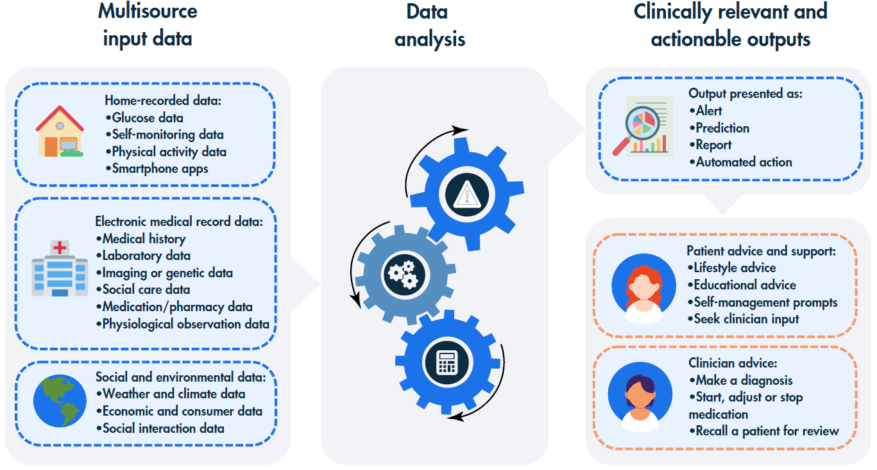
An overview of multisource data inputs, analysis techniques and potential clinically relevant and actionable outputs relevant to diabetes care
Mackenzie et al (2023) Diabetologia DOI 10.1007/s00125-021-06038-8
©The Authors 2023. Distributed under the terms of the CC BY 4.0 Attribution License (http://creativecommons.org/licenses/by/4.0/)

Slide 4
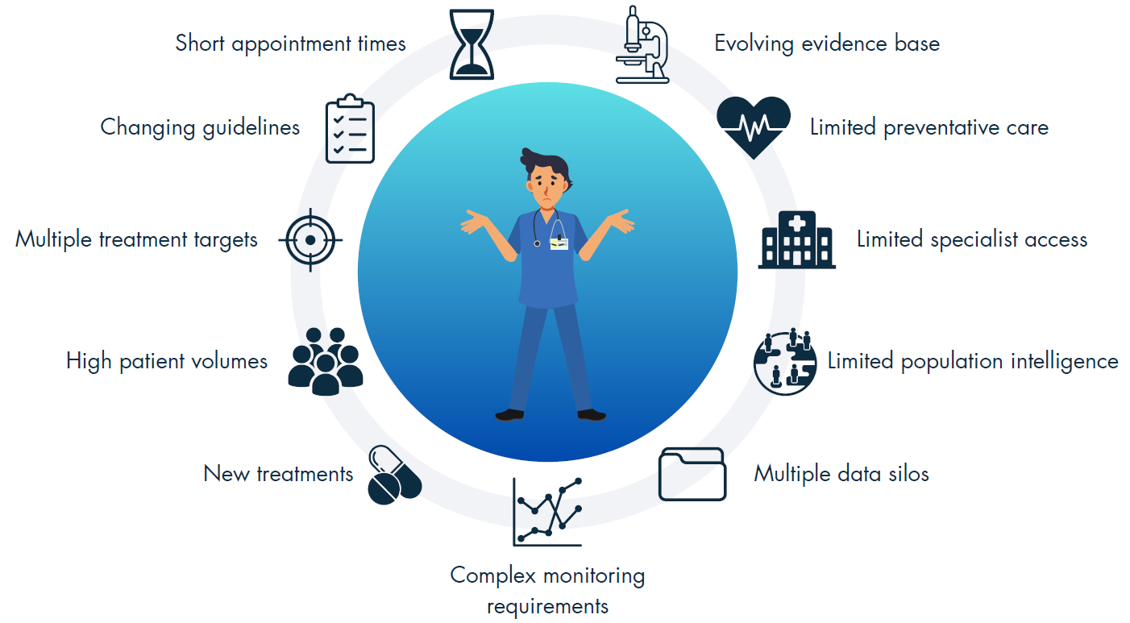
Why is clinician decision support necessary?
Mackenzie et al (2023) Diabetologia DOI 10.1007/s00125-021-06038-8
©The Authors 2023. Distributed under the terms of the CC BY 4.0 Attribution License (http://creativecommons.org/licenses/by/4.0/)

