Slide 1
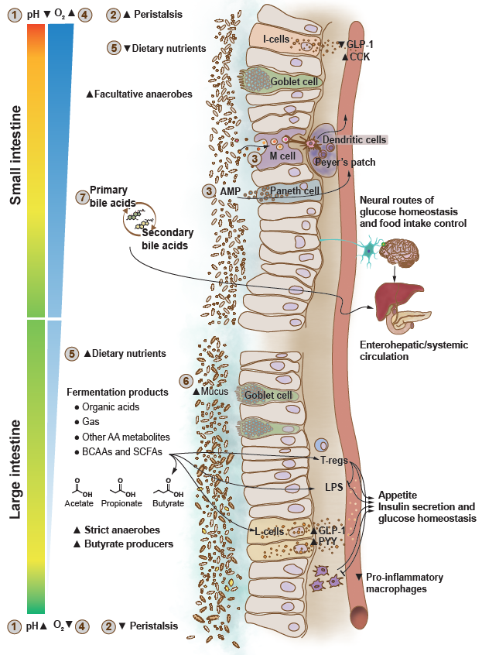
Microecological and physiological differences along the gastrointestinal tract
Byndloss et al (2024) Diabetologia DOI 10.1007/s00125-024-06198-1
© American Diabetes Association and the European Association for the Study of Diabetes 2024.
Distributed under the terms of the CC BY 4.0 Attribution License (http://creativecommons.org/licenses/by/4.0/)

Slide 2
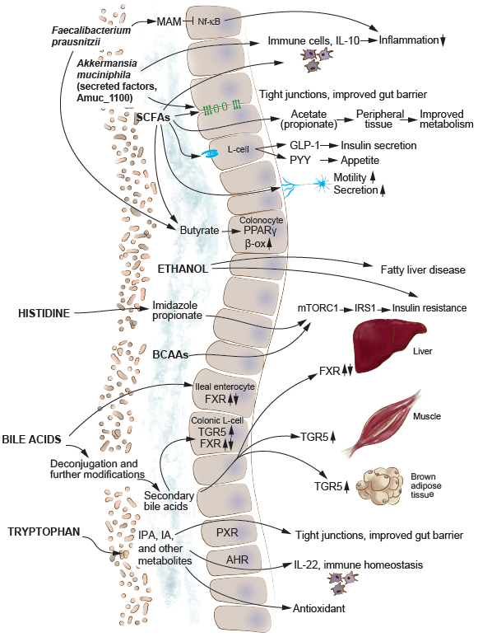
Gut microbiota metabolites and signalling molecules linked to glucose metabolism and type 2 diabetes
Byndloss et al (2024) Diabetologia DOI 10.1007/s00125-024-06198-1
© 2019 Canadian Diabetes Association. Adapted from Caesar (https://doi.org/10.1016/j.jcjd.2019.01.007)
with permission from Elsevier

Slide 3
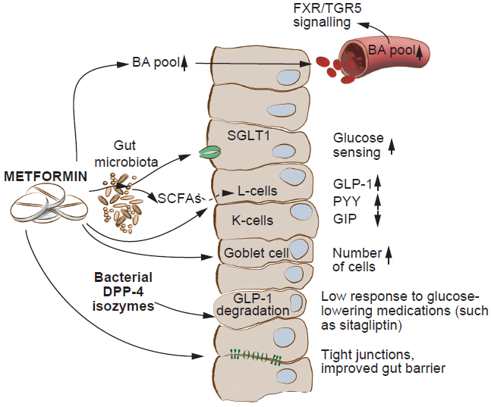
Gut microbiota interactions with glucose-lowering medications
Byndloss et al (2024) Diabetologia DOI 10.1007/s00125-024-06198-1
© 2019 Canadian Diabetes Association. Adapted from Caesar (https://doi.org/10.1016/j.jcjd.2019.01.007)
with permission from Elsevier

