Slide 1
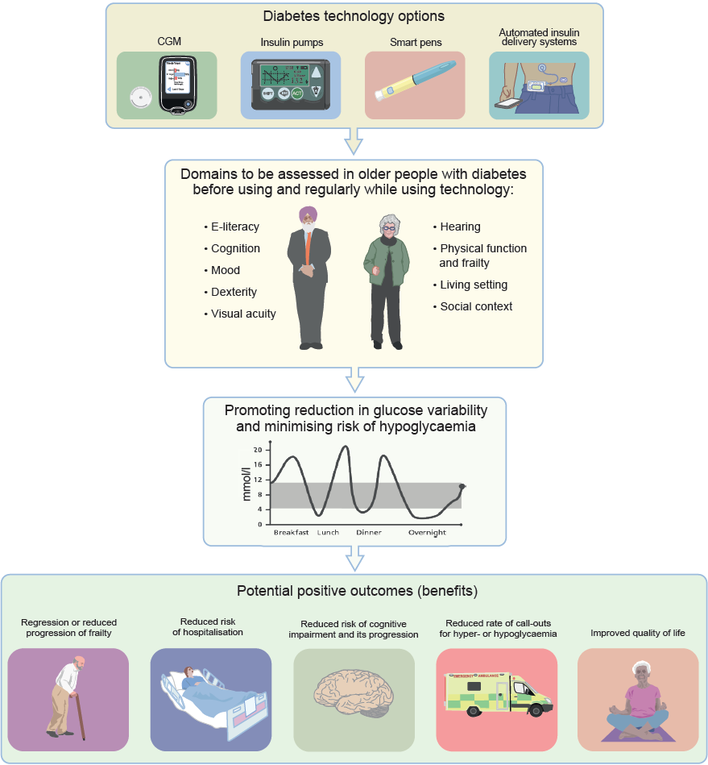
Benefits of technology in older people with diabetes
Maltese et al (2024) Diabetologia DOI 10.1007/s00125-024-06240-2
©The Authors 2024. Distributed under the terms of the CC BY 4.0 Attribution License (http://creativecommons.org/licenses/by/4.0/)

Slide 2
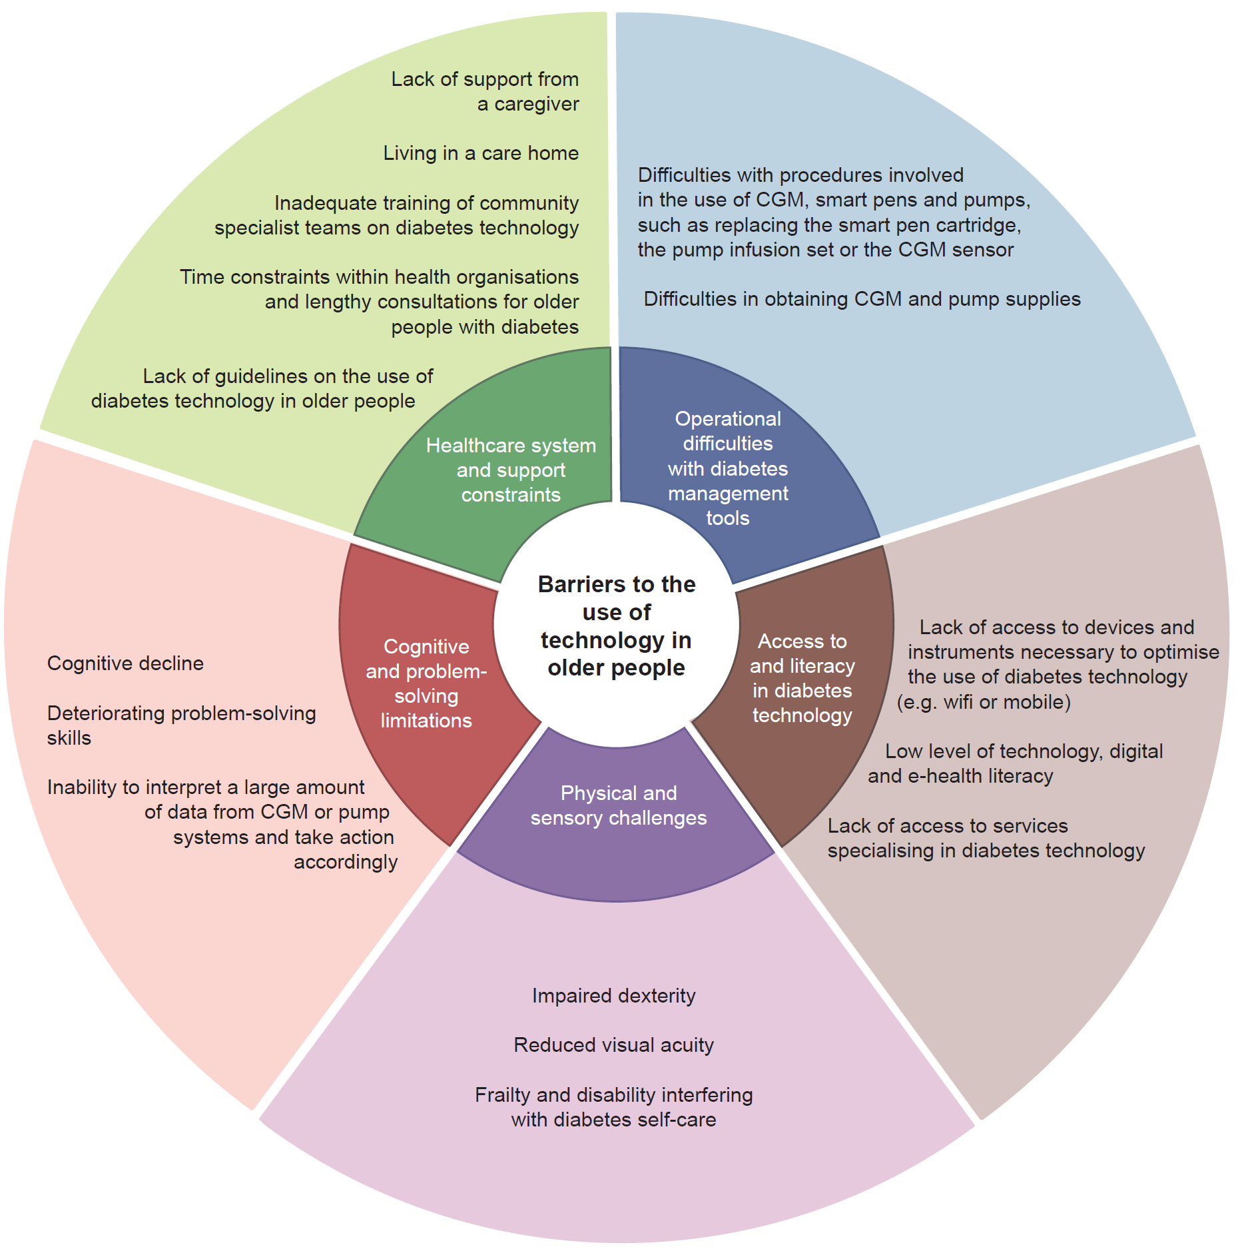
Key barriers to the use of technology in older people
Maltese et al (2024) Diabetologia DOI 10.1007/s00125-024-06240-2
©The Authors 2024. Distributed under the terms of the CC BY 4.0 Attribution License (http://creativecommons.org/licenses/by/4.0/)

Slide 3
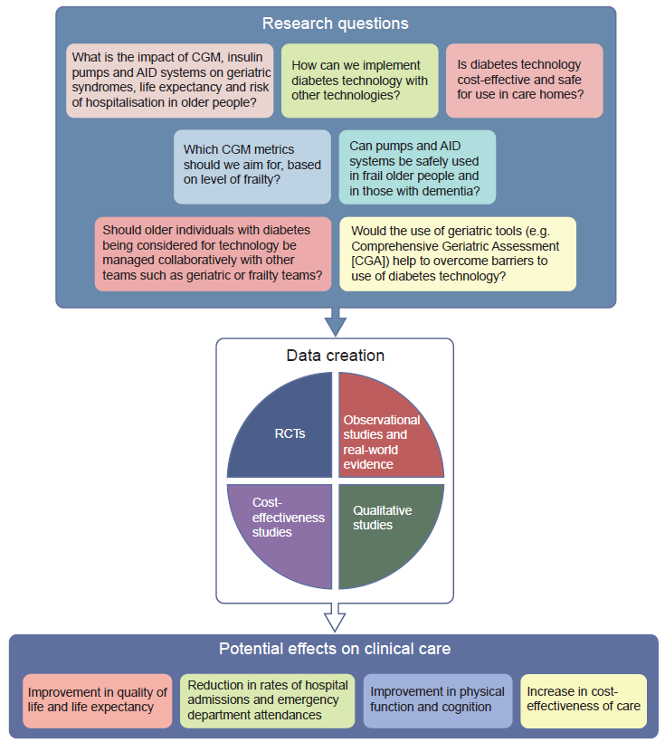
Research questions related to diabetes technology in older people
Maltese et al (2024) Diabetologia DOI 10.1007/s00125-024-06240-2
©The Authors 2024. Distributed under the terms of the CC BY 4.0 Attribution License (http://creativecommons.org/licenses/by/4.0/)

