Slide 1
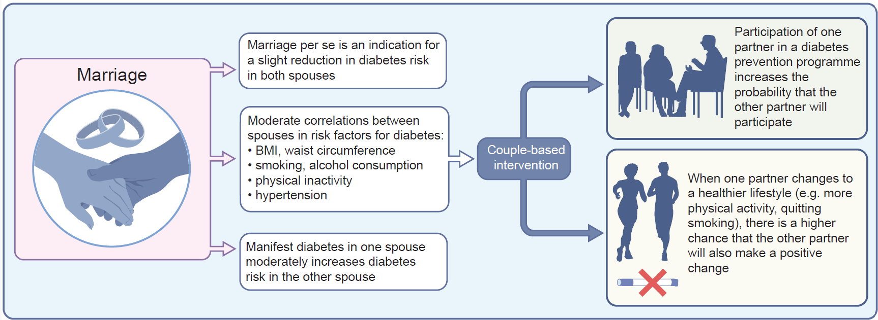
Marriage, risk of diabetes and benefits of couple-based intervention
Kowall and Rathmann (2025) Diabetologia DOI 10.1007/s00125-025-06360-3
©The Authors 2025. Distributed under the terms of the CC BY 4.0 Attribution License (http://creativecommons.org/licenses/by/4.0/)

