Slide 1
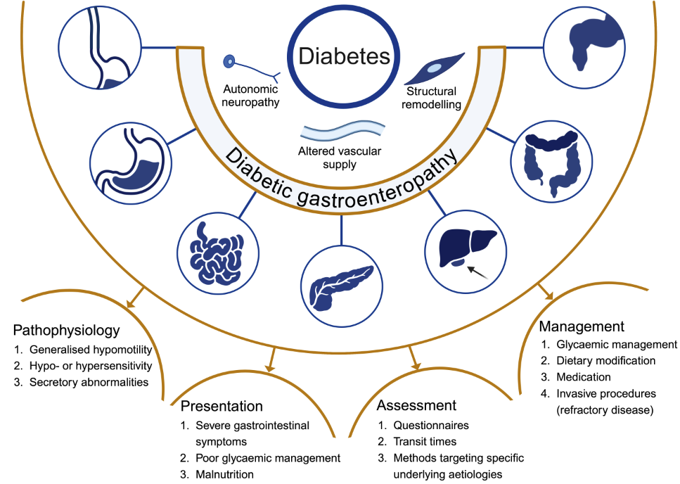
Overview of diabetic gastroenteropathy, highlighting its pan-alimentary nature and its pathophysiology, clinical presentation, assessment and management
Kornum et al (2025) Diabetologia DOI 10.1007/s00125-025-06365-y
© The Author(s), under exclusive licence to Springer-Verlag GmbH Germany, part of Springer Nature 2025

Slide 2
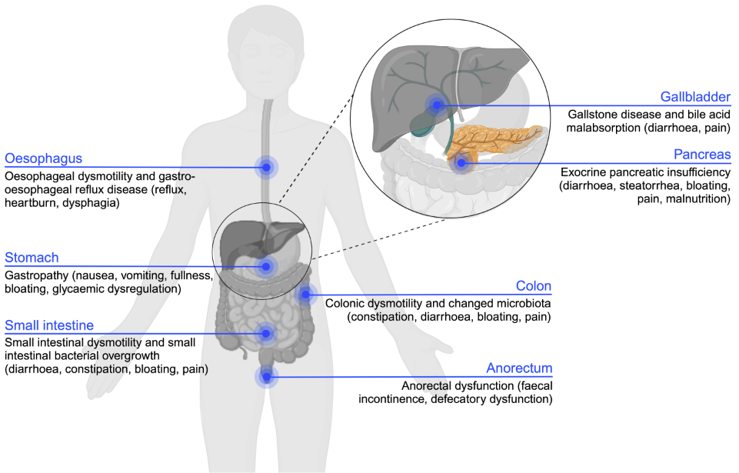
Simplified schematic overview of the pan-alimentary complications related to diabetic autonomic neuropathy
Kornum et al (2025) Diabetologia DOI 10.1007/s00125-025-06365-y
© The Author(s), under exclusive licence to Springer-Verlag GmbH Germany, part of Springer Nature 2025

Slide 3
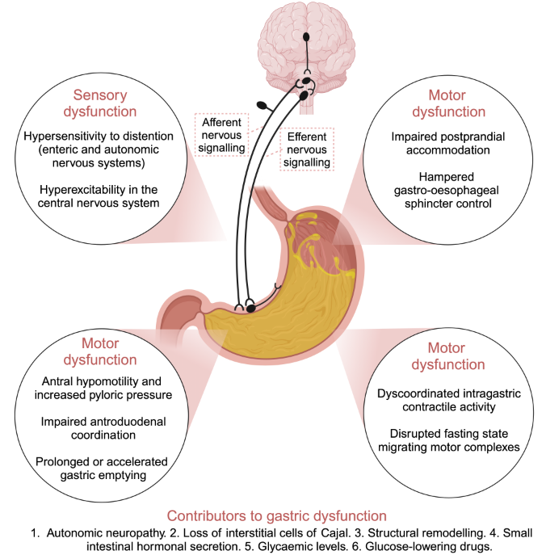
Pathophysiological disturbances in the stomach related to diabetic gastroenteropathy
Kornum et al (2025) Diabetologia DOI 10.1007/s00125-025-06365-y
© The Author(s), under exclusive licence to Springer-Verlag GmbH Germany, part of Springer Nature 2025

Slide 4
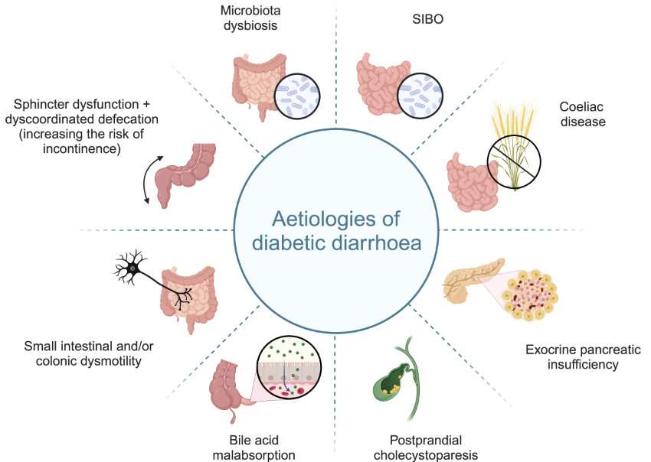
Diabetes-related pathophysiology potentially contributing to the development of diarrhoea
Kornum et al (2025) Diabetologia DOI 10.1007/s00125-025-06365-y
© The Author(s), under exclusive licence to Springer-Verlag GmbH Germany, part of Springer Nature 2025

