Slide 1
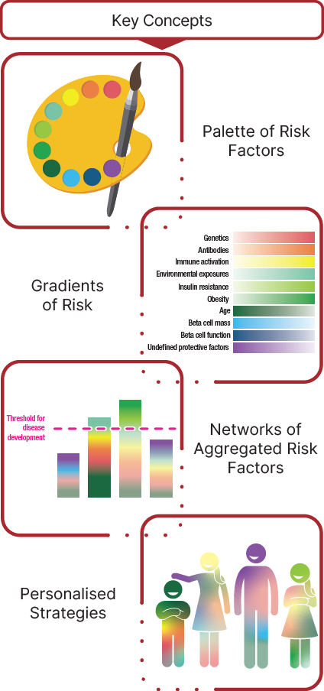
Type 1 diabetes development in at-risk individuals
Evans-Molina et al (2025) Diabetologia DOI 10.1007/s00125-025-06462-y
© American Diabetes Association and the European Association for the Study of Diabetes 2025
Distributed under the terms of the CC-BY-NC 4.0 Attribution Licence (http://creativecommons.org/licenses/by-nc/4.0/)

Slide 2
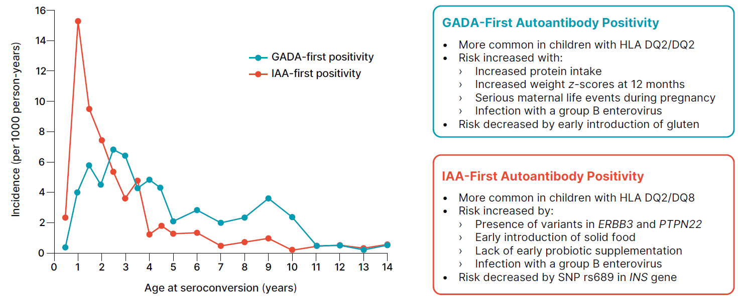
Incidence rates of IAA and GADA islet autoantibodies at seroconversion
Evans-Molina et al (2025) Diabetologia DOI 10.1007/s00125-025-06462-y
© Springer Nature Limited 2024. Adapted from Lernmark et al (2025) Nat Rev Endocrinol 21, 154–165
(https://doi.org/10.1038/s41574-024-01045-0) with permission from Springer Nature

Slide 3
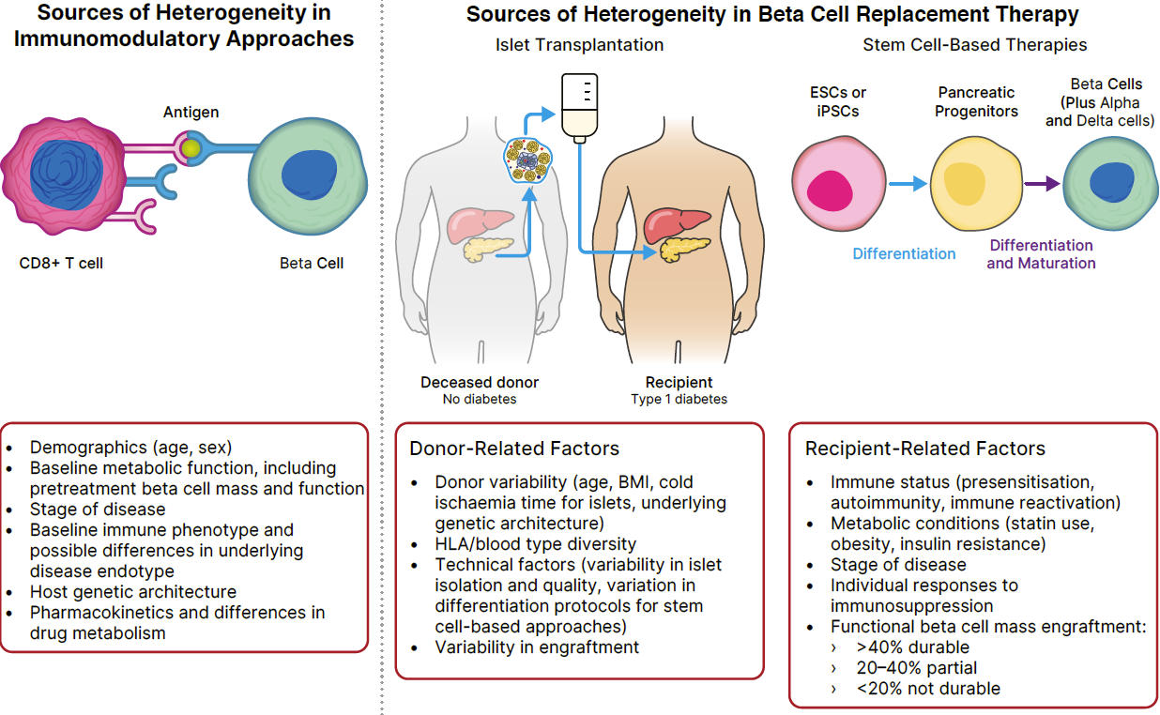
The impact of heterogeneity on type 1 diabetes therapies
Evans-Molina et al (2025) Diabetologia DOI 10.1007/s00125-025-06462-y
© 2019 Endocrine Society. Adapted in part from Rickels and Robertson (2019) Endocrine Reviews 40(2) 631–668 (https://doi.org/10.1210/er.2018-00154) with permission from Oxford University Press

