Slide 1
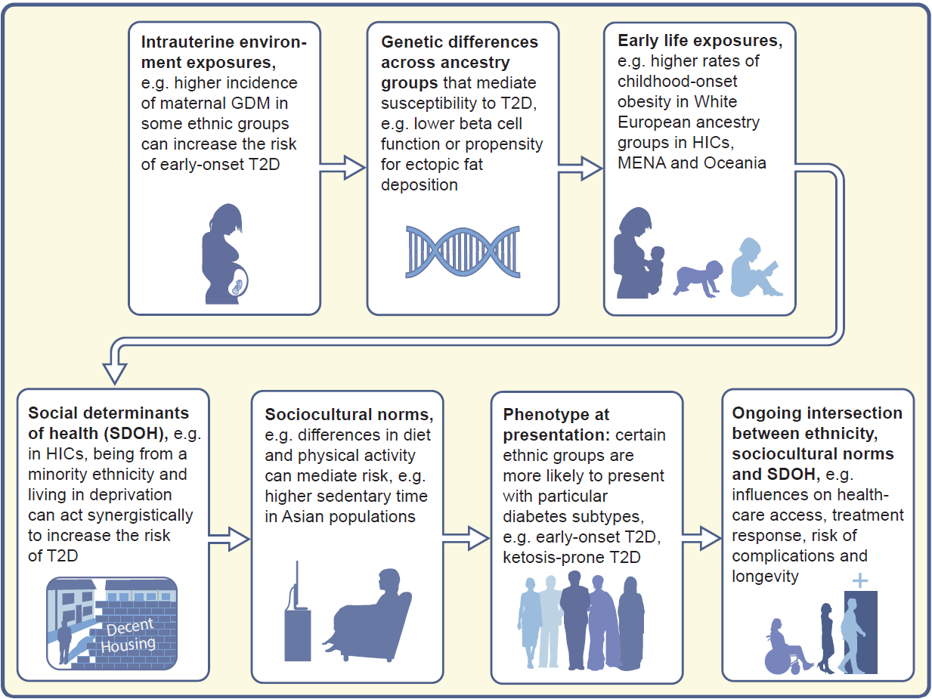
Schematic diagram illustrating how ethnicity can impact type 2 diabetes risk and outcomes across the life course
Misra (2025) Diabetologia DOI 10.1007/s00125-025-06513-4
©The Authors 2025. Distributed under the terms of the CC BY 4.0 Attribution License (http://creativecommons.org/licenses/by/4.0/)

Slide 2
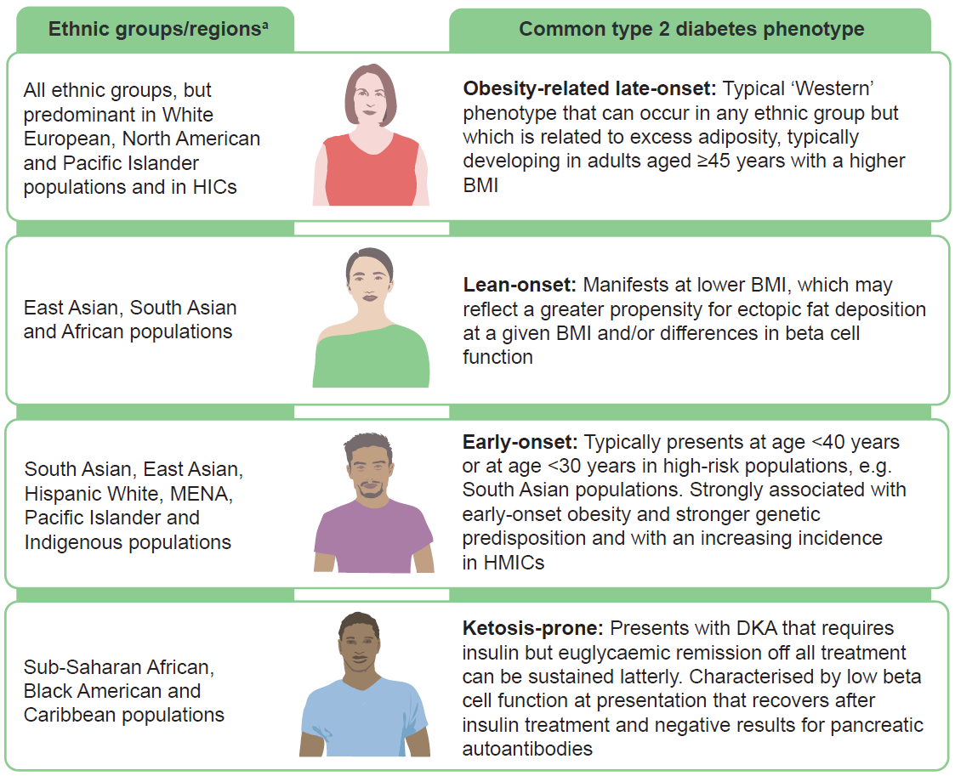
Schematic diagram illustrating common sub-phenotypes of type 2 diabetes and which ethnic groups they predominate in
Misra (2025) Diabetologia DOI 10.1007/s00125-025-06513-4
©The Authors 2025. Distributed under the terms of the CC BY 4.0 Attribution License (http://creativecommons.org/licenses/by/4.0/)

Slide 3
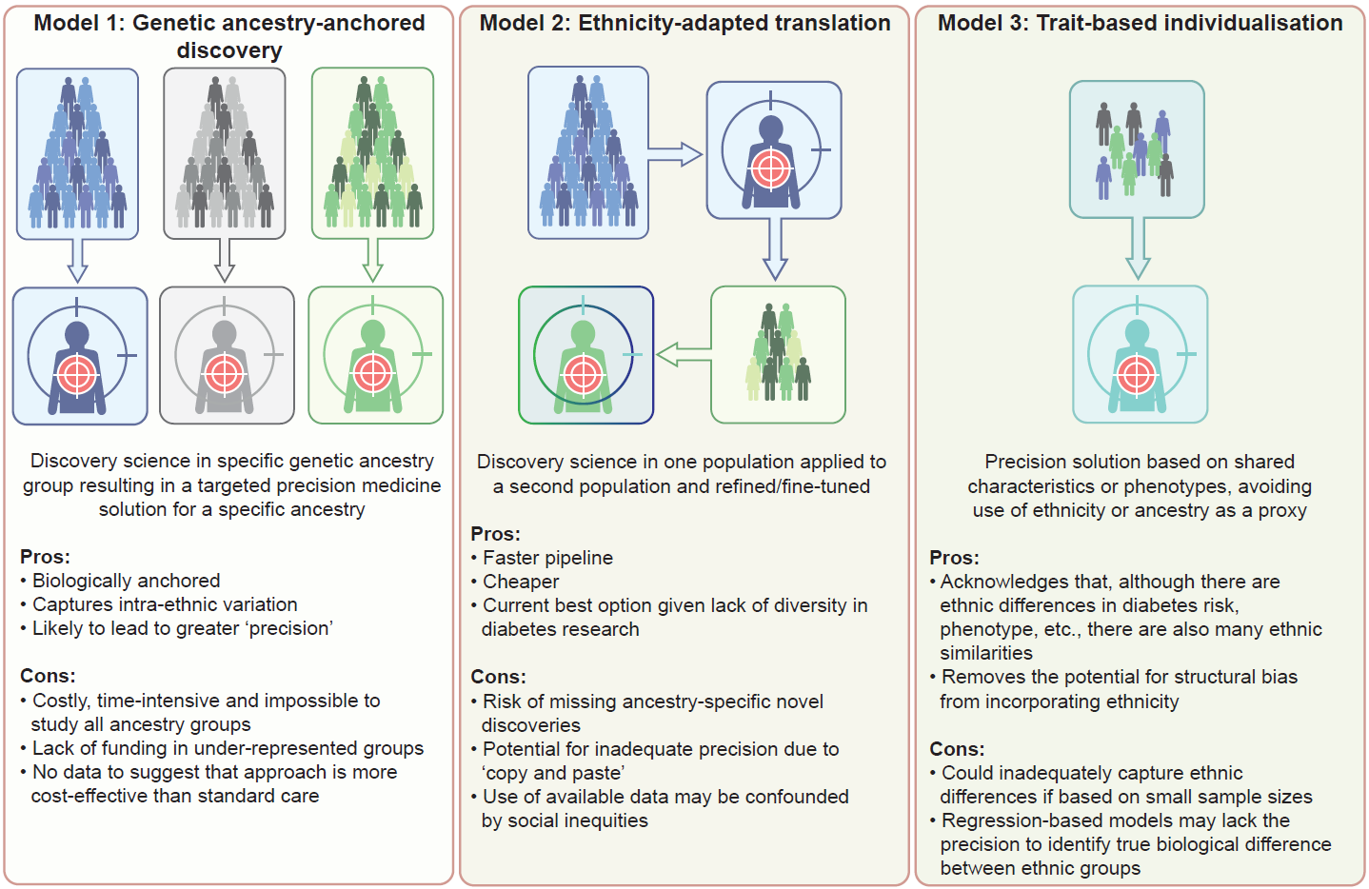
Conceptual models for how ethnicity could be incorporated into precision medicine tools
Misra (2025) Diabetologia DOI 10.1007/s00125-025-06513-4
©The Authors 2025. Distributed under the terms of the CC BY 4.0 Attribution License (http://creativecommons.org/licenses/by/4.0/)

