Slide 1
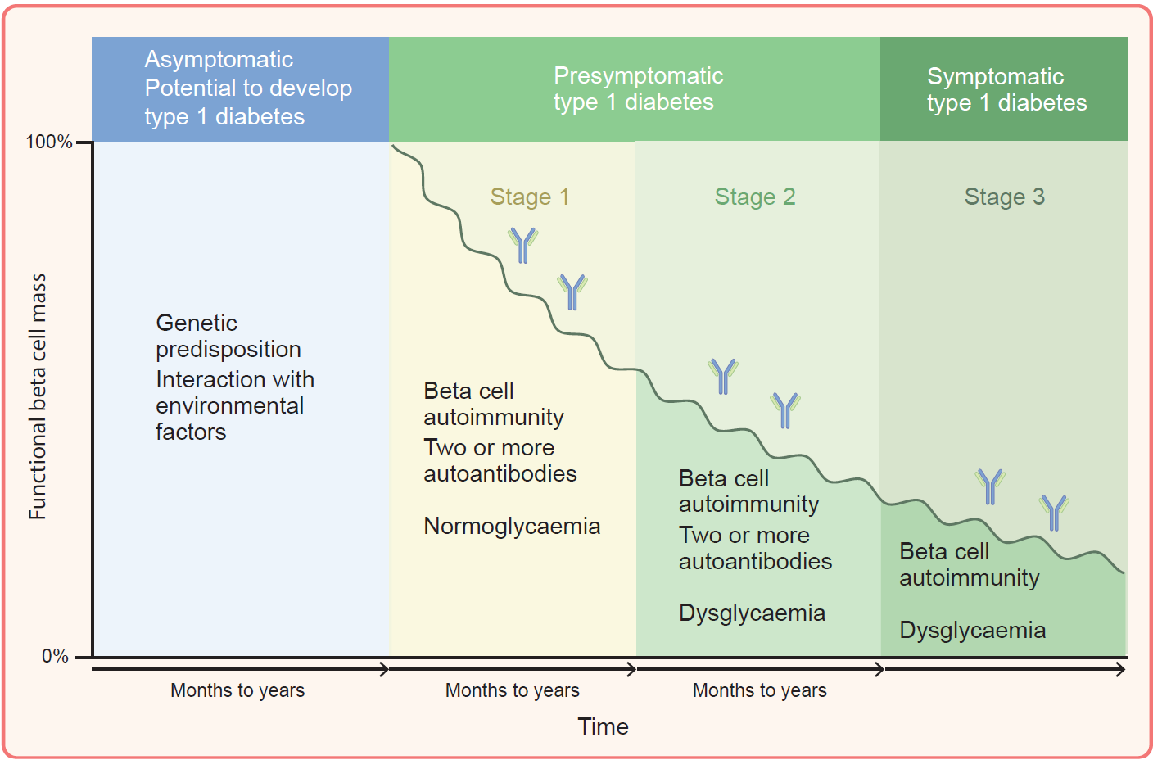
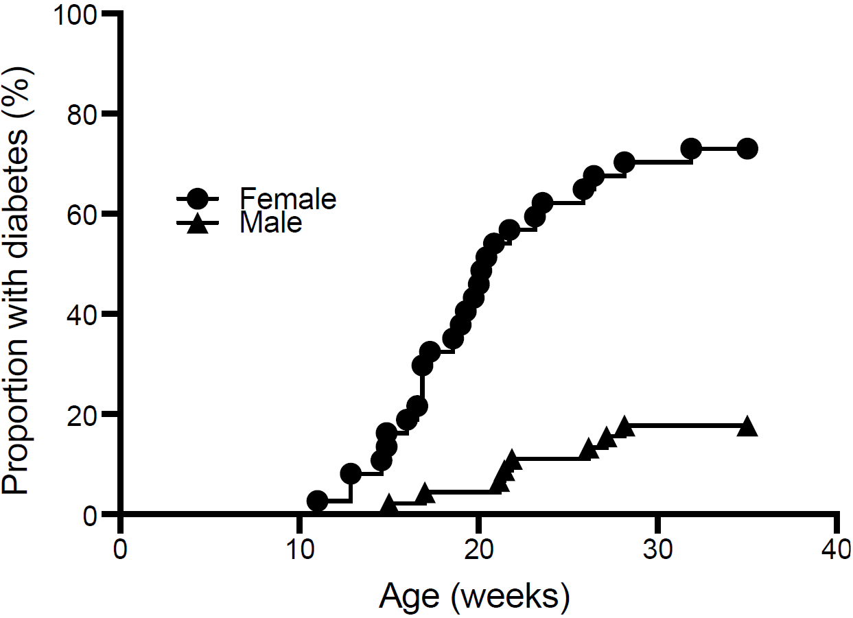
(a) Incidence of autoimmune diabetes in NOD mice and (b) current staging of type 1 diabetes in humans based on autoantibodies and glucose abnormalities
b
a
Wong et al (2025) Diabetologia DOI 10.1007/s00125-025-06579-0
(a) Adapted from Insel et al (https:doi/org/10.2337/dc15-1419) under the terms of the Creative Commons CC BY License. (b) ©The Authors 2025. Distributed under the terms of the CC BY 4.0 Attribution License (http://creativecommons.org/licenses/by/4.0/)

Slide 2
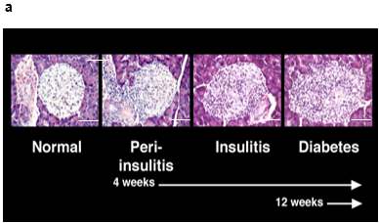
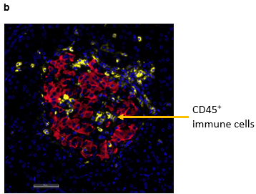
(a) Development of insulitis in NOD mice and (b) insulitis in human type 1 diabetes demonstrated by immunofluorescence staining of an islet (red, insulin; yellow CD45) from an adult donor recently diagnosed with type 1 diabetes
Wong et al (2025) Diabetologia DOI 10.1007/s00125-025-06579-0
©The Authors 2025. Distributed under the terms of the CC BY 4.0 Attribution License (http://creativecommons.org/licenses/by/4.0/) (a) Image courtesy of Irene Visintin, Yale University;
(b) image courtesy of Pia Leete, Exeter University

