Slide 1
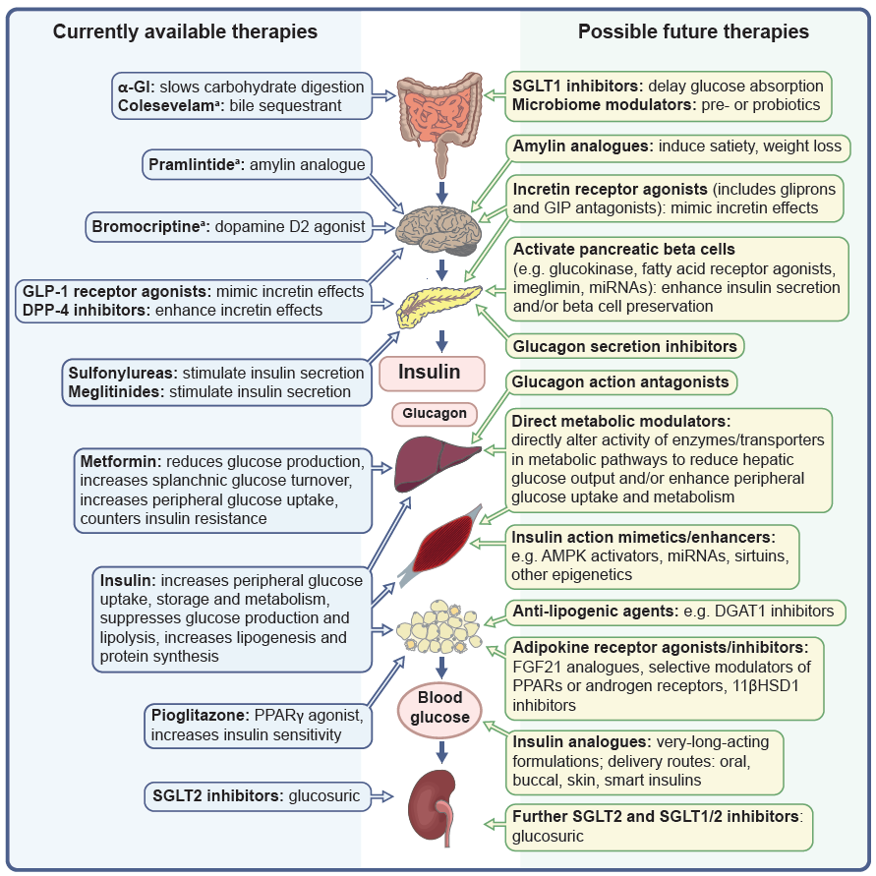
Sites of action of currently available and potential future glucose-lowering agents for use in the management of type 2 diabetes
Bailey (2025) Diabetologia DOI 10.1007/s00125-025-06581-6
Adapted from Bailey et al (2016) with permission (http://dx.doi.org/10.1016/S2213-8587(15)00462-3)

