Slide 1
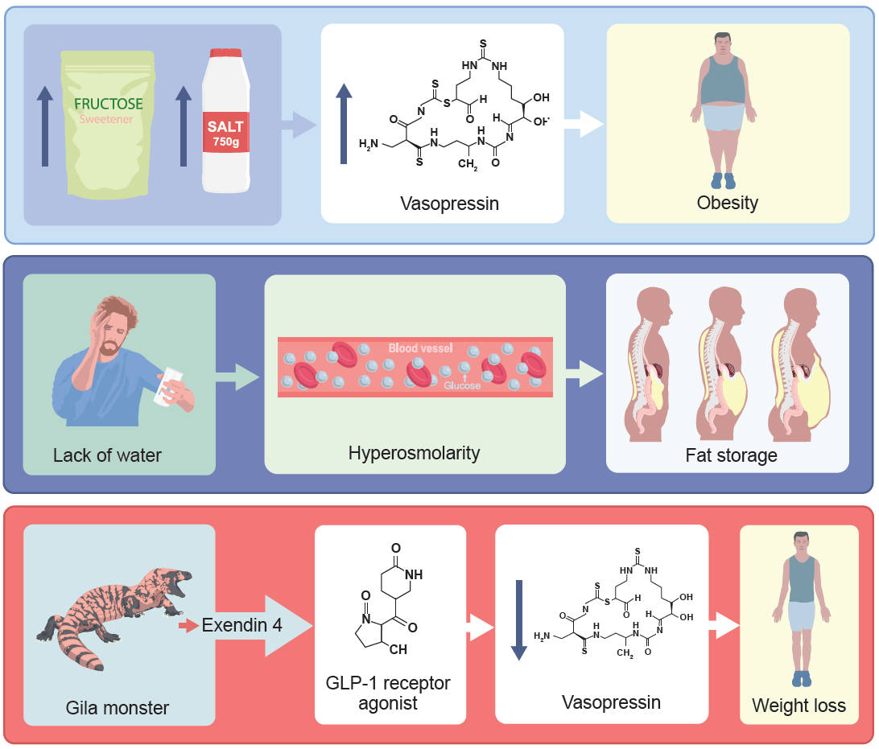
Insights from nature elucidate the interplay between water metabolism, vasopressin and obesity
Stenvinkel et al (2025) Diabetologia DOI 10.1007/s00125-025-06611-3
©The Authors 2025. Distributed under the terms of the CC BY 4.0 Attribution License (http://creativecommons.org/licenses/by/4.0/)

Slide 2
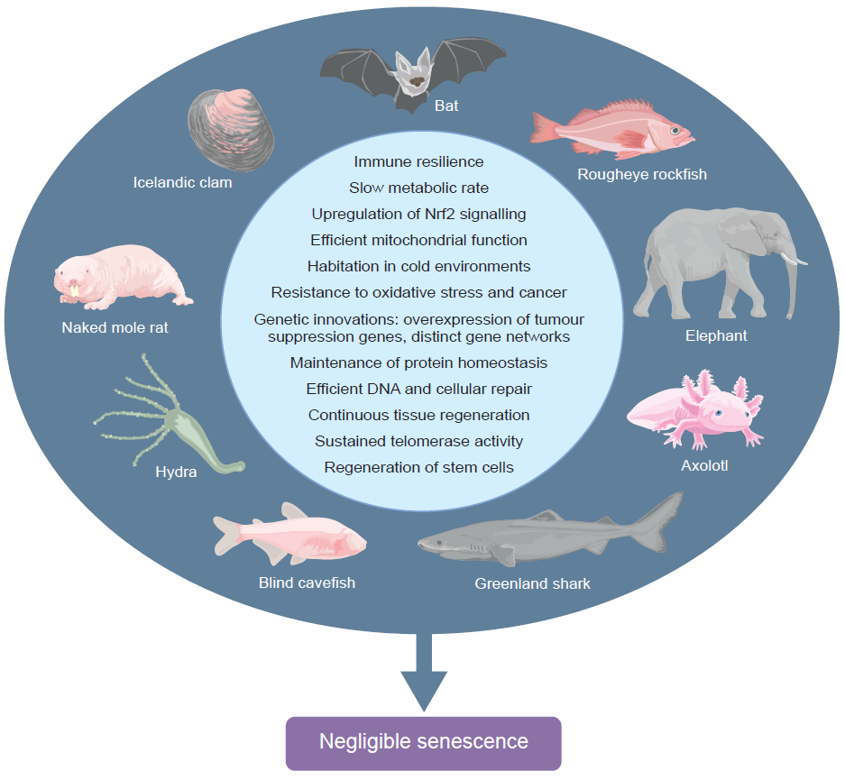
Long-lived organisms with negligible senescence provide valuable insights for geroscience
Stenvinkel et al (2025) Diabetologia DOI 10.1007/s00125-025-06611-3
©The Authors 2025. Distributed under the terms of the CC BY 4.0 Attribution License (http://creativecommons.org/licenses/by/4.0/)

Slide 3
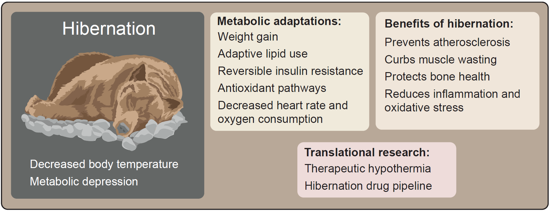
Hibernation provides a unique physiological model for developing therapeutic strategies against metabolic and degenerative diseases
Stenvinkel et al (2025) Diabetologia DOI 10.1007/s00125-025-06611-3
©The Authors 2025. Distributed under the terms of the CC BY 4.0 Attribution License (http://creativecommons.org/licenses/by/4.0/)

Slide 4
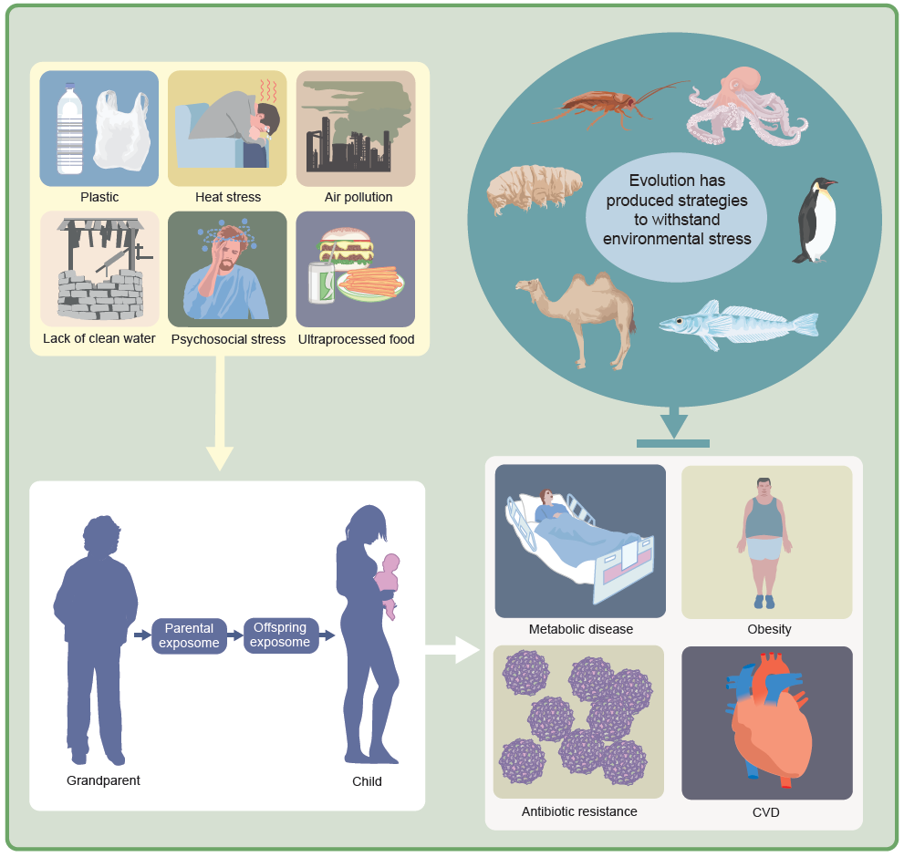
Natural models of resilience: lessons from evolution for environmental health and longevity
Stenvinkel et al (2025) Diabetologia DOI 10.1007/s00125-025-06611-3
©The Authors 2025. Distributed under the terms of the CC BY 4.0 Attribution License (http://creativecommons.org/licenses/by/4.0/)

