Slide 1
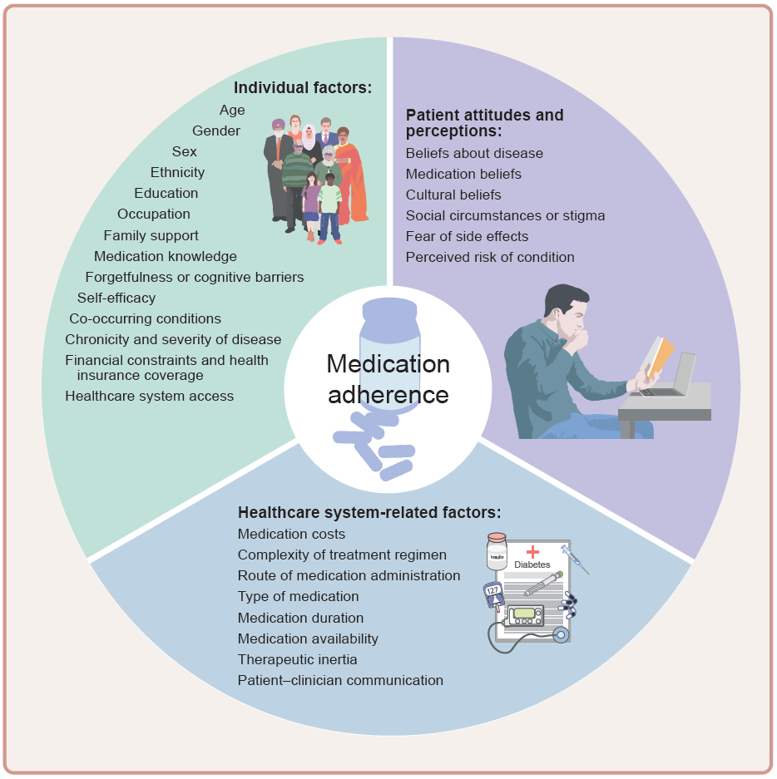
Factors influencing medication adherence in type 2 diabetes
Highton et al (2025) Diabetologia DOI 10.1007/s00125-025-06617-x
©The Authors 2025. Distributed under the terms of the CC BY 4.0 Attribution License (http://creativecommons.org/licenses/by/4.0/)

Slide 2
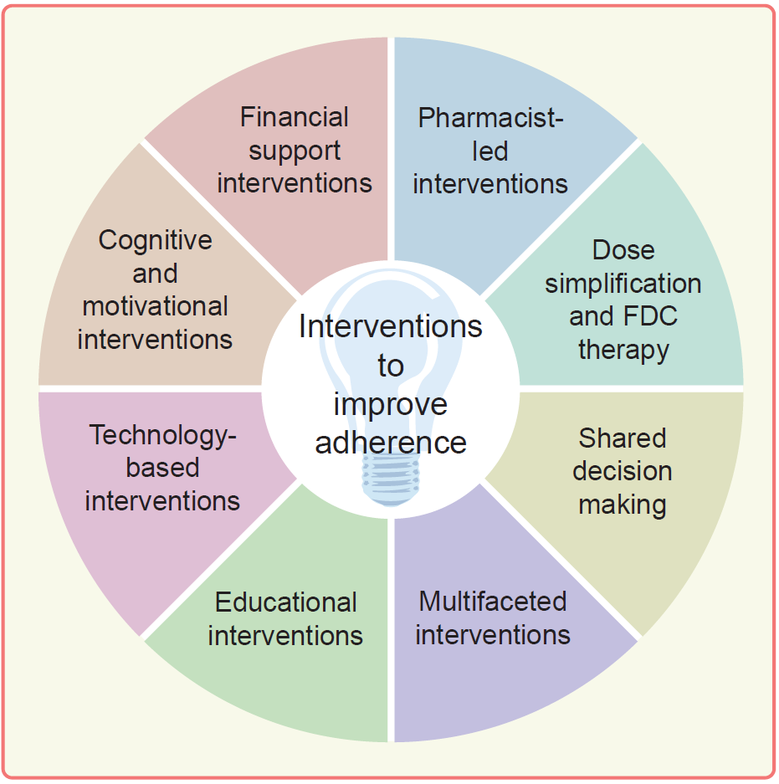
Intervention strategies to improve medication adherence in type 2 diabetes
Highton et al (2025) Diabetologia DOI 10.1007/s00125-025-06617-x
©The Authors 2025. Distributed under the terms of the CC BY 4.0 Attribution License (http://creativecommons.org/licenses/by/4.0/)

