Slide 1
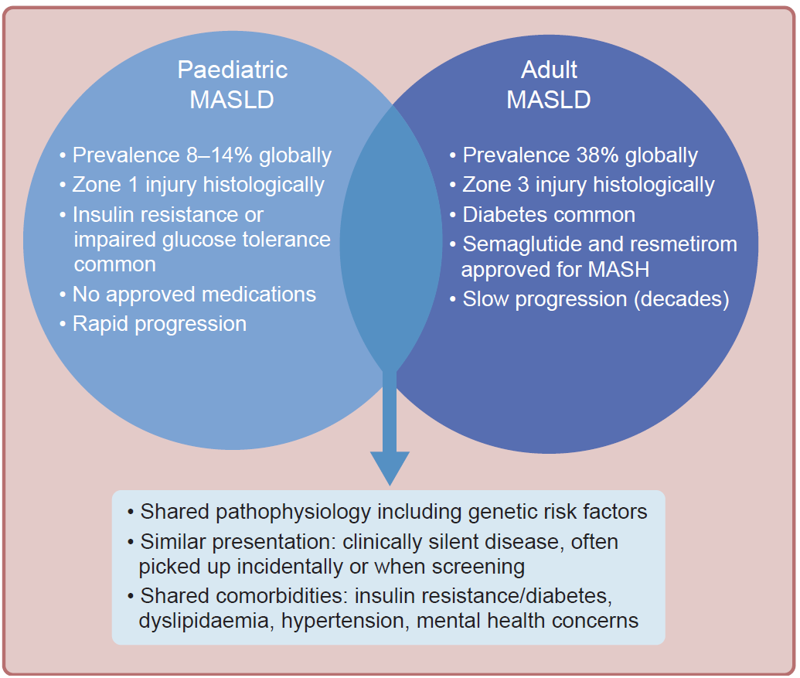
Similarities and differences between paediatric and adult MASLD
Segev and Mouzaki (2026) Diabetologia DOI 10.1007/s00125-026-06724-3
© The Author(s), under exclusive licence to Springer-Verlag GmbH Germany, part of Springer Nature 2026

Slide 2
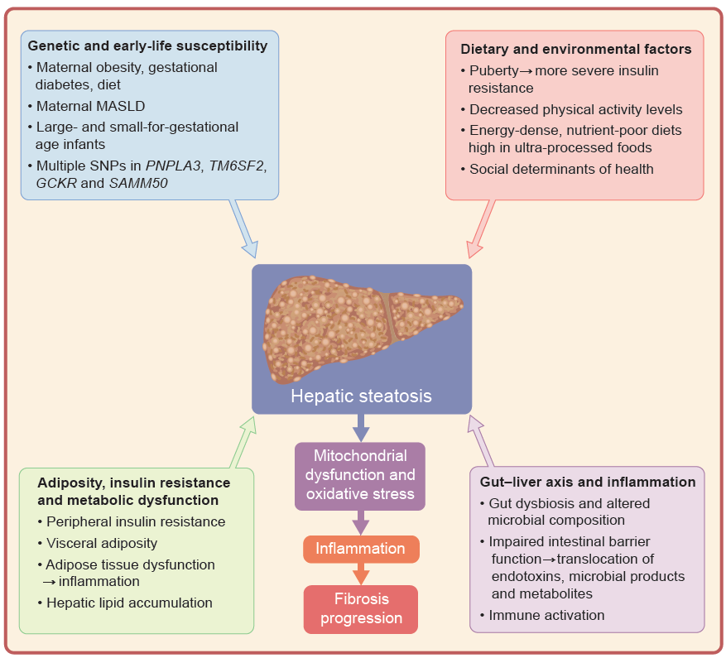
Summary of the variable influences that lead to the development and progression of paediatric MASLD
Segev and Mouzaki (2026) Diabetologia DOI 10.1007/s00125-026-06724-3
© The Author(s), under exclusive licence to Springer-Verlag GmbH Germany, part of Springer Nature 2026

